Slide 1

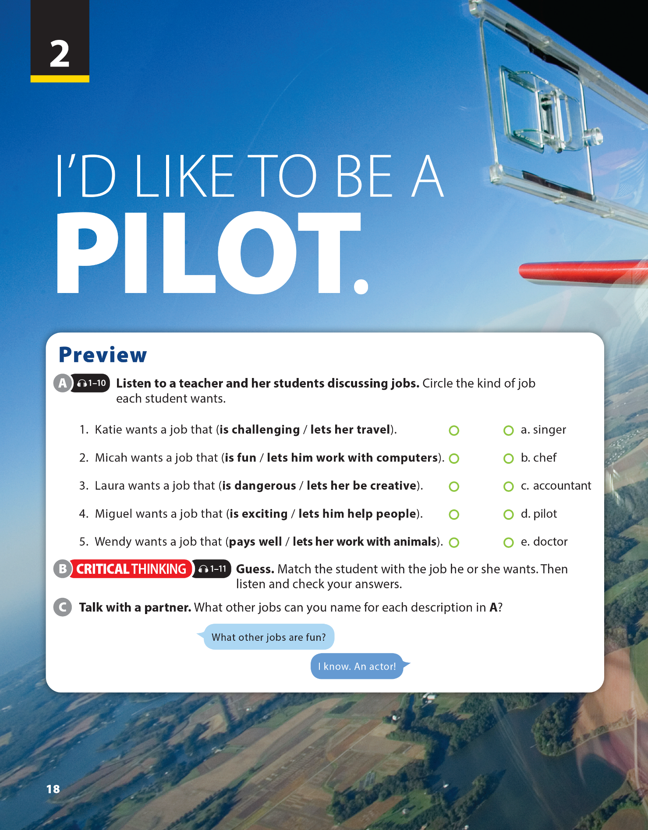
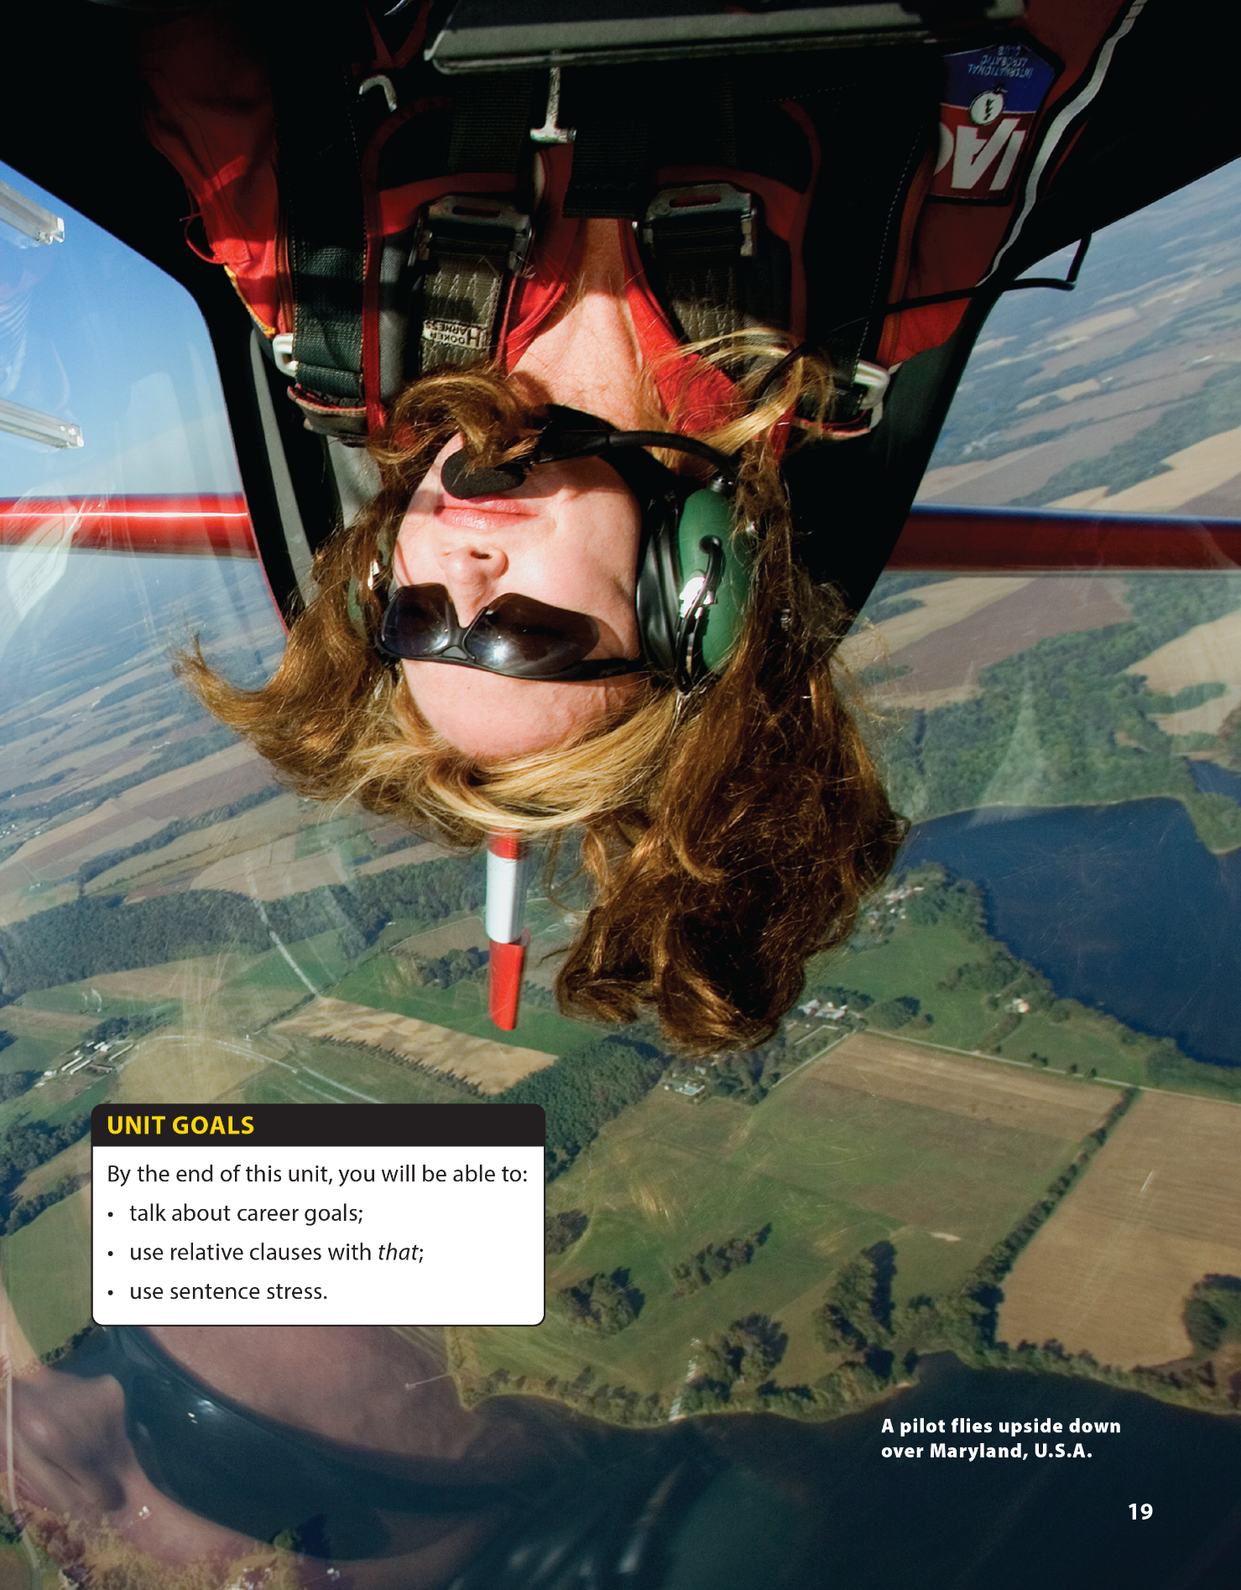

Reading and
Communication
National Geographic Learning, a Cengage Company © 2022 Cengage Learning, Inc. ALL RIGHTS RESERVED. This presentation tool is intended for teaching purposes only and may not be scanned, copied, duplicated, or posted to a publicly accessible platform in whole or in part.

Slide 2
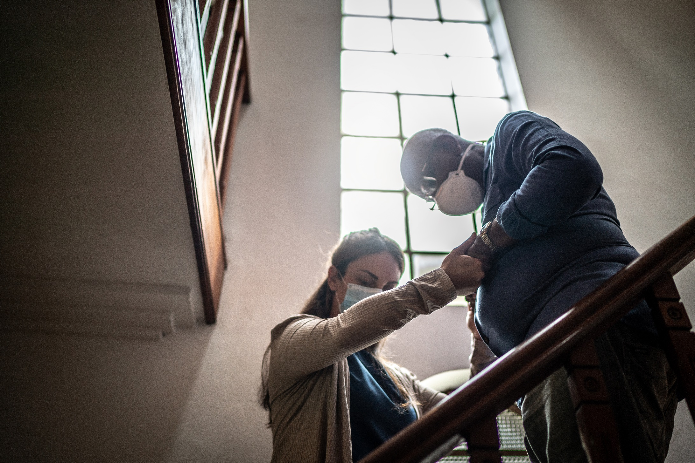
UNIT 2
I'D LIKE TO BE A PILOT.
READING
Notes:
Tell students to describe specifically the big picture in the textbook.
Eg: There are two people.
The woman is helping a man move
downstairs., etc.
Ask students some questions:
Have you ever thought that you will work in that environment?
Think you the difficulties people may get

Slide 3

UNIT 2
I'D LIKE TO BE A PILOT.
READING

Slide 4

UNIT 2
I'D LIKE TO BE A PILOT.
READING

Slide 5



UNIT 2
I'D LIKE TO BE A PILOT.
READING
SCANNING SKILL
Definition
Hints for scanning
Look for specific information.
Find information in a list (for example: a phone number, the time a TV show starts, the page of an item in a catalog).
Don’t read every word.
Think about the order of the information
When possible, use titles and headings to help you find the information quickly. With longer texts, also use header words at the top of pages and columns.
When searching for names or places, scan for capital letters.
When searching for a statistic or other numerical value, look for numbers in the text.

Slide 6
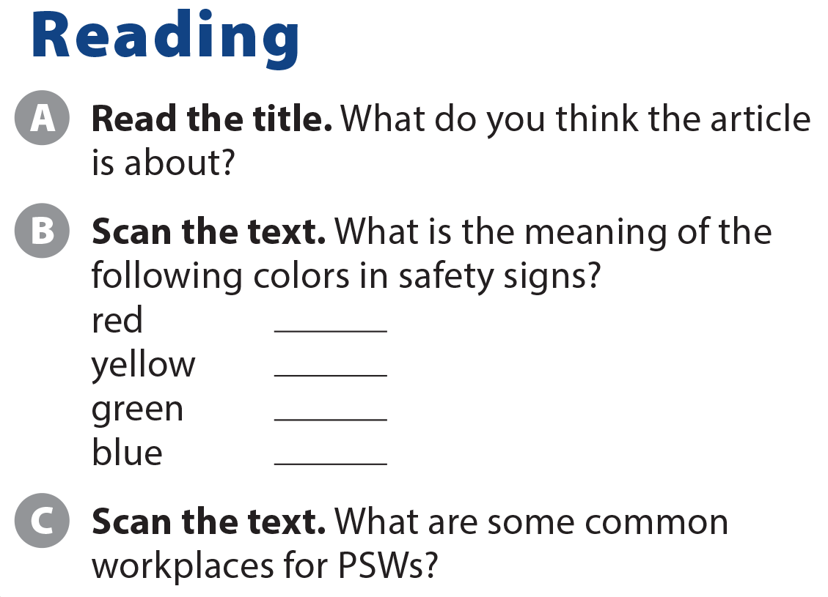
UNIT 2
I'D LIKE TO BE A PILOT.
COMMUNICATION
stop/ do not
danger
safe
you must do

Slide 7
UNIT 2
I'D LIKE TO BE A PILOT.
READING
Private homes
Hospitals
Care organizations
Community support centers

Slide 8
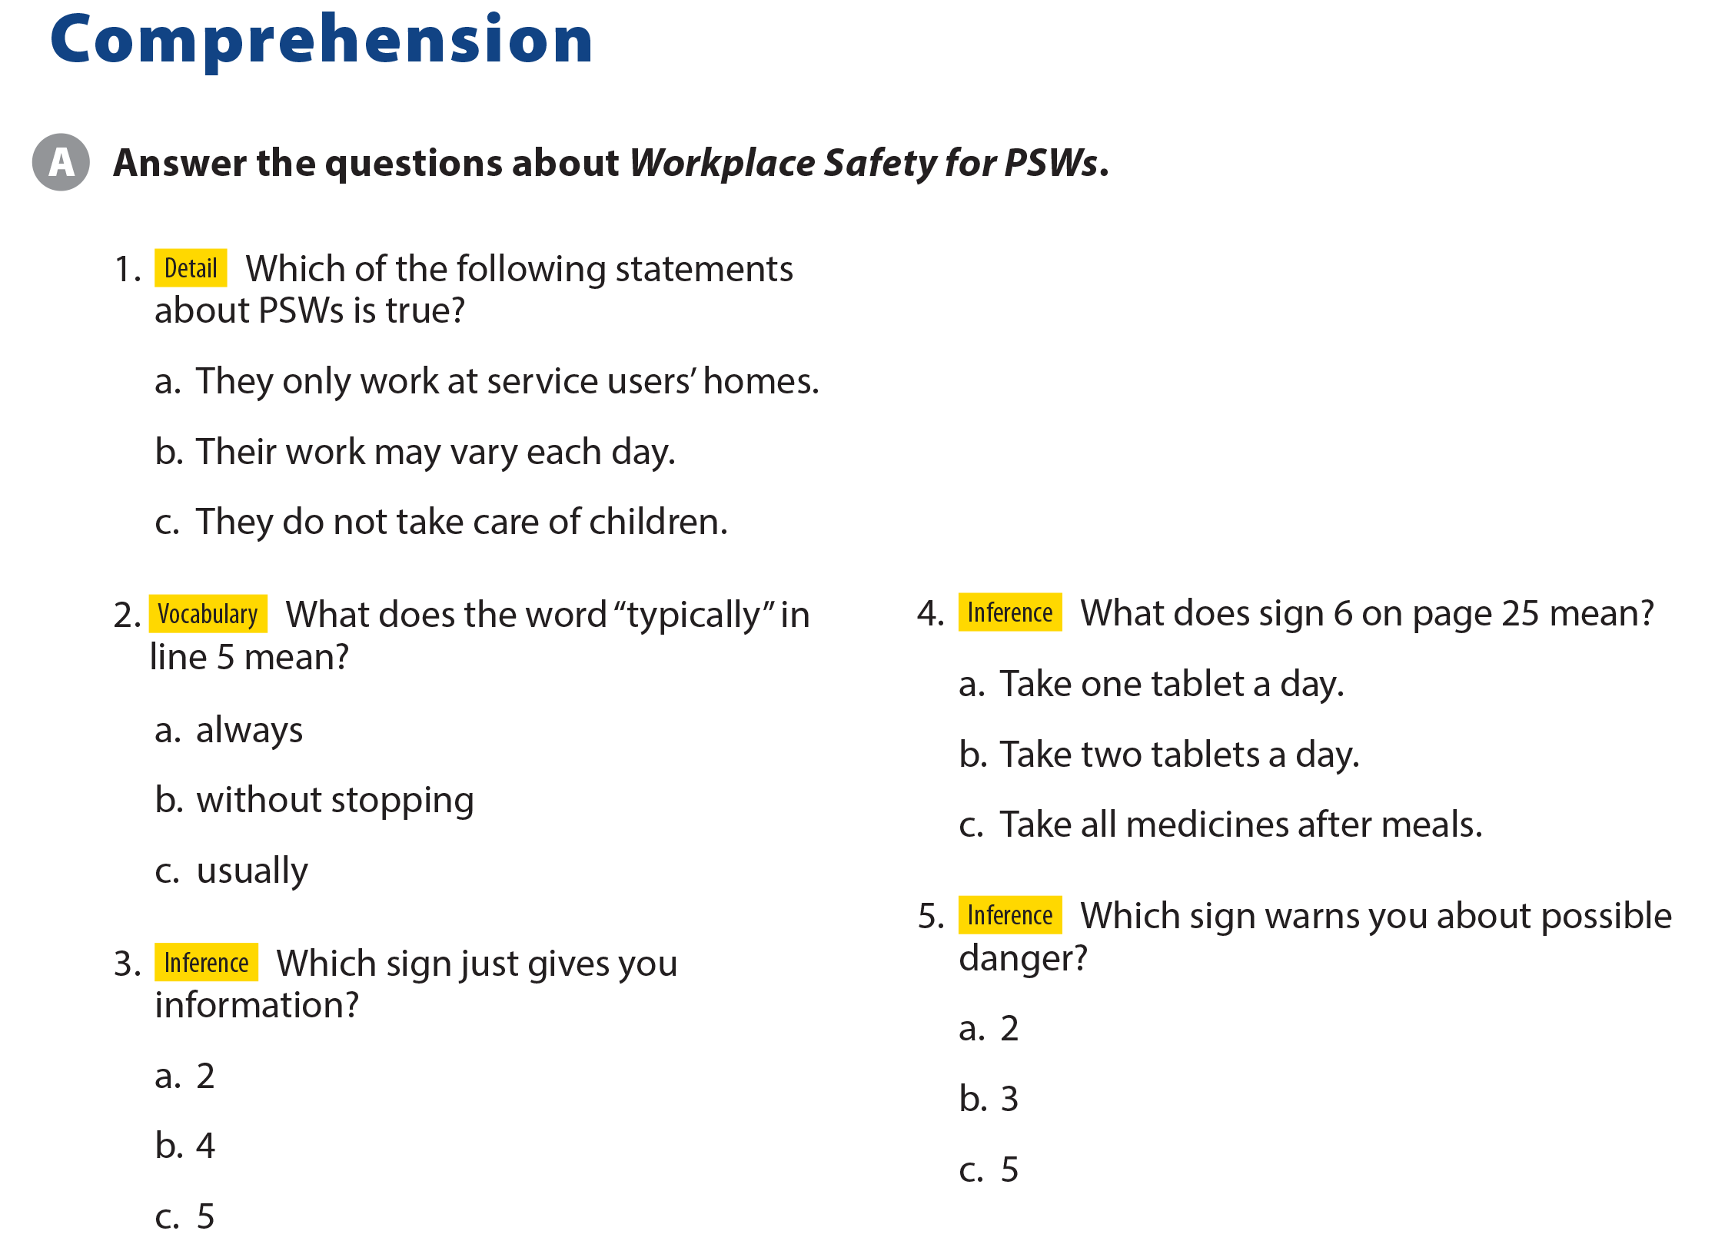
UNIT 2
I'D LIKE TO BE A PILOT.
COMPREHENSION

Slide 9
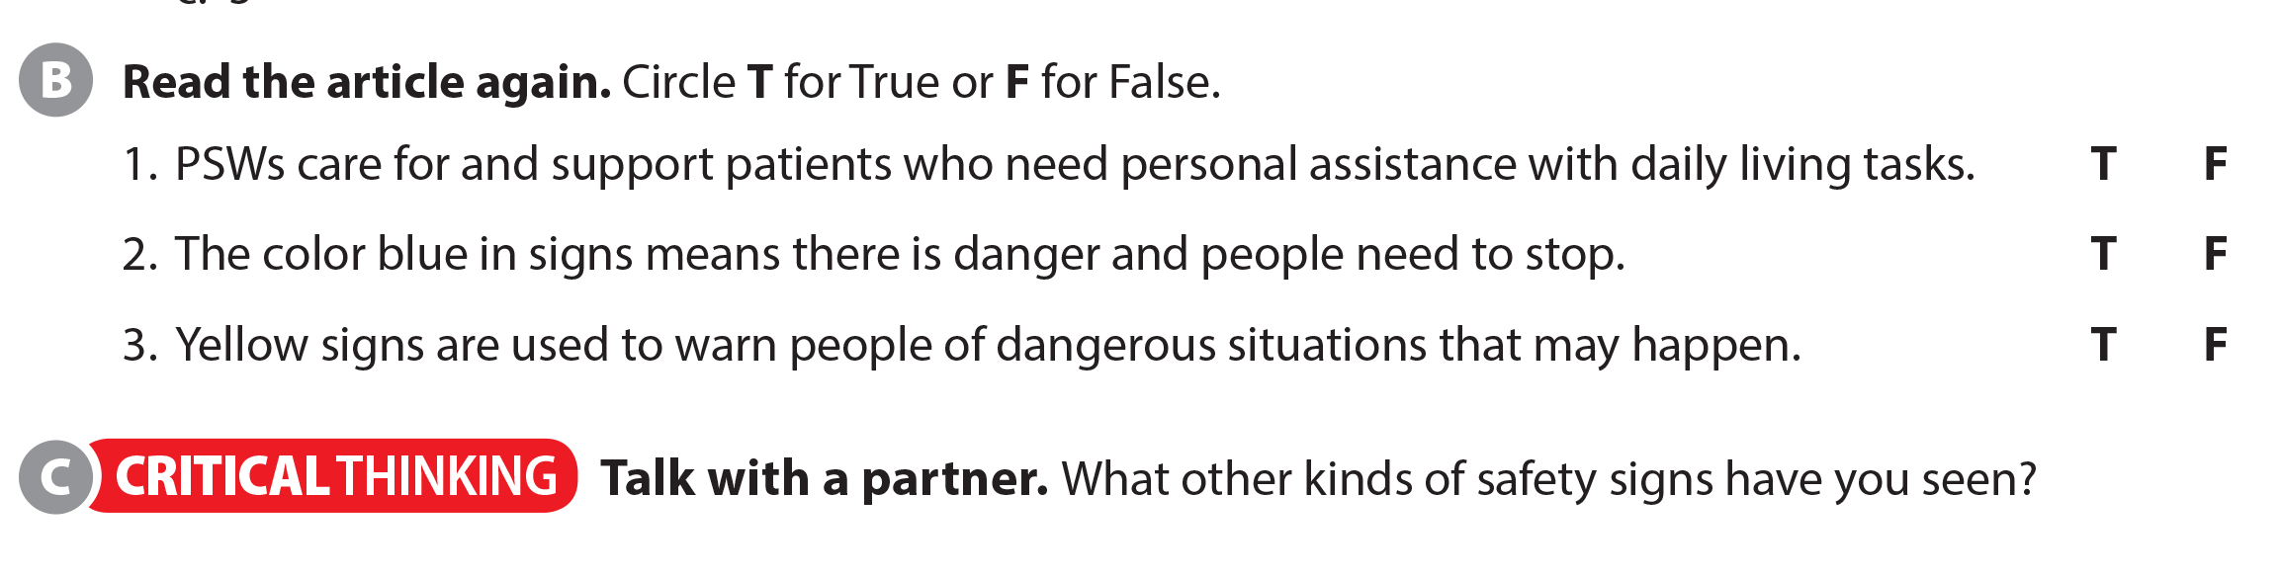
UNIT 2
I'D LIKE TO BE A PILOT.
COMPREHENSION

Slide 10
UNIT 2
I'D LIKE TO BE A PILOT.
READING
Vocabulary | Structures
Safety (n): sự an toàn | Provide st for sb: cung cấp cái gì cho ai
Physical disabilities (n): khuyết tật về thể chất | Depend on: phụ thuộc vào
Learning disabilities (n): khuyết tật trong học tập | Be responsible for: chịu trách nhiệm
Mental health issue (np): vấn đề sức khoẻ tinh thần
Fulfilling (adj): đầy đủ
Community support center (n): Trung tâm hỗ trợ cộng đồng

Slide 11
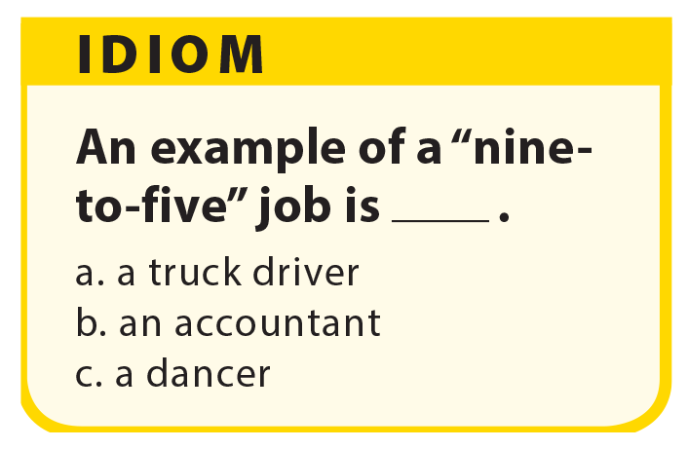
UNIT 2
I'D LIKE TO BE A PILOT.
COMPREHENSION
Notes:
As students follow along, read the
questions aloud.
Have students get into pairs and discuss the questions.

Slide 12


THANK YOU!

