Slide 1
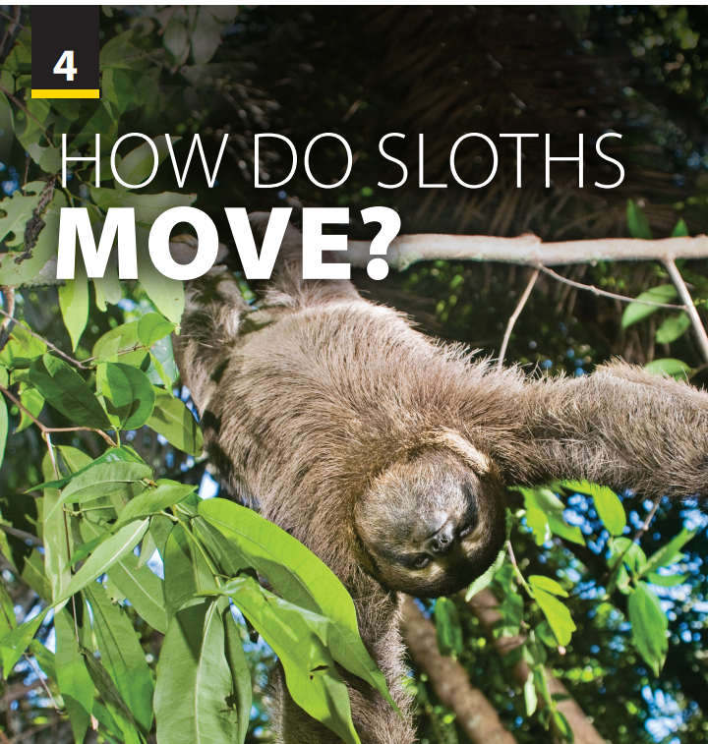
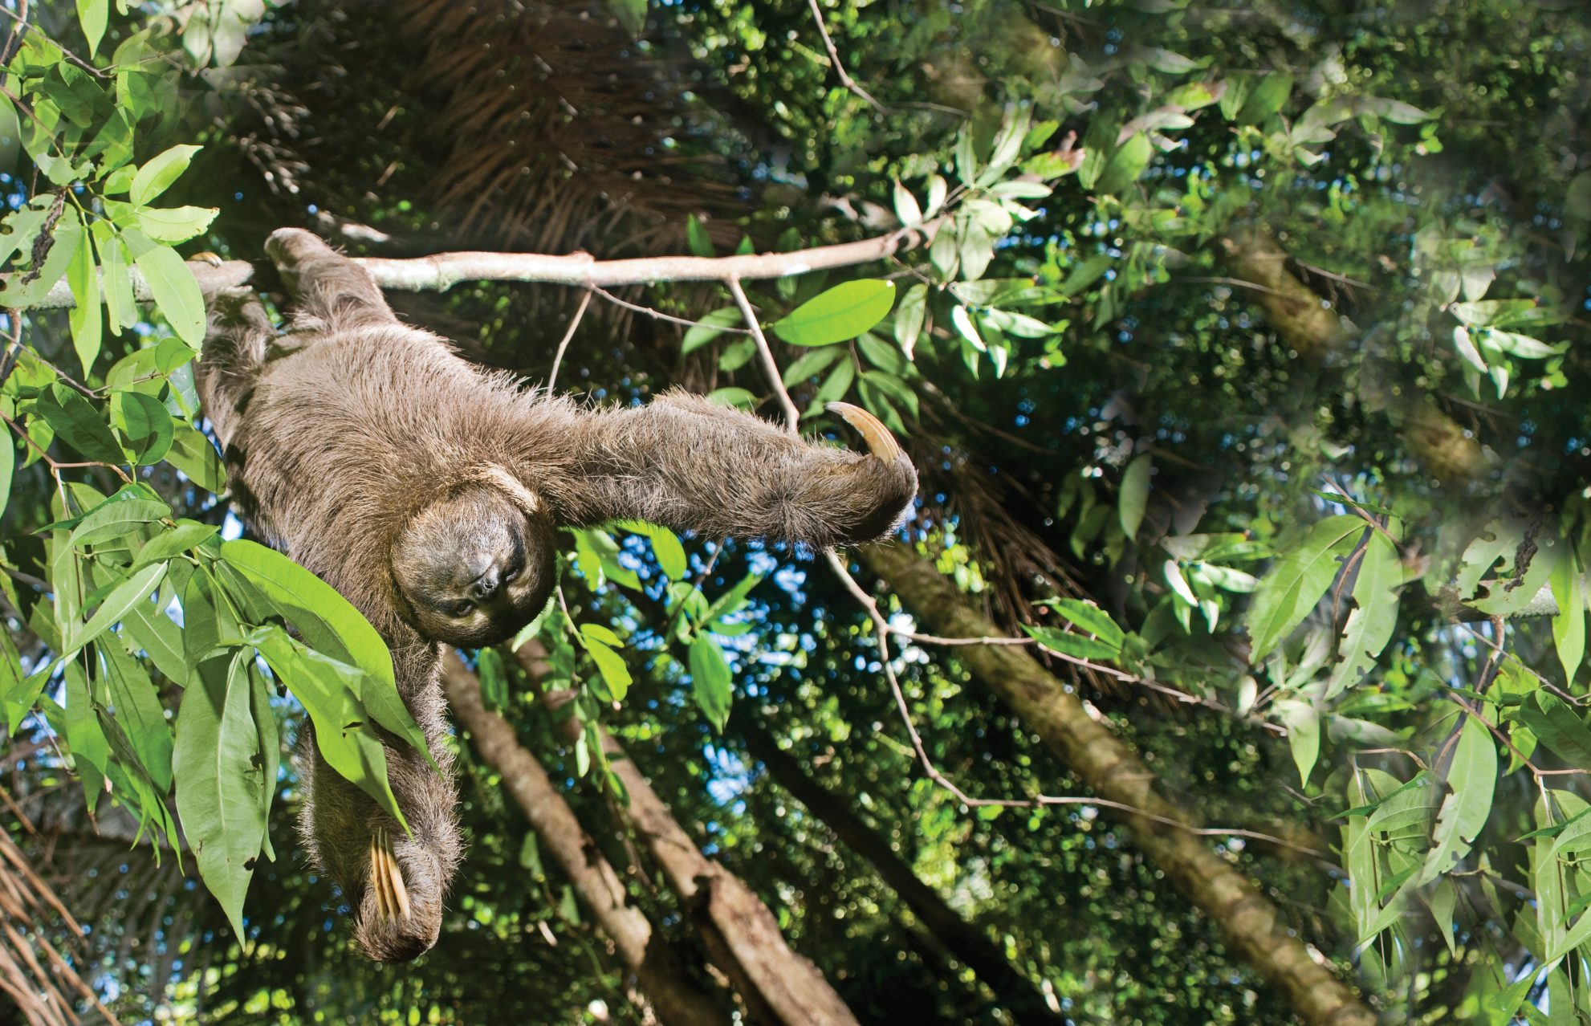
Video and
Video Worksheet

Slide 2

UNIT 4
HOW DO SLOTHS MOVE?
VIDEO

Slide 3
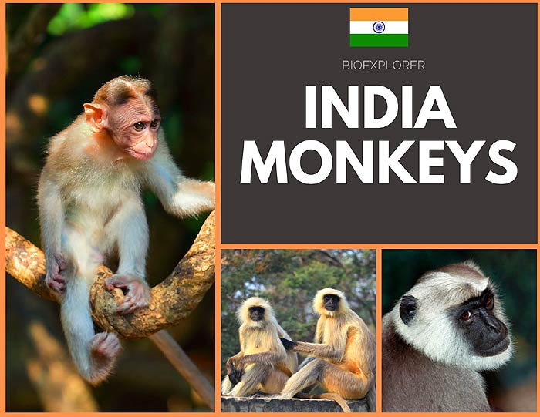
UNIT 4
HOW DO SLOTHS MOVE?
VIDEO
Notes:
Have students look at the poster and check their understanding about this kind of money
Where do they mainly live? (In India)
Give some of their feathers (their arms are as long as their legs, they are smart/ intelligent, naughty…)
T can make Yes/No questions if students’ knowledge is not good enough.

Slide 4
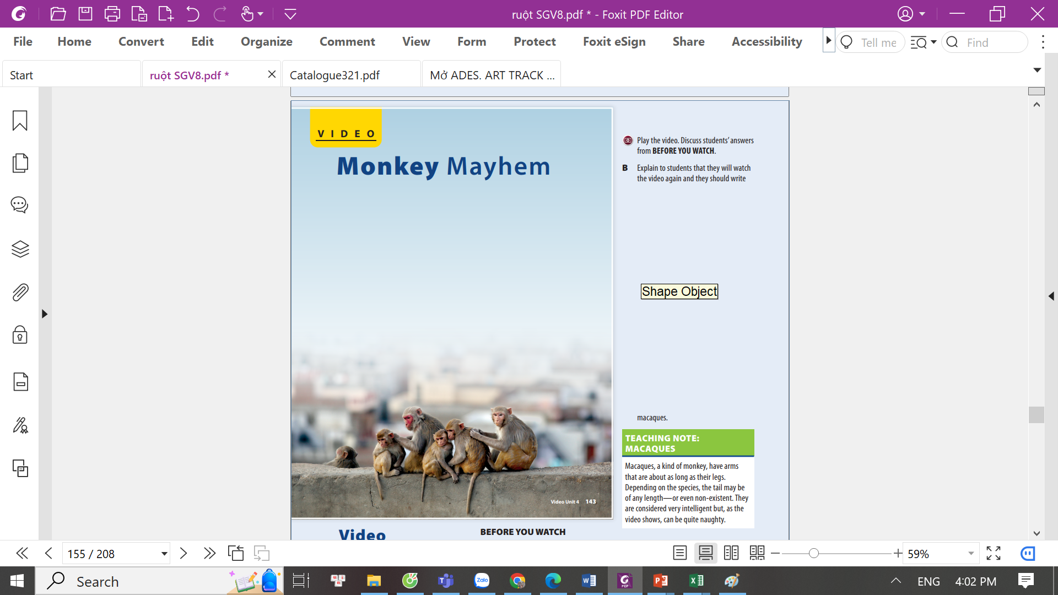
UNIT 4
HOW DO SLOTHS MOVE?
VIDEO
India is home to 19 species of Old World monkeys; 6 of them are endemic to the nation. Macaques, a kind of monkey, have arms that are about as long as their legs. Depending on the species, the tail may be of any length—or even non-existent. They are considered very intelligent but, as the video shows, can be quite naughty

Slide 5
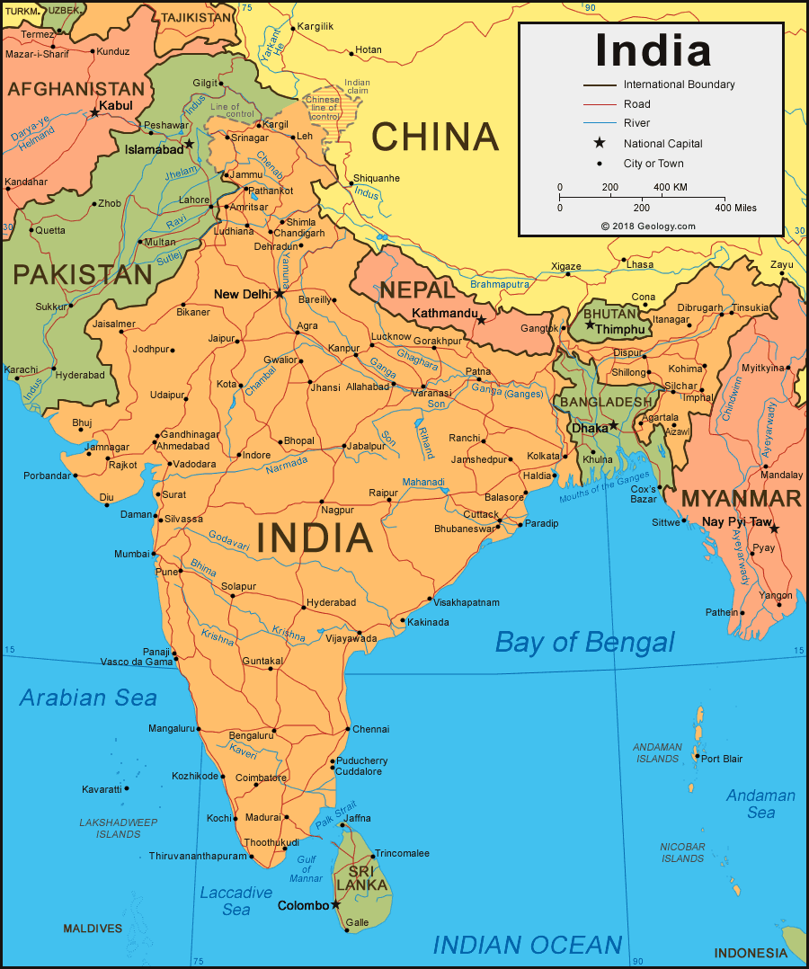
UNIT 4
HOW DO SLOTHS MOVE?
VIDEO
Notes:
India is home to 19 species of Old World monkeys; 6 of them are endemic to the nation. Macaques, a kind of monkey, have arms that are about as long as their legs. Depending on the species, the tail may be of any length—or even non-existent. They are considered very intelligent but, as the video shows, can be quite naughty.
Have students find India on a world map

Slide 6
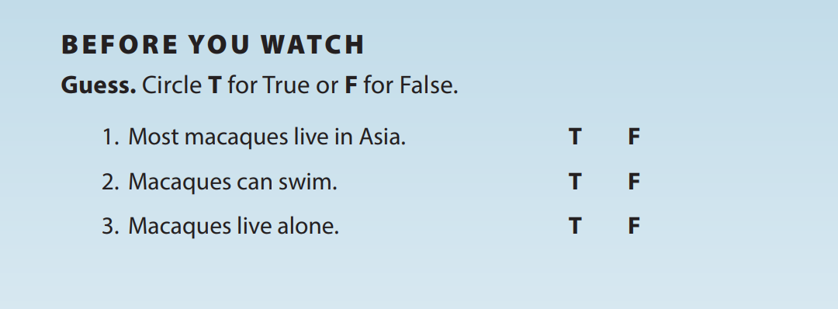
UNIT 4
HOW DO SLOTHS MOVE?
VIDEO

Slide 7
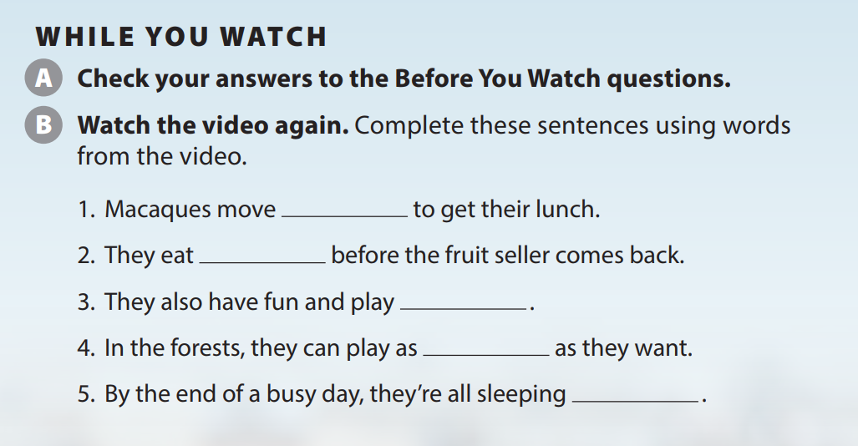
UNIT 4
HOW DO SLOTHS MOVE?
VIDEO
fast
quickly
noisily
loudly
quietly
Notes:
OPTIONAL Have students use the
adverbs (fast, quickly, bravely, roughly, noisily, loudly, quietly) to talk about other things the macaques might do.

Slide 8
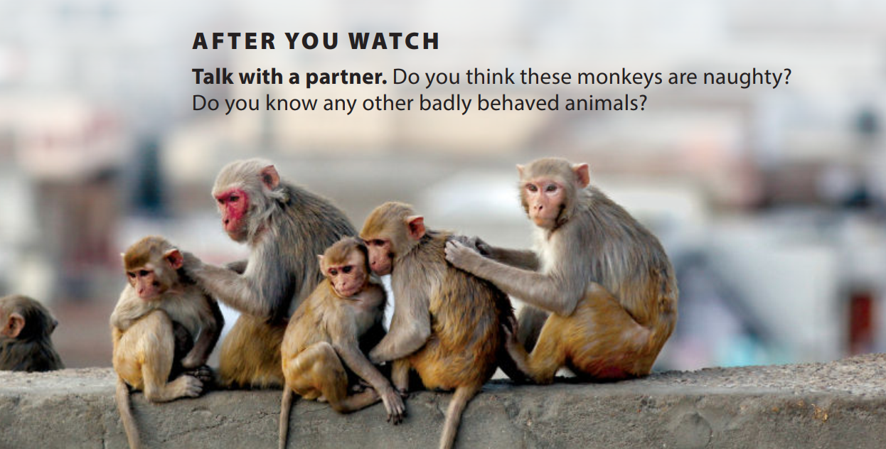
UNIT 4
HOW DO SLOTHS MOVE?
VIDEO
Notes:
Tell students they will get into pairs and talk about the video.
As students follow along in their books, read the two questions aloud.
Have them do the task.
OPTIONAL Have students discuss
what people can do to try to control the macaques.

Slide 9


THANK YOU!

