Slide 1
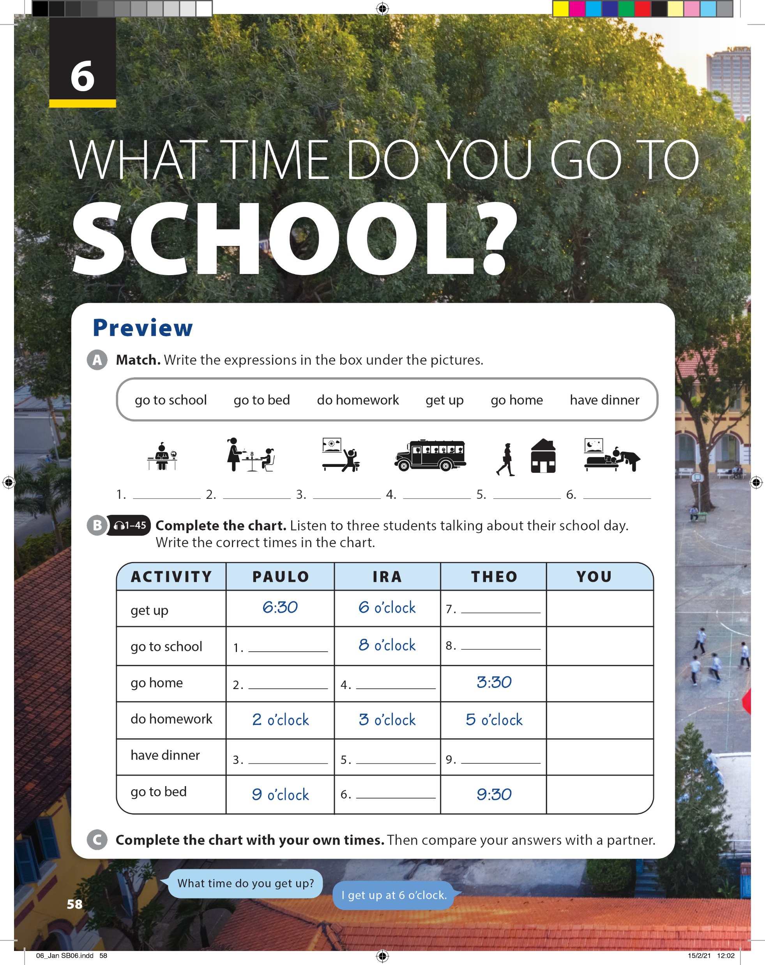
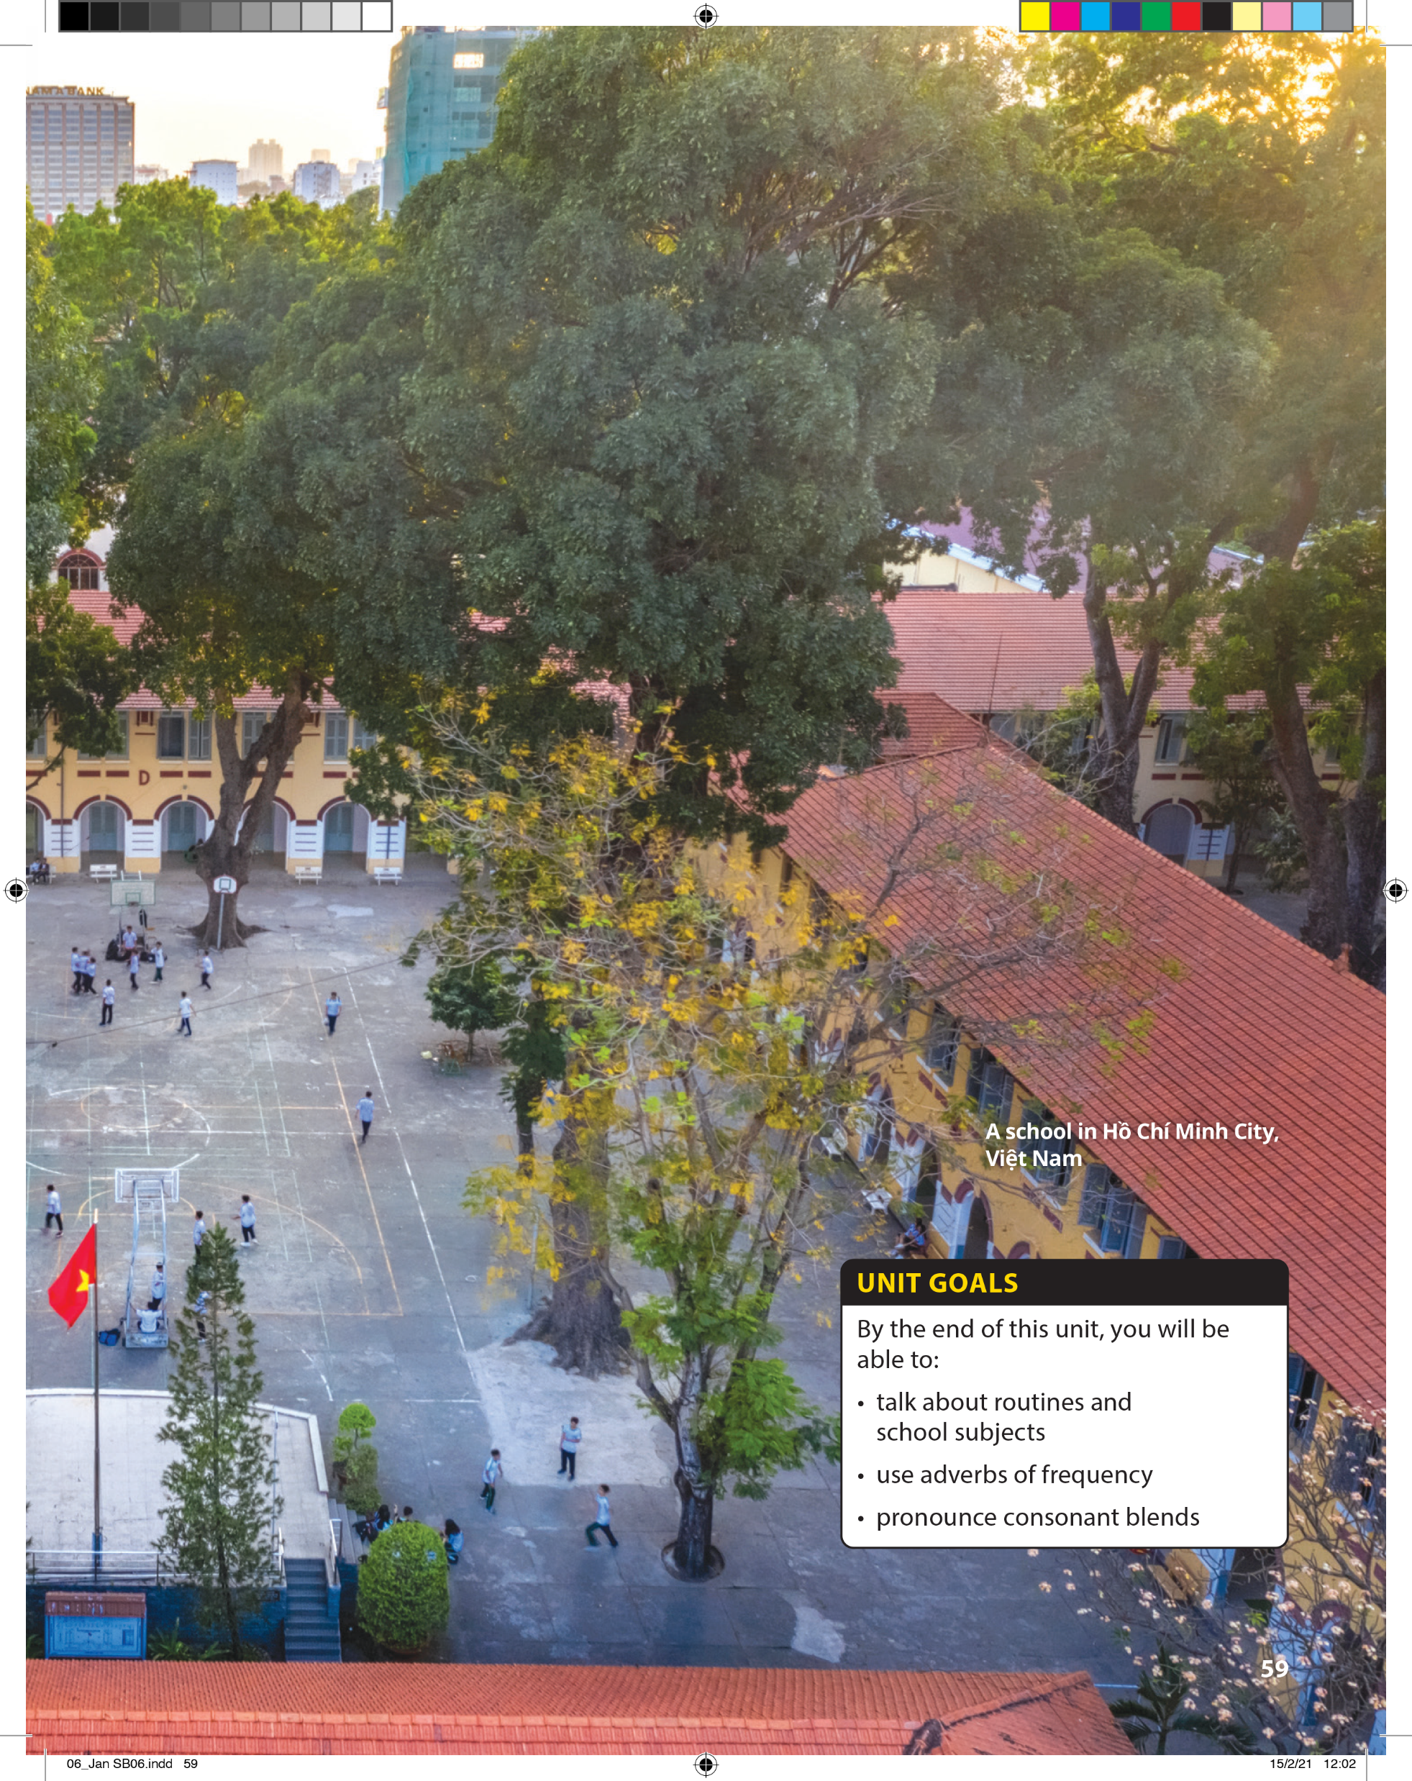

Slide 2


UNIT 6
WHAT TIME DO YOU GO TO SCHOOL?
PREVIEW
do homework
go to school
have dinner
get up
go home
go to bed

Slide 3

UNIT 6
WHAT TIME DO YOU GO TO SCHOOL?
PREVIEW
6:45
7:15
8 o’clock
11 o’clock
12 o’clock
7 o’clock
5:30
8:30
8:30

Slide 4
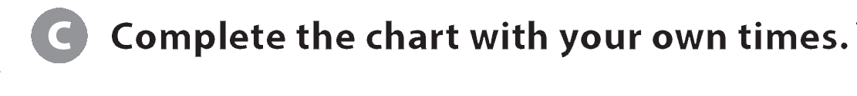
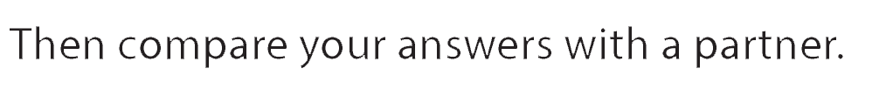

UNIT 6
WHAT TIME DO YOU GO TO SCHOOL?
PREVIEW

Slide 5
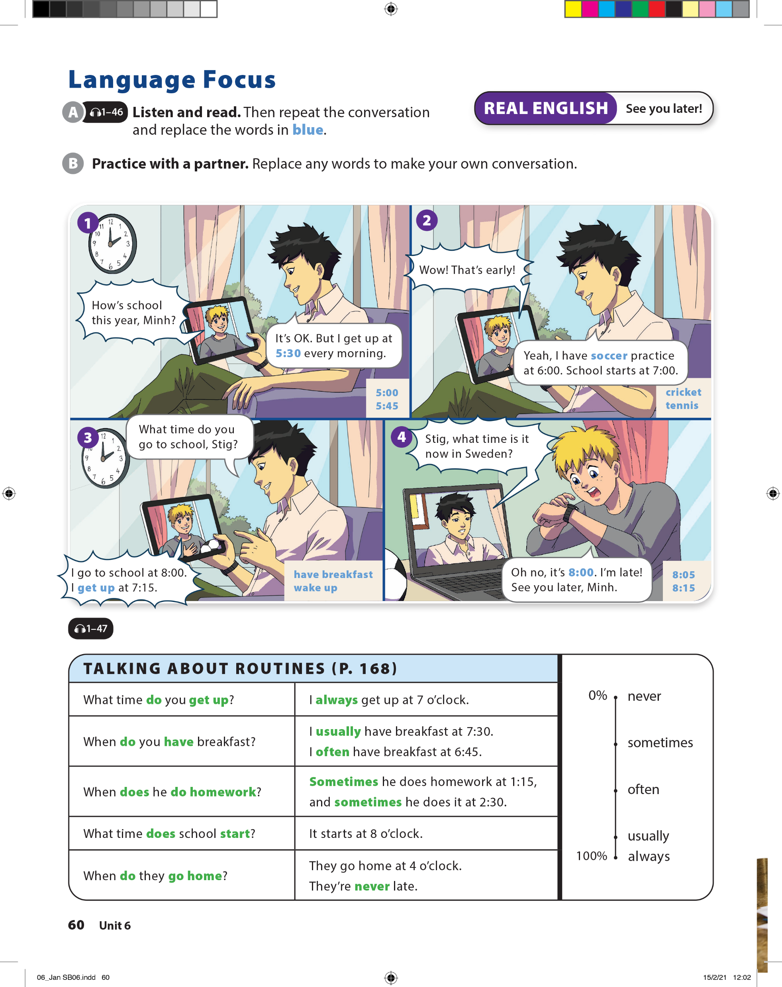


UNIT 6
WHAT TIME DO YOU GO TO SCHOOL?
LANGUAGE FOCUS

Slide 6
UNIT 6
WHAT TIME DO YOU GO TO SCHOOL?
LANGUAGE FOCUS

Slide 7
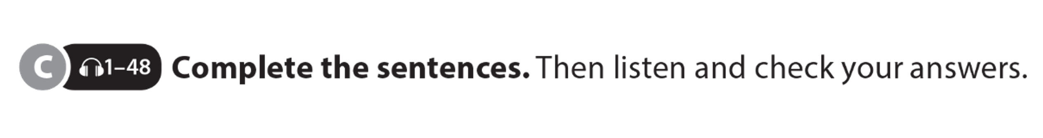
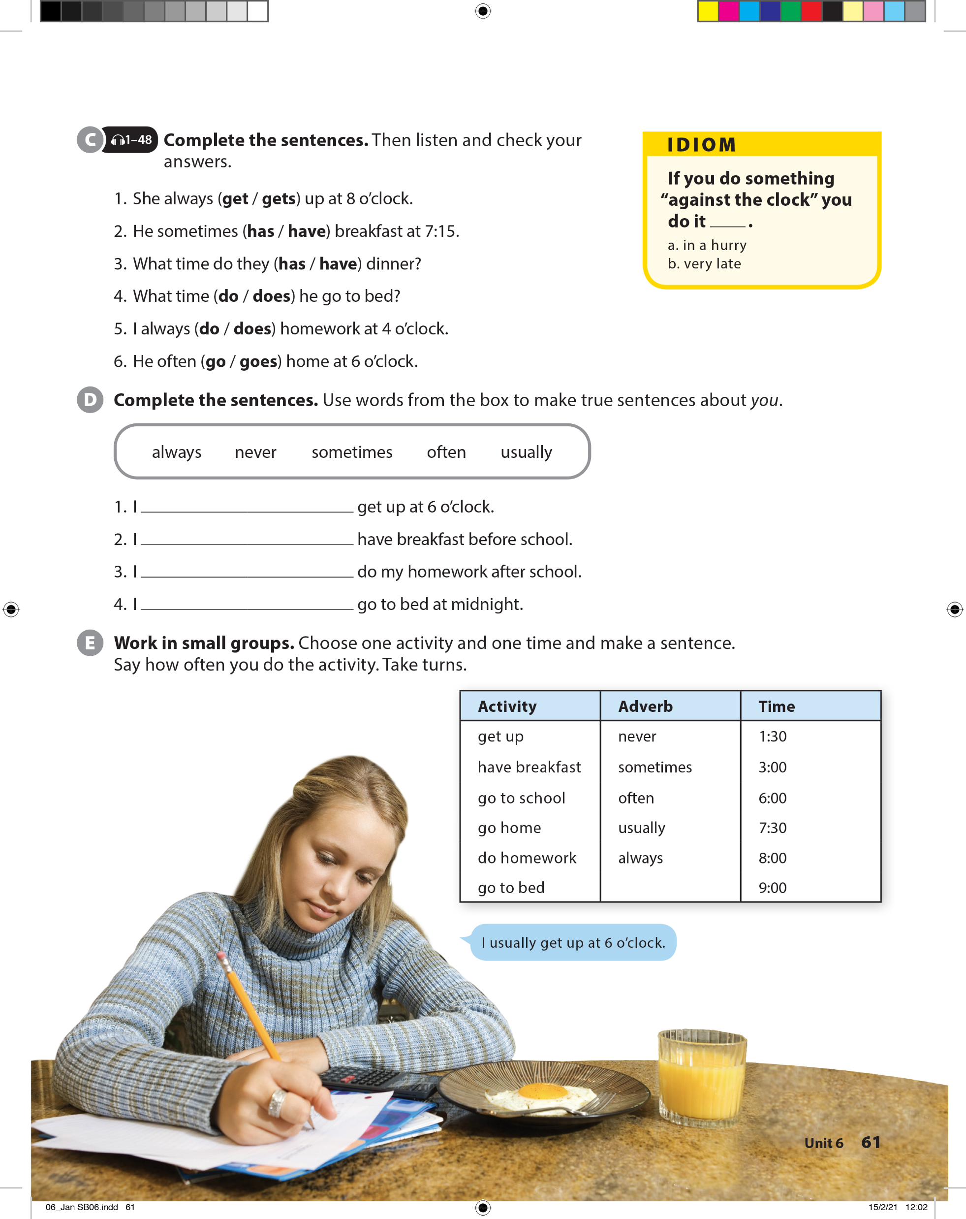
UNIT 6
WHAT TIME DO YOU GO TO SCHOOL?
LANGUAGE FOCUS

Slide 8
UNIT 6
WHAT TIME DO YOU GO TO SCHOOL?
IDIOM
If you do something “against the clock” you do it _______.
in a hurry
very late

Slide 9
UNIT 6
WHAT TIME DO YOU GO TO SCHOOL?
LANGUAGE FOCUS

Slide 10
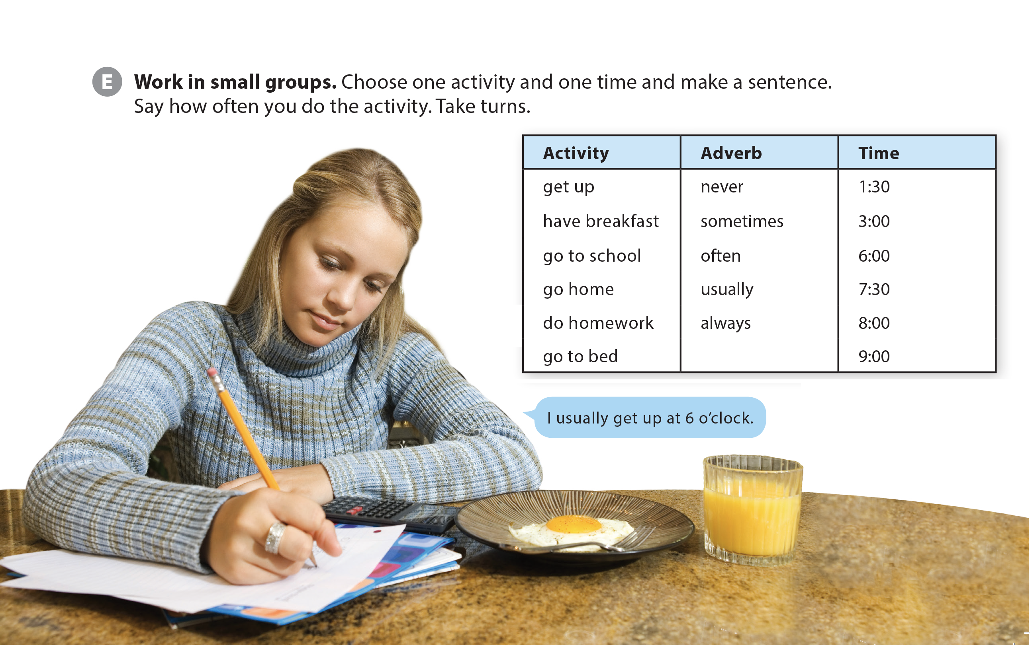
UNIT 6
WHAT TIME DO YOU GO TO SCHOOL?
LANGUAGE FOCUS

Slide 11
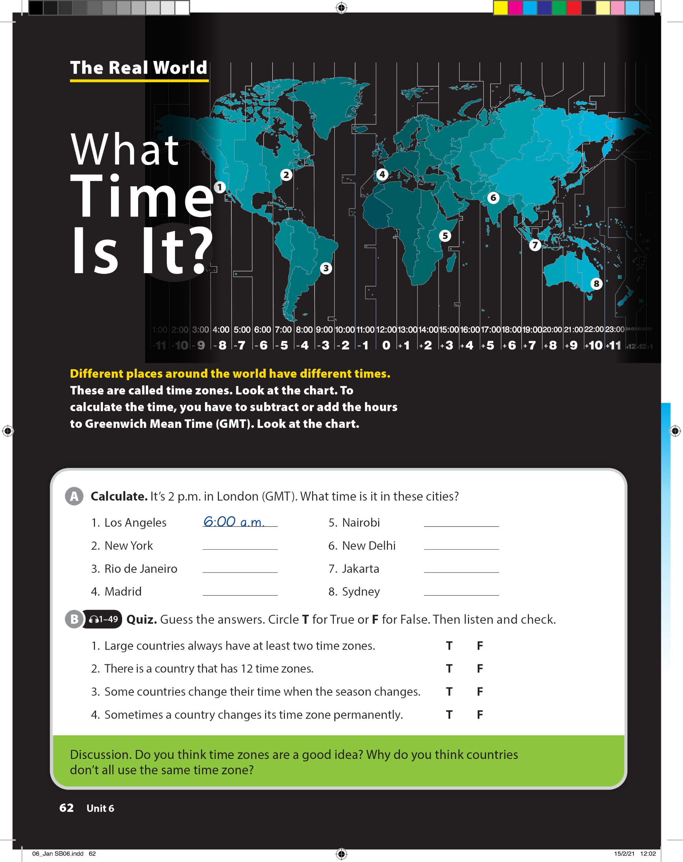
UNIT 6
WHAT TIME DO YOU GO TO SCHOOL?
THE REAL WORLD

Slide 12
UNIT 6
WHAT TIME DO YOU GO TO SCHOOL?
THE REAL WORLD
9:00 a.m.
11:00 a.m.
2:00 p.m.
5:00 p.m.
7:00 p.m.
9:00 p.m.
12:00 a.m.

Slide 13
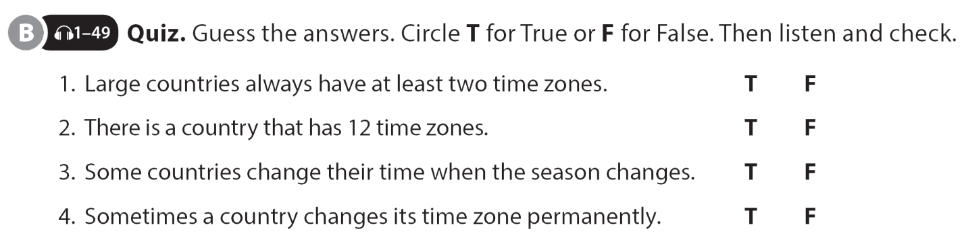
UNIT 6
WHAT TIME DO YOU GO TO SCHOOL?
THE REAL WORLD

Slide 14
UNIT 6
WHAT TIME DO YOU GO TO SCHOOL?
THE REAL WORLD

Slide 15
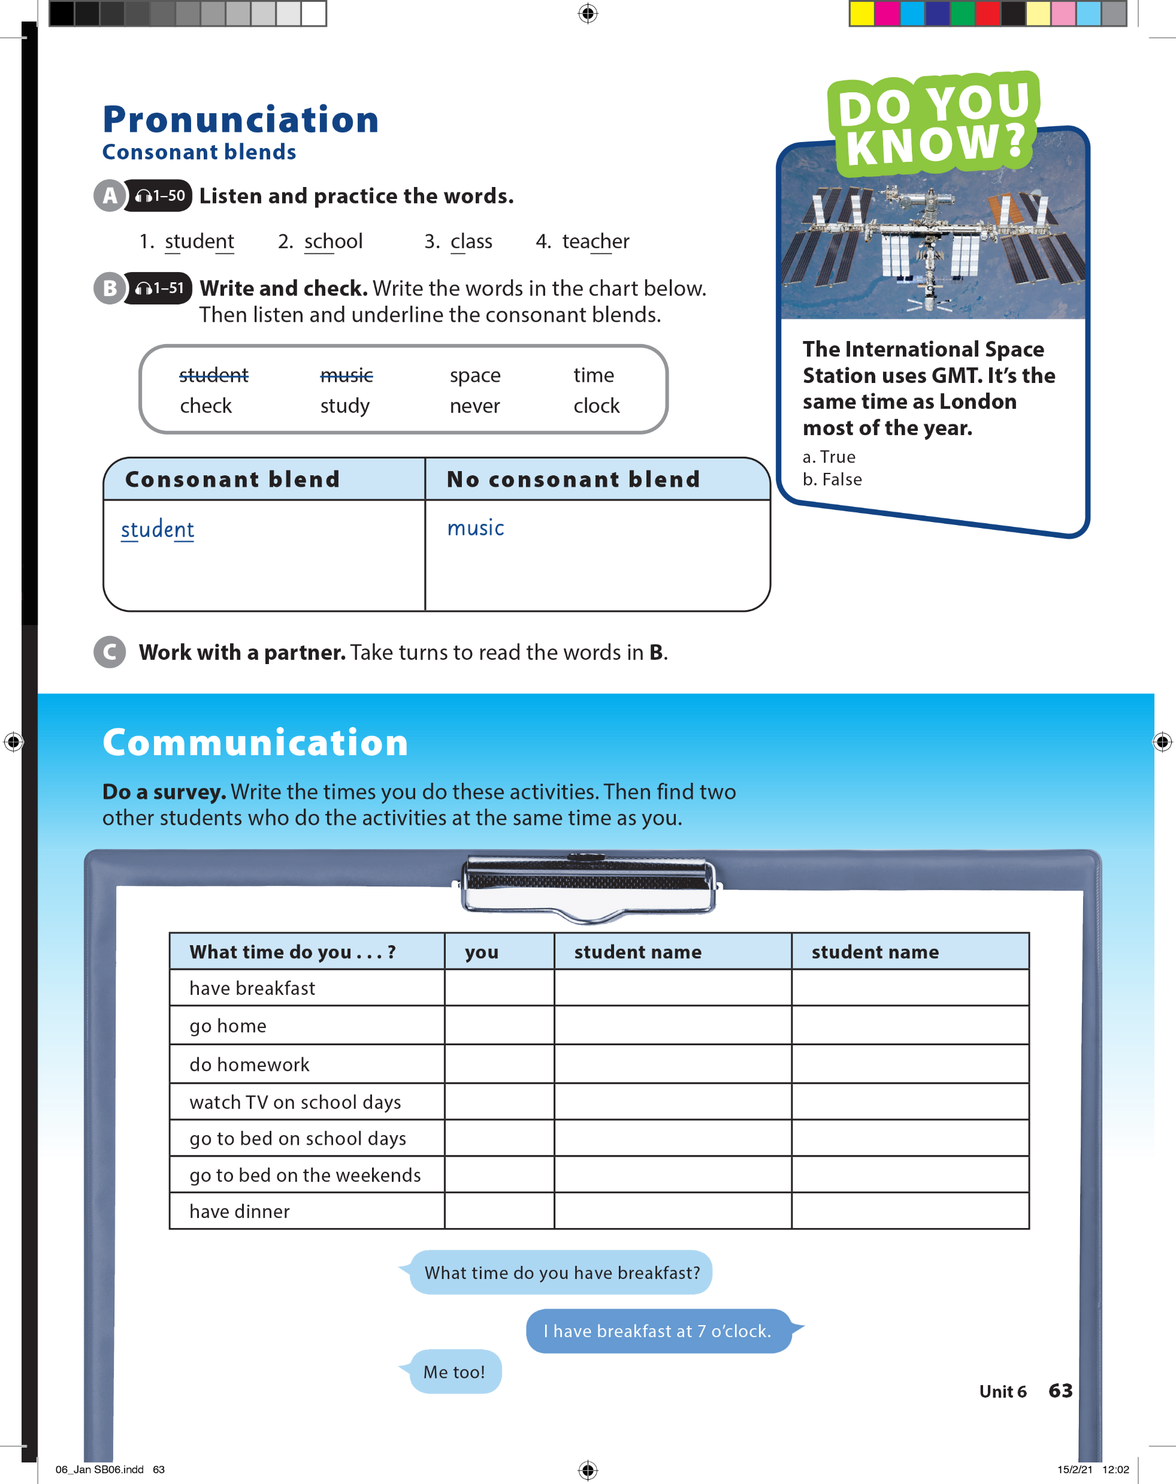
UNIT 6
WHAT TIME DO YOU GO TO SCHOOL?
PRONUNCIATION

Slide 16
UNIT 6
WHAT TIME DO YOU GO TO SCHOOL?
PRONUNCIATION
space
check
study
clock
time
never

Slide 17
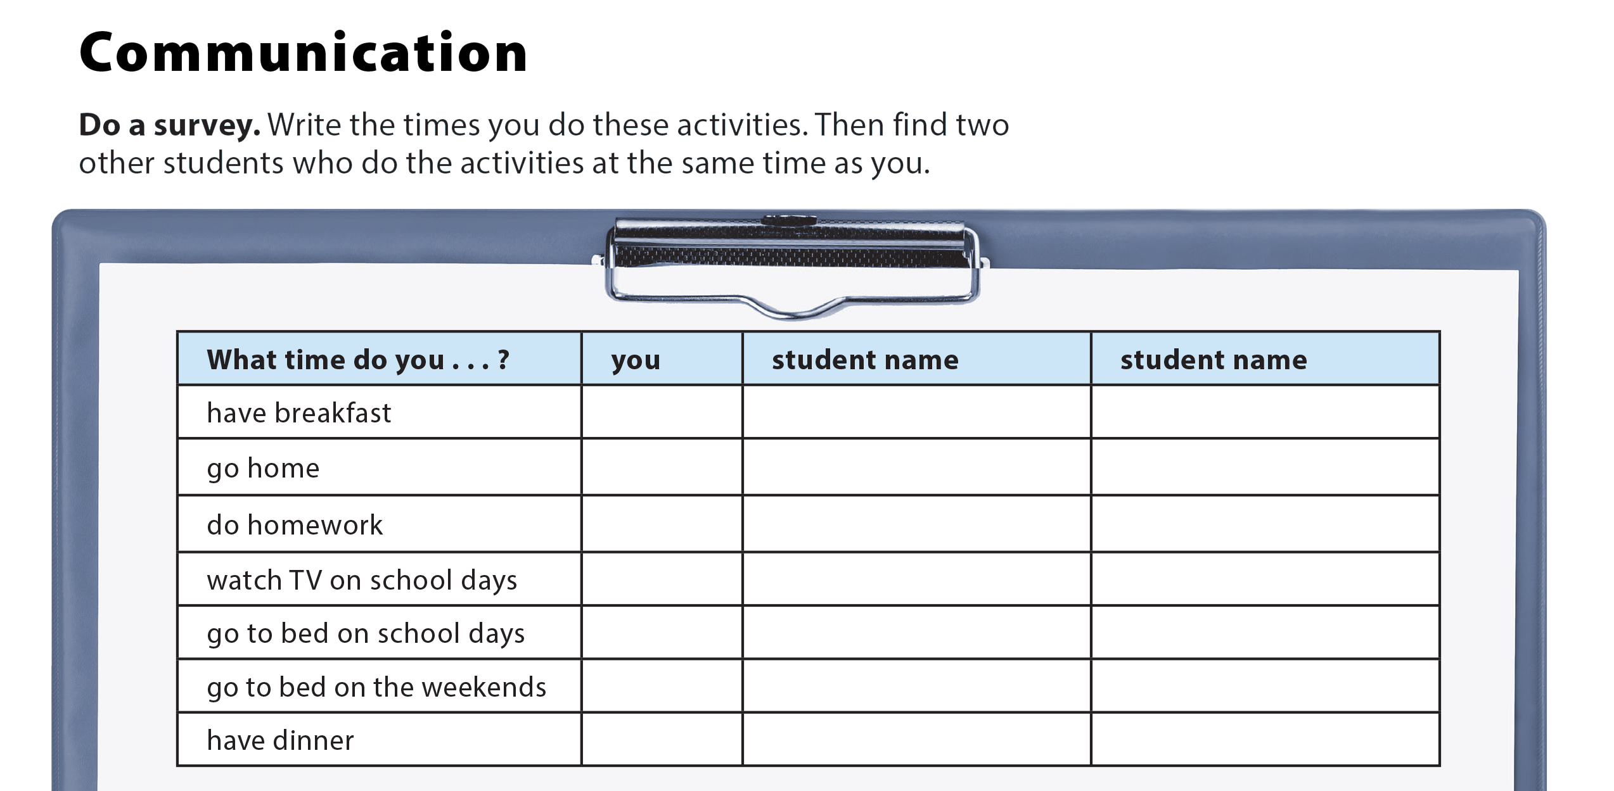
UNIT 6
WHAT TIME DO YOU GO TO SCHOOL?
COMMUNICATION

Slide 18

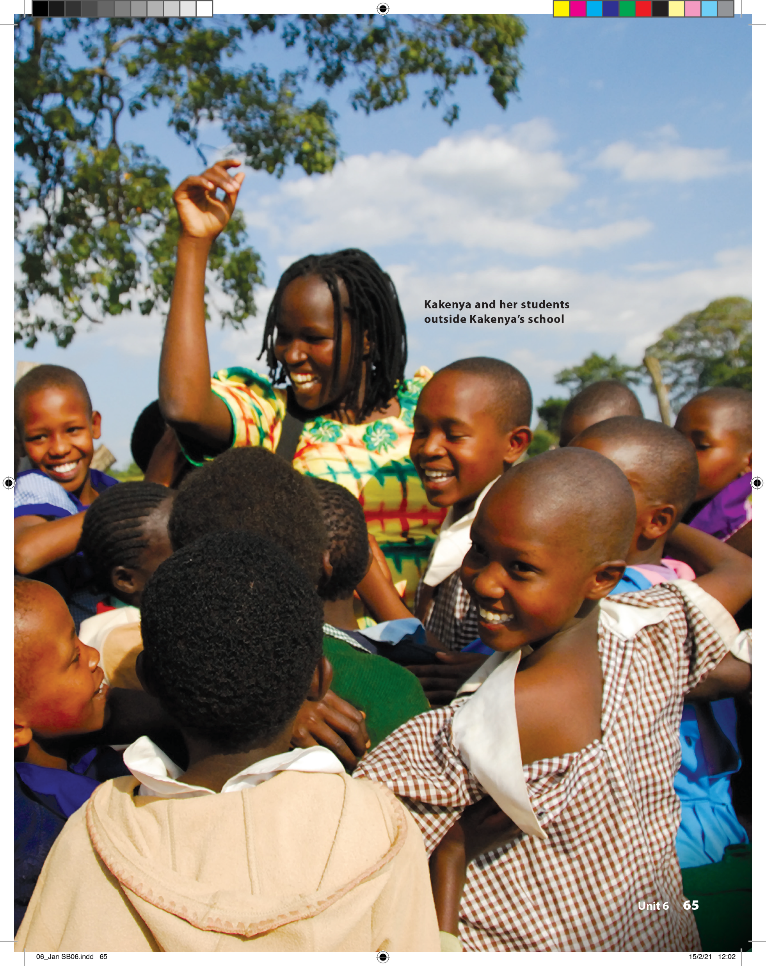
UNIT 6
WHAT TIME DO YOU GO TO SCHOOL?
READING

Slide 19

UNIT 6
WHAT TIME DO YOU GO TO SCHOOL?
READING

Slide 20
UNIT 6
WHAT TIME DO YOU GO TO SCHOOL?
READING

Slide 21
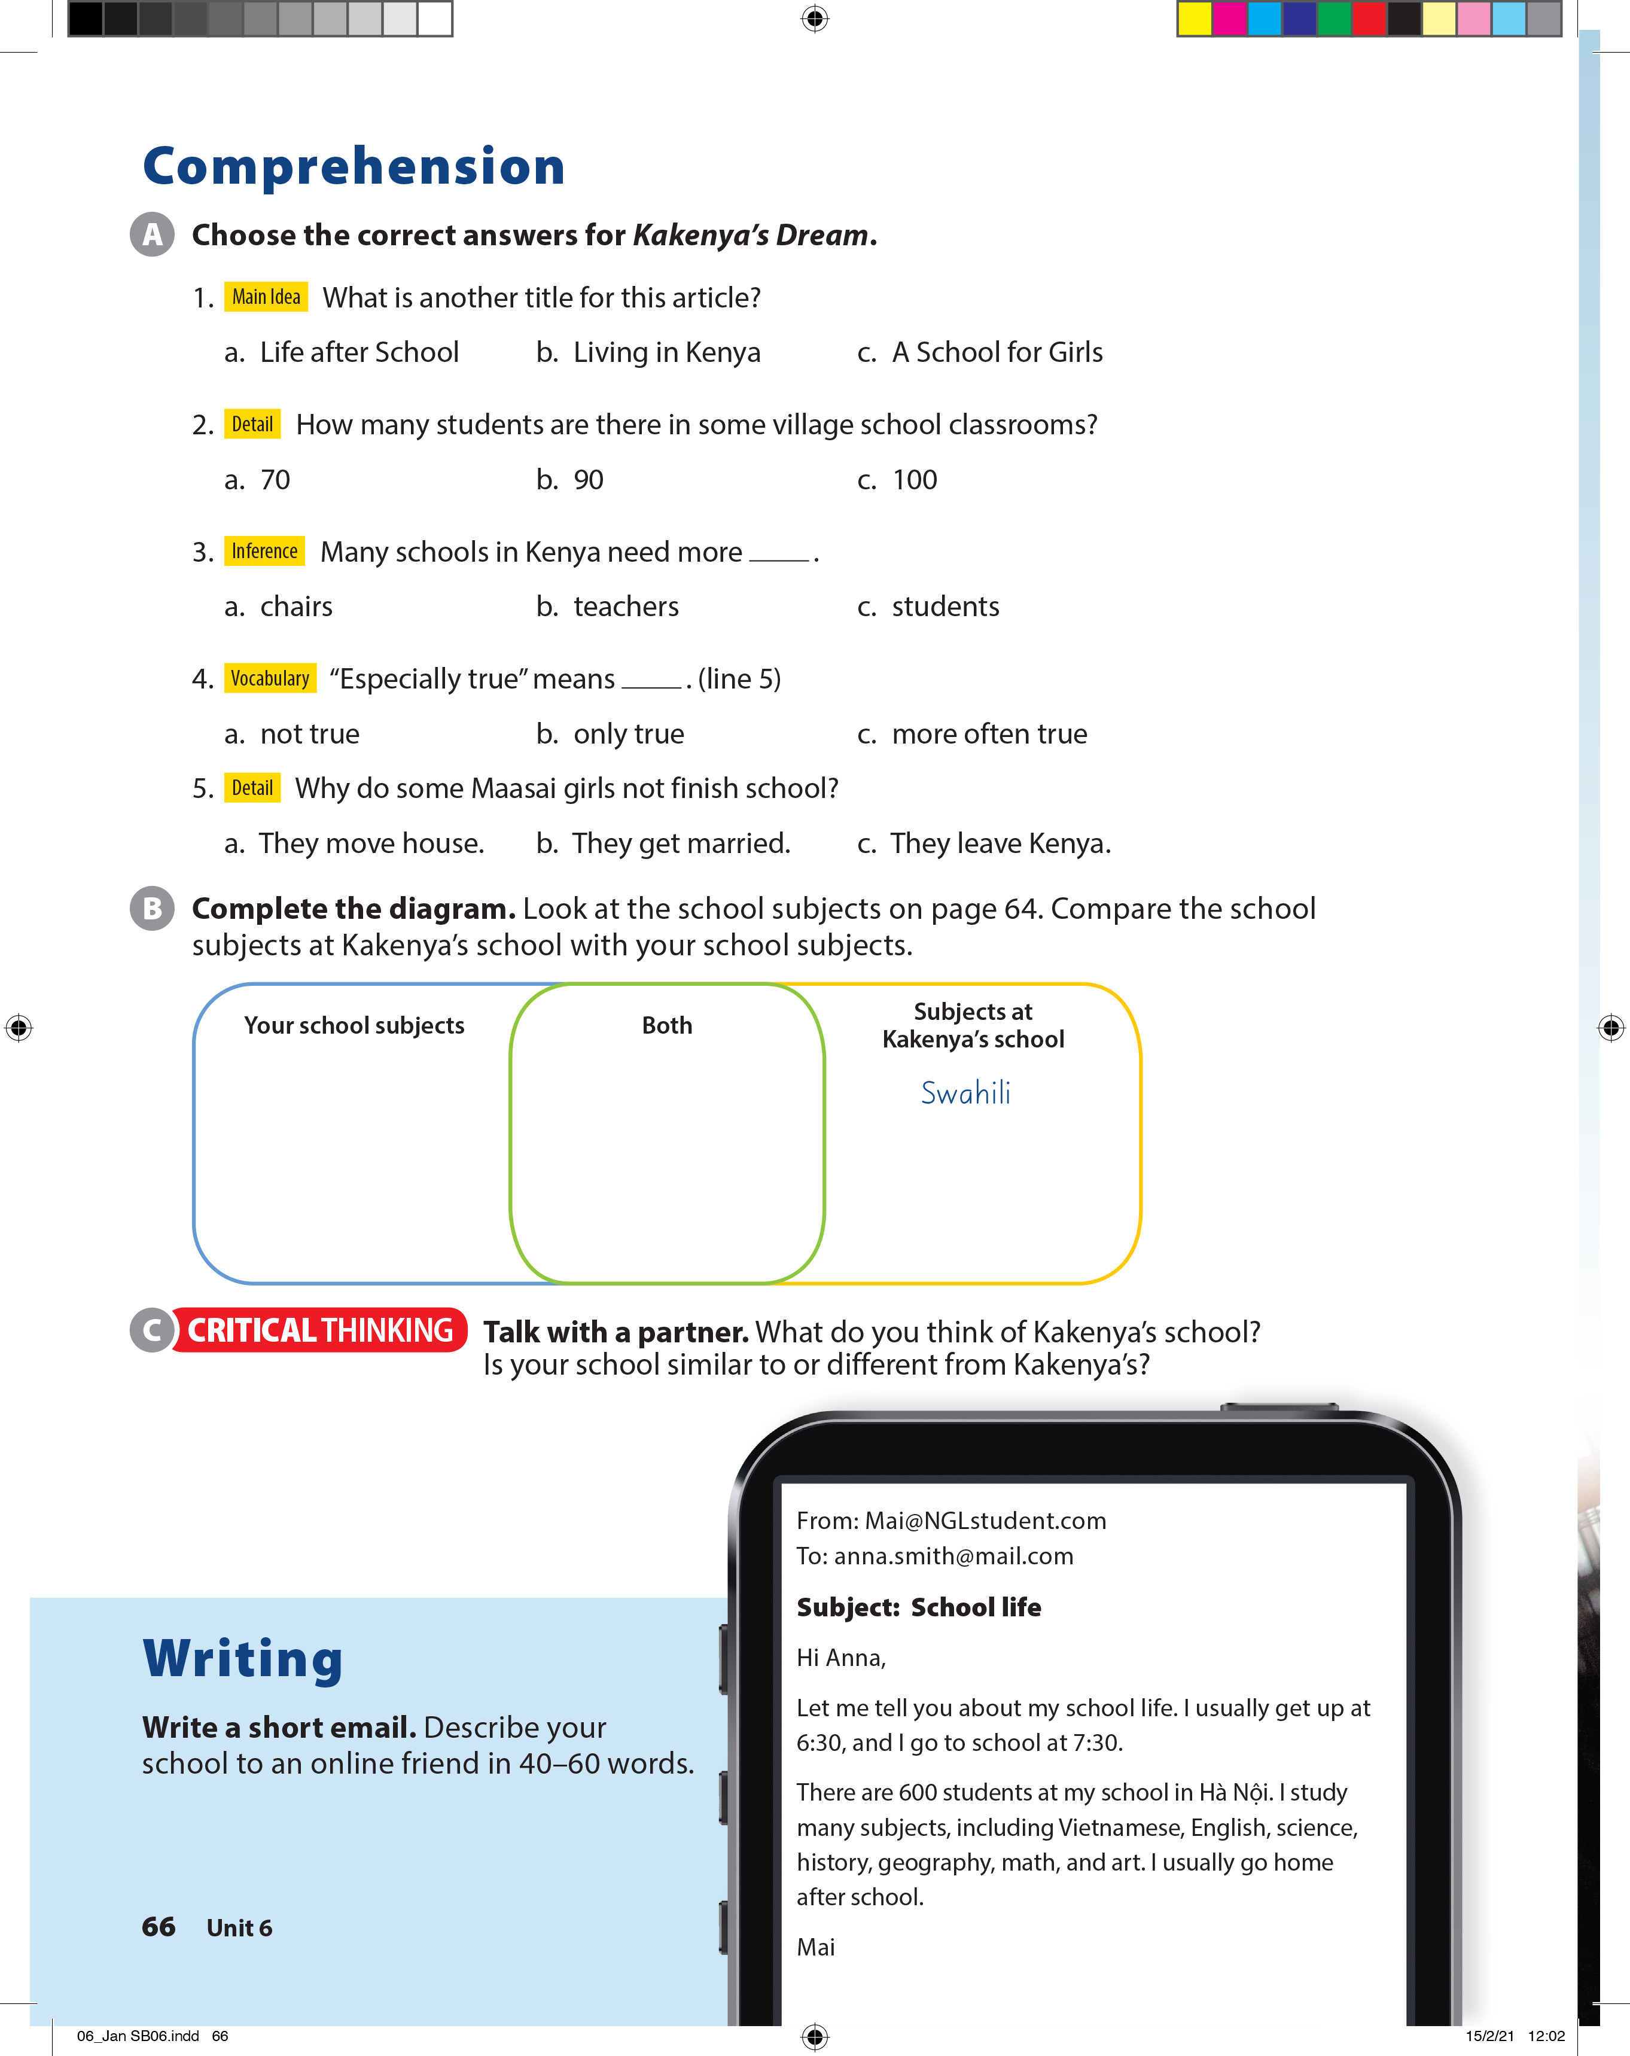
UNIT 6
WHAT TIME DO YOU GO TO SCHOOL?
COMPREHENSION

Slide 22
UNIT 6
WHAT TIME DO YOU GO TO SCHOOL?
COMPREHENSION
English
Math
Science
Geography
History
Art
PE

Slide 23
UNIT 6
WHAT TIME DO YOU GO TO SCHOOL?
WRITING

Slide 24


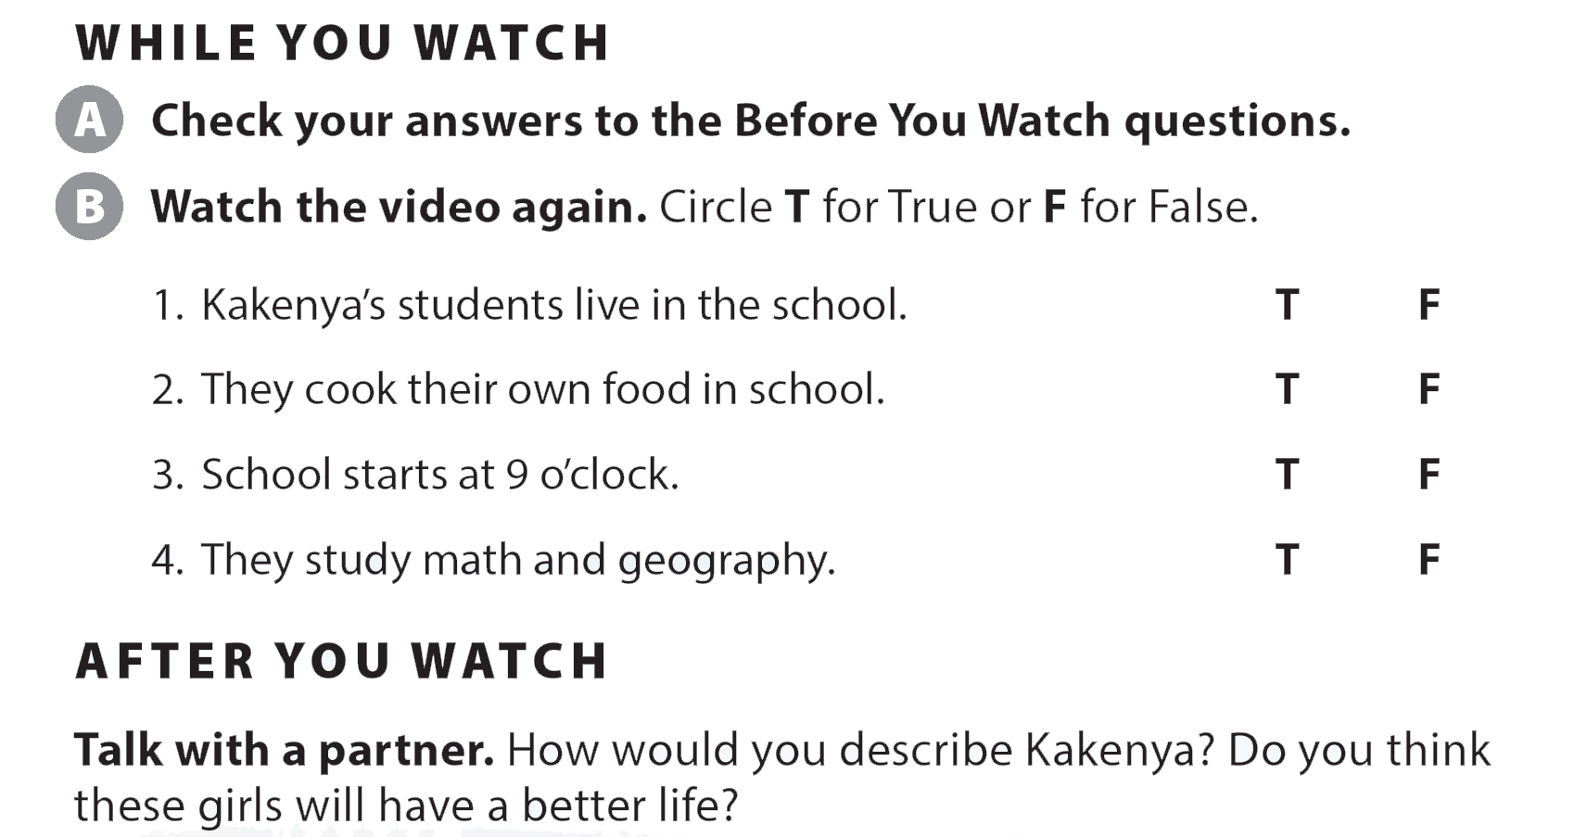
UNIT 6
WHAT TIME DO YOU GO TO SCHOOL?
VIDEO

Slide 25
UNIT 6
WHAT TIME DO YOU GO TO SCHOOL?
VIDEO

Slide 26
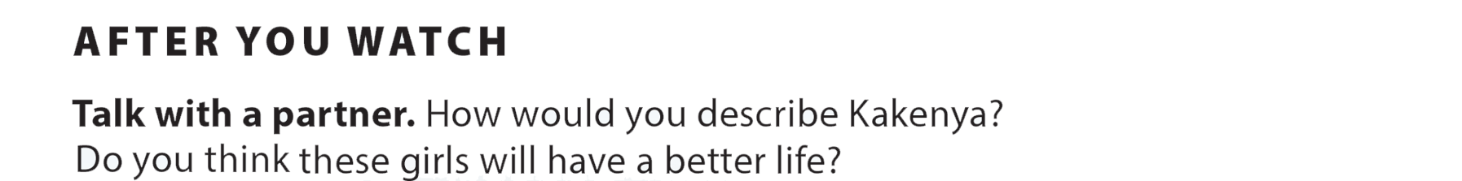
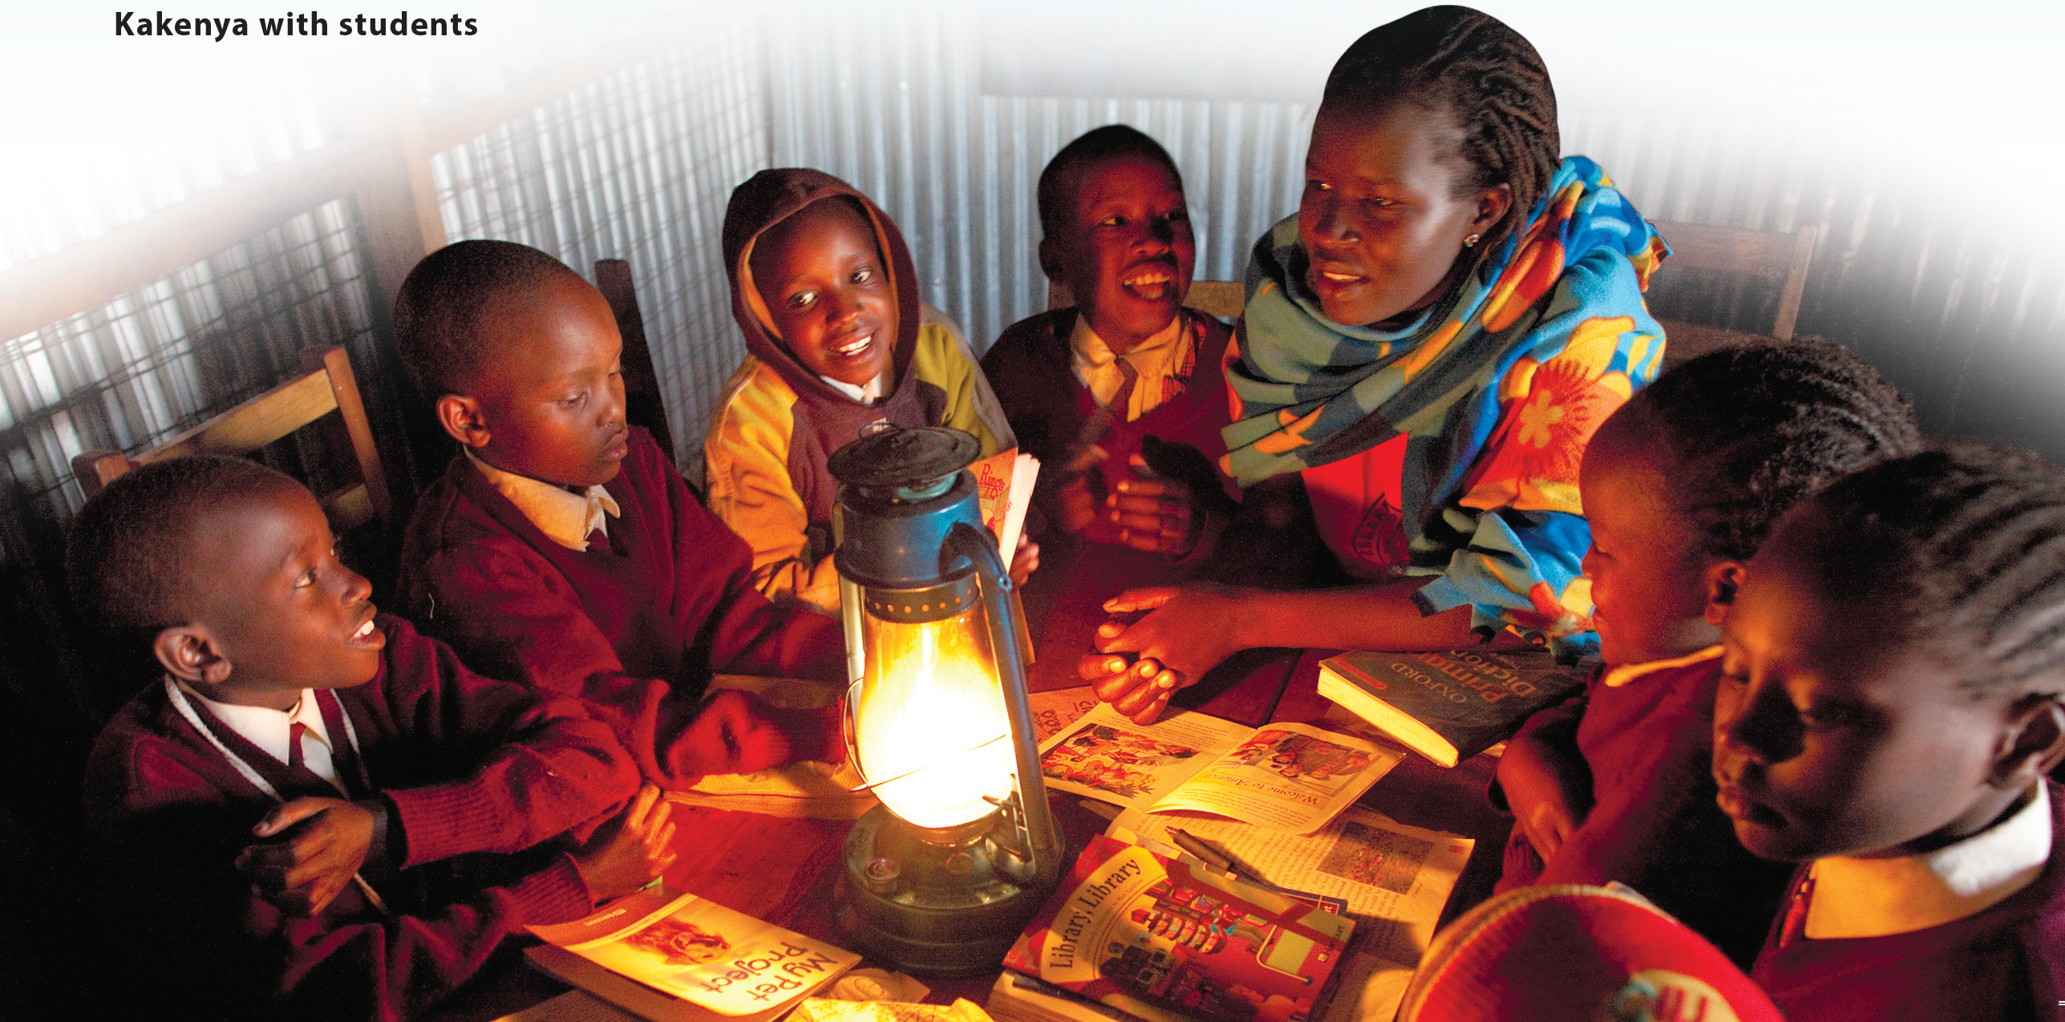
UNIT 6
WHAT TIME DO YOU GO TO SCHOOL?
VIDEO

