Slide 1

Unit 11 Opener and Vocabulary

Slide 2
Warm-up

Slide 3
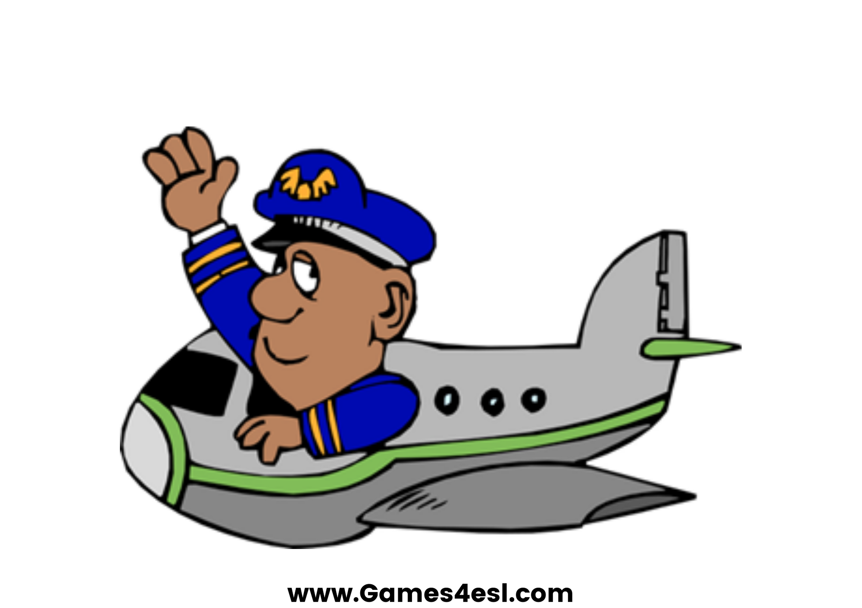
pilot
SHOW

Slide 4
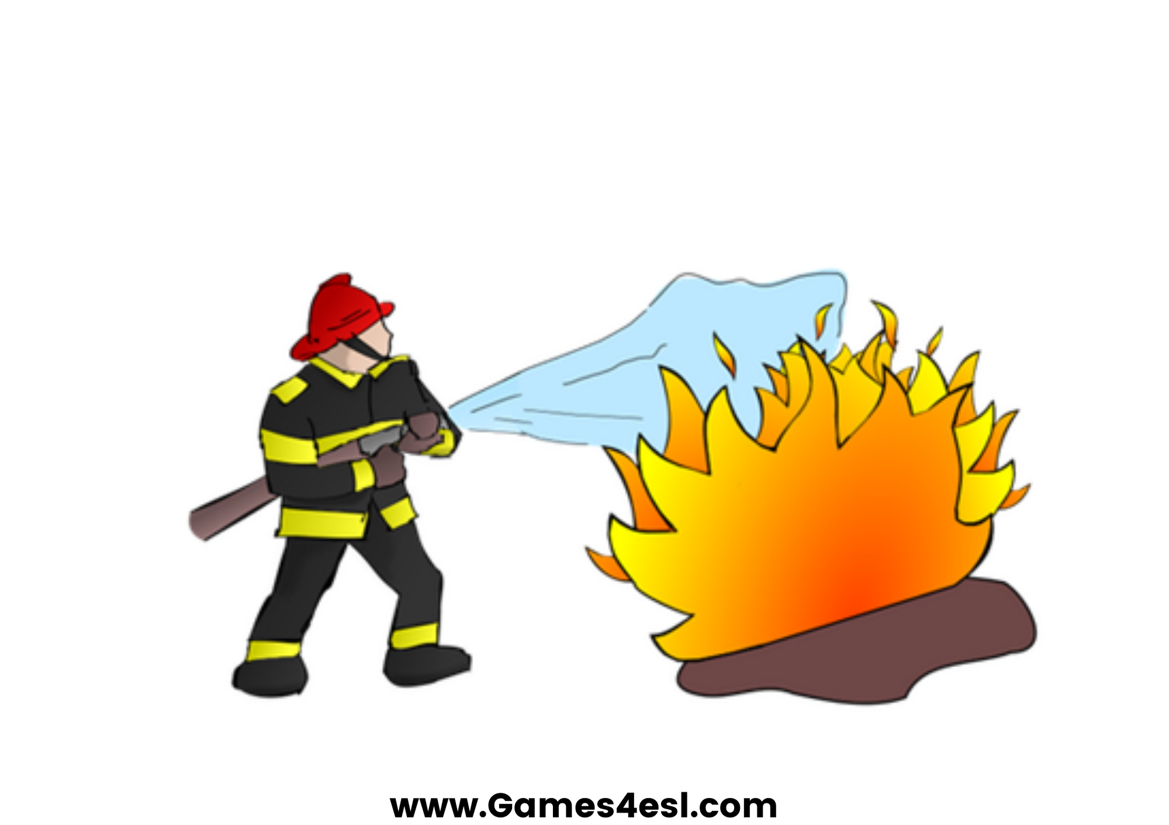
firefighter
SHOW

Slide 5

cook
SHOW

Slide 6
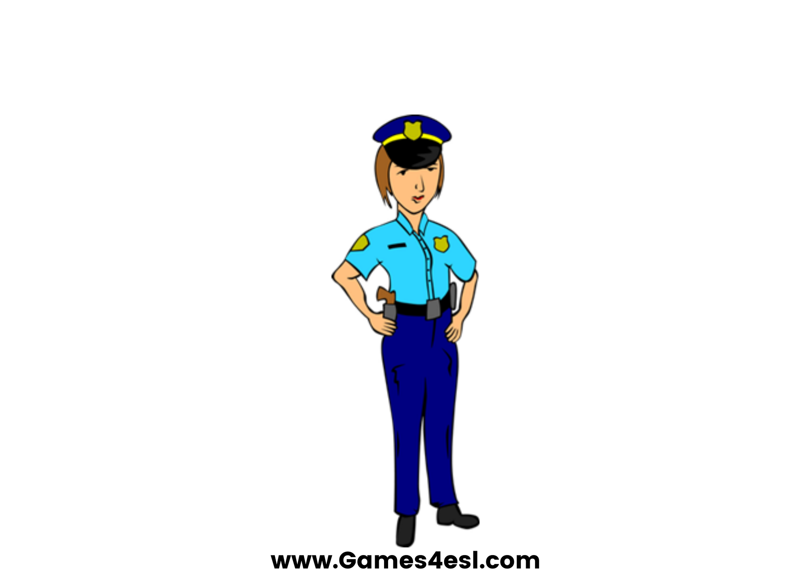
police officer
SHOW

Slide 7

nurse
SHOW

Slide 8

post man
SHOW

Slide 9

teacher
SHOW

Slide 10

doctor
SHOW

Slide 11
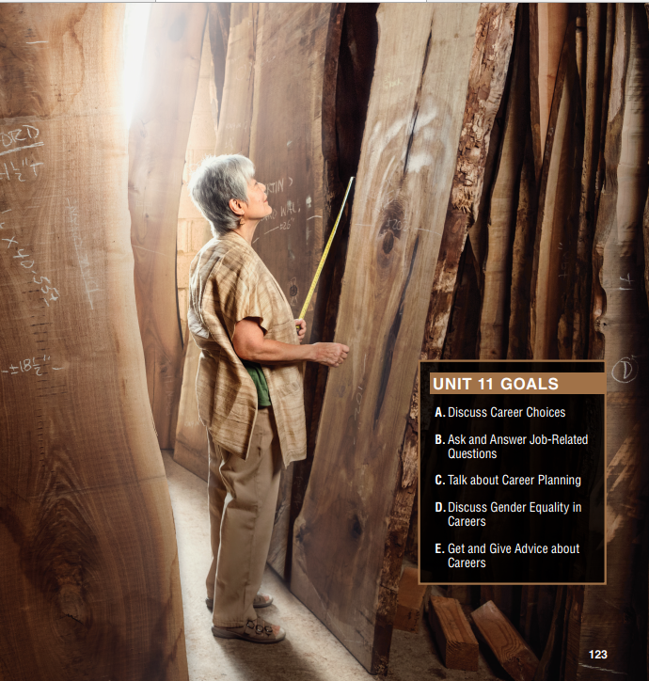
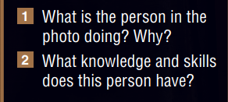
Wood (n) /wʊd/
Measure (v) /ˈmeʒə(r)/

Slide 12
Career choices
When you are trying to choose a career, who can help?
What do you need to think about?

Slide 13
Listen and Repeat
Healthcare worker (n): nhân viên y tế
Senior (n) cấp trên
Highschool senior (n) học sinh lớp 12
Careers advisor (n): cố vấn nghề nghiệp
Graduate (n): cử nhân/người tốt nghiệp đại học
Assistant (n) trợ lý
Qualification (n) bằng cấp
Volunteer (n) tình nguyện viên

Slide 14
Listen and Repeat
Encourage (v) động viên
Collaboration (n) hợp tác
Creativity (n) sự sáng tạo
Innovation (n) sự đổi mới
Bachelor’s degree (n): bằng cử nhân/ bằng ĐH
Vocational degree (n) bằng trung cấp nghề
Extracurricular (a) ngoại khóa

Slide 15
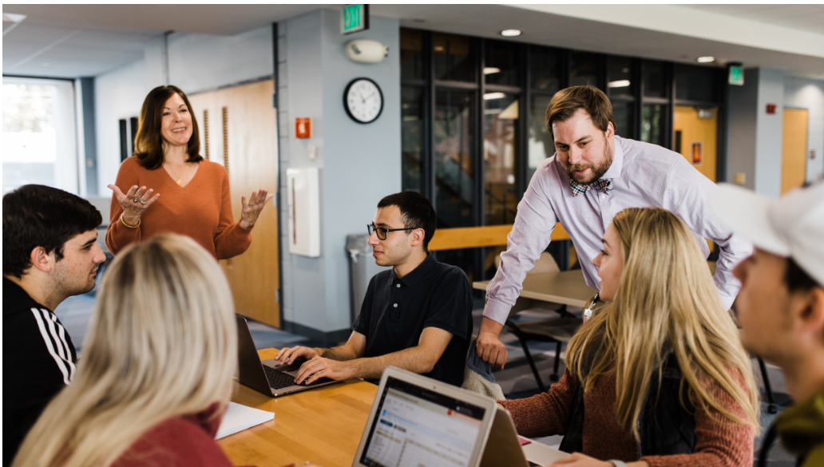

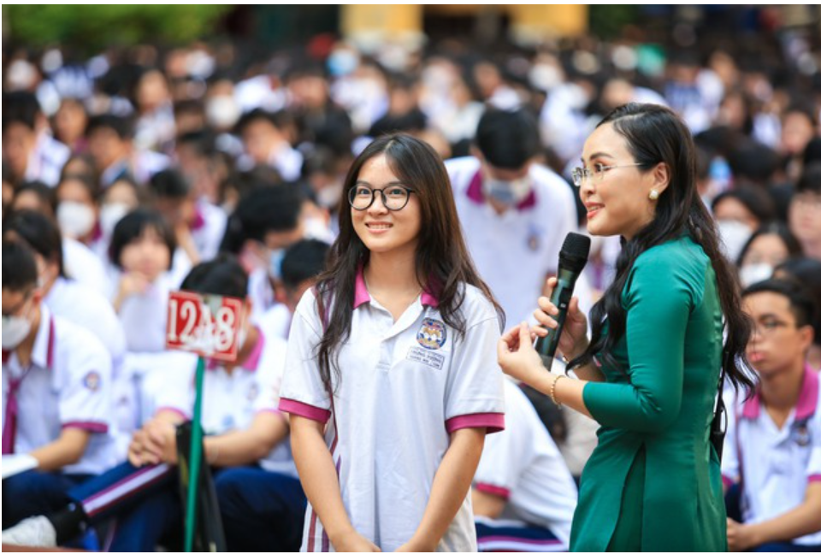
A – what does macy do at the hospital?
Career advisor
= a person who gives career advice
She/Macy is a volunteer family assistant.
Senior student
= a K-12 student

Slide 16
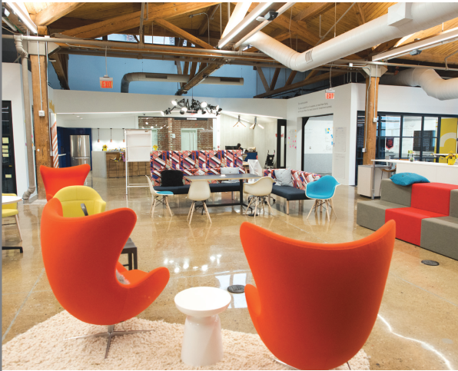
B – fill in the blanks
Marcy has some work (1) experience. She went through a (2) ___________ program to become a family (3) _____________ at the hospital. It’s (4) _____________ work, so Marcy doesn’t get paid.
Marcy would like to be a business (5) _____________, but she doesn’t have the necessary (6) ______________ yet.
I explained that she could start as an (7) _____________ at a business. Later, perhaps, she can be the (8) ____________ when she has her own business.
training
assistant
volunteer
owner
qualifications
assistant boss
employee owner
experience training
qualifications
volunteer
employee
boss

Slide 17
Audio script track 54
Student: Thanks for seeing me today, Ms. Carter.
Ms. Carter: No problem at all, Marcy. Have a seat.
Student: Thanks. I wanted to talk to you about my future. I’m graduating soon, and I still don’t know what
I want to do with my life.
Ms. Carter: That’s what I’m here for. Do you have any work experience now?
Student: Not really, but I do have some volunteer experience. I went through a training program to
become a family assistant at the hospital. I give people information when they come in, and I walk with
them to different parts of the hospital. It’s a big place!
Ms. Carter: That’s great! Maybe you should become a healthcare worker—a nurse or a doctor, perhaps.
Student: Actually, I don’t think I want to work in a hospital after I graduate. I think I’d like to be a business
owner.
Ms. Carter: Sure, many people have their own business. But most of them start as employees. They work
for a boss, and later, they open their own business.
Student: That makes sense. I could get a job, work for a while, and build up my qualifications, and
then—who knows?
Ms. Carter: That’s the idea. Just make sure your job is going somewhere. It should be related to the kind
of business you want to get into.
Student: You’re right. Thanks for the advice, Ms. Carter!
Ms. Carter: Any time.

Slide 18
C. Complete the sentences
1. An ______________ works for an employer.
2. If you do ______________ work, you don’t get paid.
3. In a _____________ program, you learn how to do something.
4. If you are the _____________ of a company, it is your company.
5. An ______________ helps you do something.
employee
volunteer
training
owner
assistant

Slide 19
D - discussion
What do you think Marcy should do to prepare for her future?
What degrees or training should she get?

Slide 20
D - discussion
What do you think Marcy should do to prepare for her future?
What degrees or training should she get?
Since Marcy wants to become a business owner, she could consider pursuing a degree or certification in business administration, entrepreneurship, or a related field. She could also gain practical experience by working as an employee in a business and learning from the company's operations and management.
In addition, Marcy could develop her skills in marketing, accounting, and finance, which are essential for running a successful business. She could also network with other entrepreneurs and attend industry events to learn from their experiences.
Finally, Marcy could continue volunteering and gaining experience in the healthcare industry, as this could potentially lead to opportunities to start her own business in that field.

Slide 21
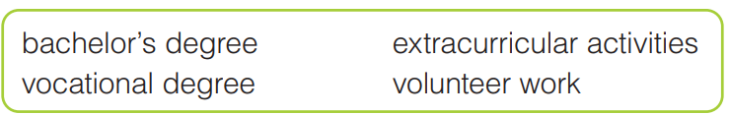
E. MY WORLD
Work in pairs
Talk about the education or experience that you have
Use the information in the box to help you

Slide 22
Suggested answer
As a high school student, I do not have a bachelor's or vocational degree yet, but I am actively involved in extracurricular activities and volunteer work.
In terms of extracurricular activities, I am a member of the school's debate team and drama club. These activities have helped me improve my public speaking and critical thinking skills. I have also learned to work collaboratively with my peers to achieve common goals.
When it comes to volunteer work, I have been involved in various initiatives in my community. I have volunteered at a local soup kitchen, helping to prepare and serve meals to those in need. This experience has taught me the value of giving back to the community and has helped me develop empathy and compassion for others.
Additionally, I have also volunteered at a local animal shelter, where I have helped take care of the animals and assisted in organizing adoption events. This experience has helped me develop responsibility, patience, and compassion towards animals.
Overall, my extracurricular activities and volunteer work have helped me develop various skills and qualities that will be useful in my future studies and career. I am grateful for these opportunities and look forward to continuing to learn and grow through these experiences.

Slide 23


