Slide 1
communication
UNIT 11 - CAREERS

Slide 2
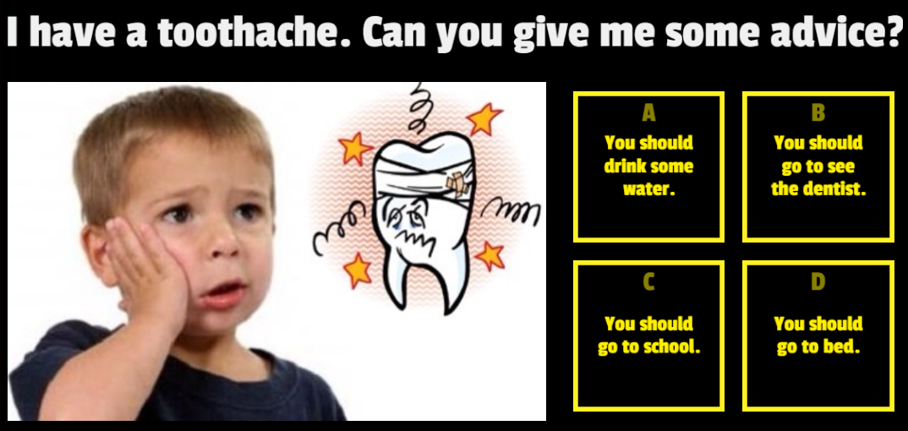

Warm up
GIVING ADVICE

Slide 3
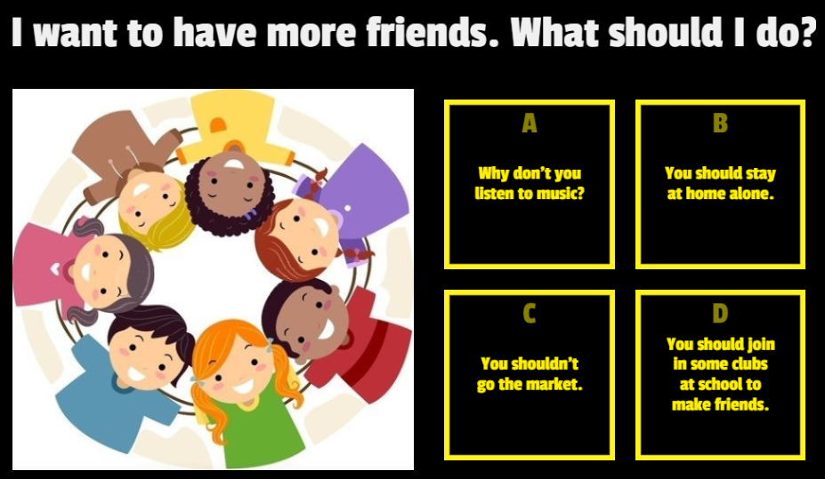

Warm up
GIVING ADVICE

Slide 4
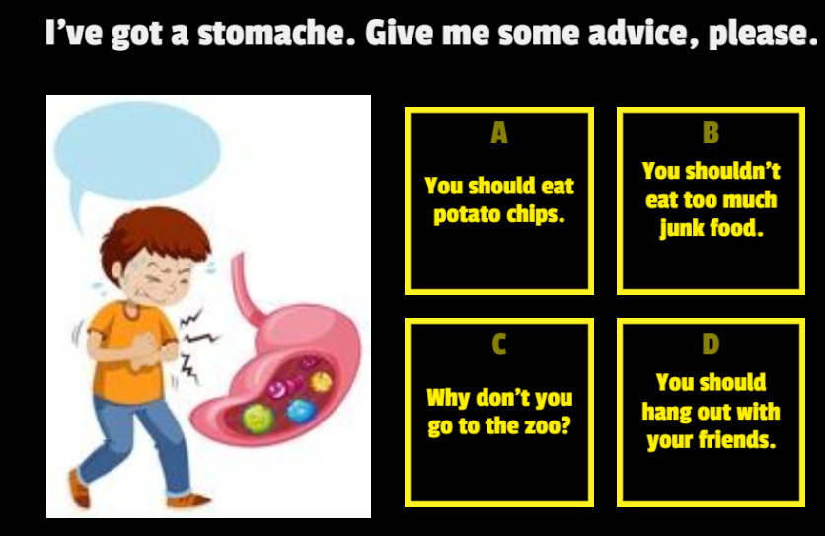

Warm up
GIVING ADVICE

Slide 5
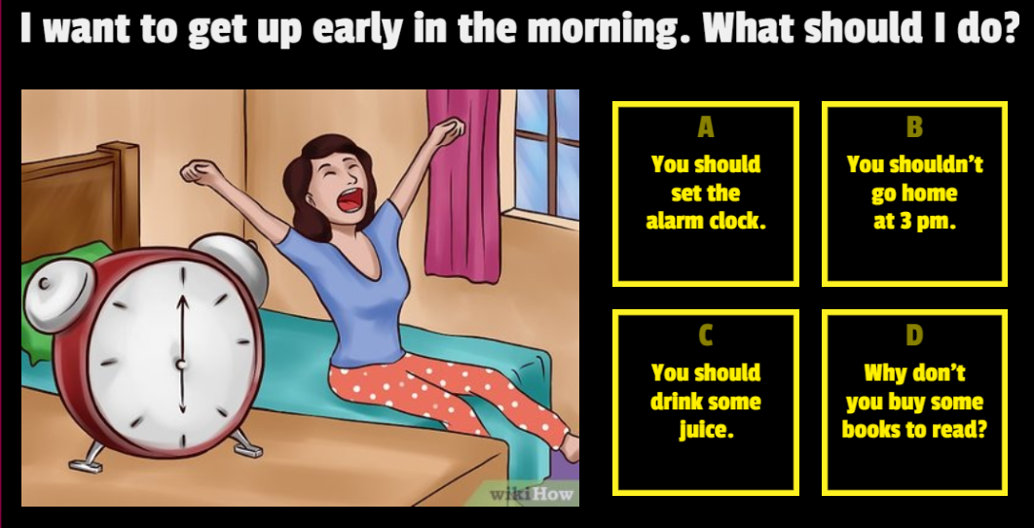

Warm up
GIVING ADVICE

Slide 6
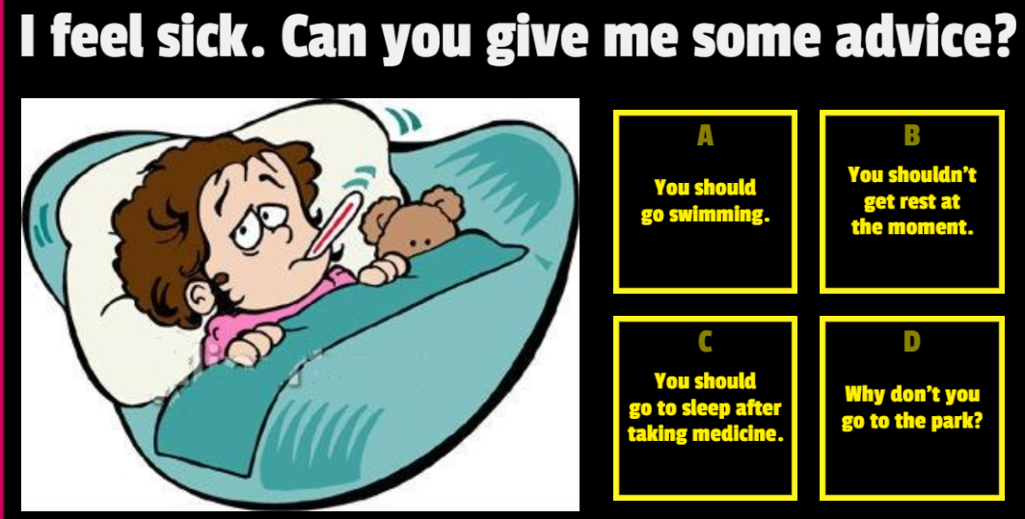

Warm up
GIVING ADVICE

Slide 7
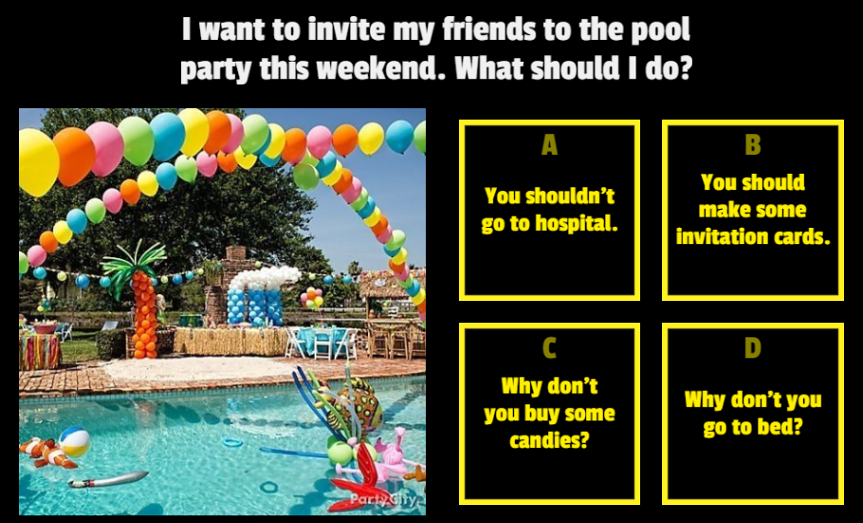

Warm up
GIVING ADVICE

Slide 8
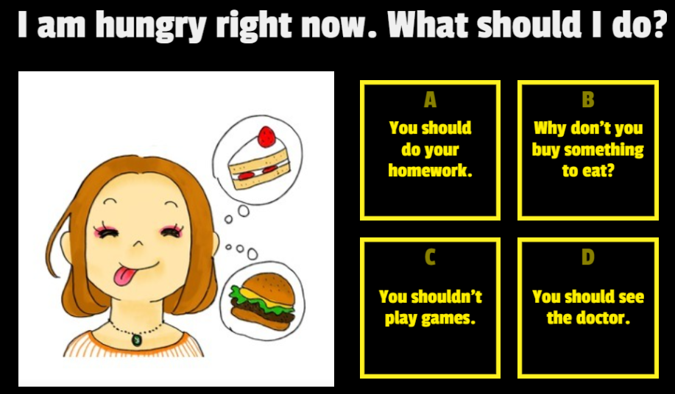

Warm up
GIVING ADVICE

Slide 9
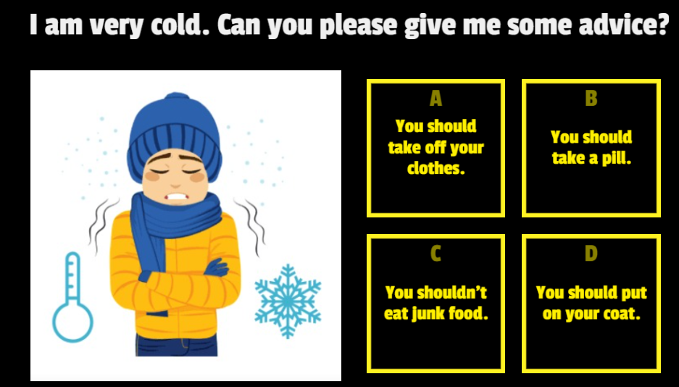

Warm up
GIVING ADVICE

Slide 10
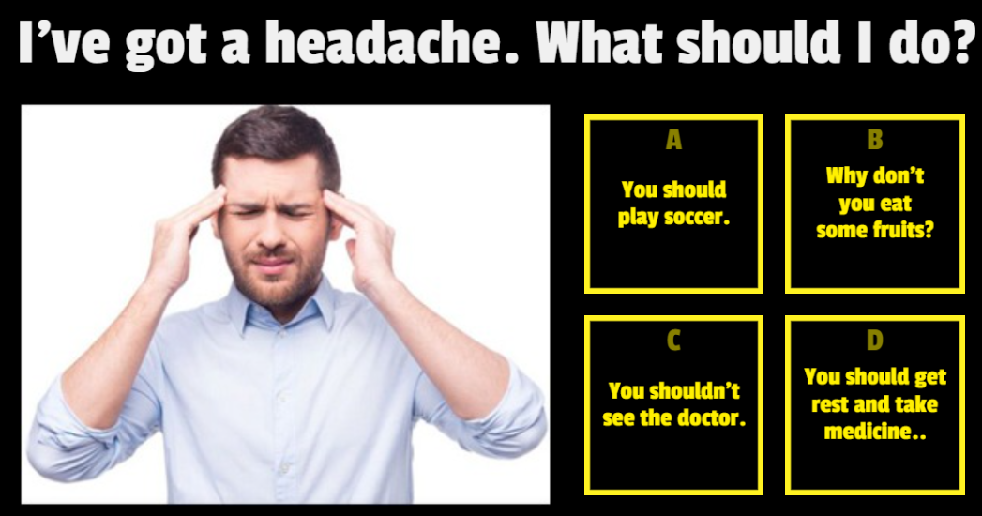

Warm up
GIVING ADVICE

Slide 11
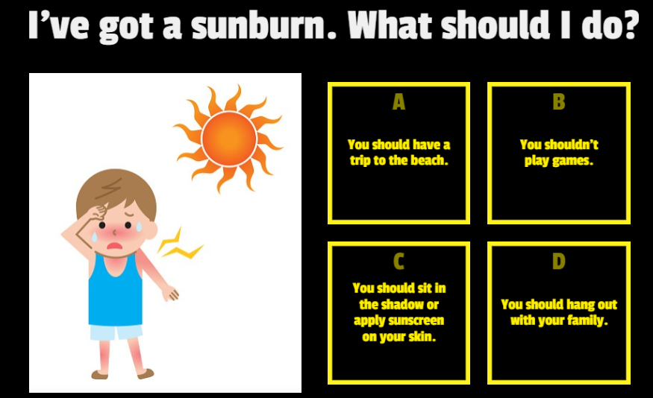

Warm up
GIVING ADVICE

Slide 12






MOST RESPECTED JOBS IN VIETNAM?
PILOT
TEACHER
DOCTOR
ARTIST
SINGER
FIREFIGHTER

Slide 13


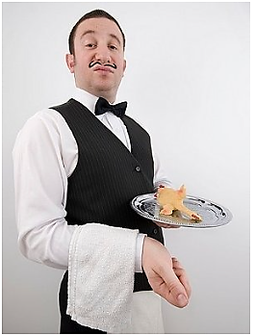
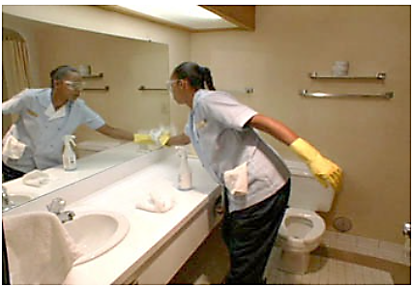





MOST COMMON PART-TIME JOBS
content creator/live streamer
shipper
cashier/teller

Slide 14
brainstorming
ROLE-PLAY: GET A PART-TIME JOB
Reasons for having a part-time job | Reasons for not having a part-time job
Money to pay for tuition fee Chance to meet different people Learn new skills Know how to behave in different situations Learn more knowledge that can’t learn at school, etc. | Not enough time for study Unsuitable jobs Bad bosses/managers/ colleagues Low pay Dangers at work/ on the way Etc.

Slide 15
Brainstorming: tips on balancing work-study
ROLE-PLAY: GET A PART-TIME JOB
Keep an updated schedule/ set time-table
Prioritize your work
Try to study everyday
Do homework/review lesson right after class
Get enough sleep
Etc.

Slide 16


ROLE-PLAY: GET A PART-TIME JOB
What should I do?
YOU SHOULD/HAD BETER
+ DO/ NOT DO

Slide 17
Modelling
ROLE-PLAY: GET A PART-TIME JOB
A: I want to get a part-time job but I’m not sure if it’s a wise decision.
B: Why do you want to have a part-time job?
A: Because I want to have money to pay for the tuition fee.
B: Uhm, but I think you’d better focus on studying while you are still at school.
A: Yeah, I know, but having a part-time job can bring me chance to meet different people
B: You should think carefully because …. (REASONS FOR NOT HAVING PART-TIME JOB)
A: You’re right. But I think ….. (GIVE YOUR REASON(S FOR A PART-TIME JOB)

Slide 18
LET’S MATCH
What’s your name? | I’m good at marketing, Microsoft Office. I’m punctual, ….
Where are you from? | I’ve graduated 2 years ago from ULIS.
What are your strengths? | I’m an experienced one so I want my salary would be from … to...
What do you consider your weaknesses? | I come from Hanoi.
When did you graduate from school? | I need to improve my English skills to get IELTS band 8.
How do you want your salary be? | I used to work as a sale staff at ….
Do you have any experience for this job? | I’m Susan.

Slide 19
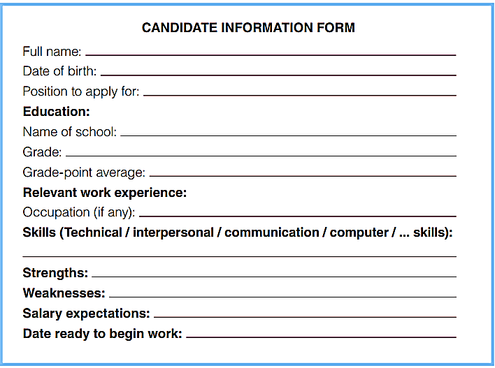
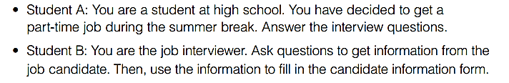
Communication

Slide 20


