Slide 1
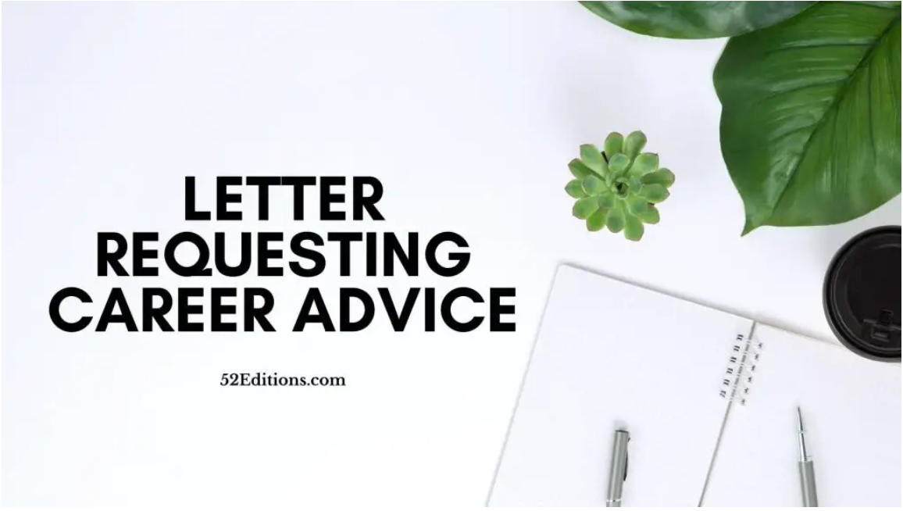
r
Writing
Useful Language
For formal letters
UNIT 11 - CAREERS

Slide 2
Warm-up -Arranging Letter
I am a(n) (1)________ graduate specializing in social media marketing. I have significant experience with tour companies and hotels, and have developed my design and (2) _________ skills through these marketing projects. At the moment, I am a marketing freelancer. I work in a team managing many e-commerce websites for companies.
Recently, I have gotten an offer from ABC Models, a Vietnamese model management and training company. Being a marketing manager for this company is very appealing to me. However, I have very little (7) _________ knowledge in modeling and fashion. I am afraid that my limited knowledge in the (8) _________ may cause difficulties in performing my job. Could you suggest some of the fastest ways to learn about this field?
I am looking forward to hearing from you.
Sincerely yours,
Trang
Dear Sir/Madam,
I’m writing this letter to ask for your advice
I’m (3)_________ in finding a(n) (4) _________ position as a social media (5) _________ where I can use my creativity to develop (6) _________ ways of using social media for the company’s growth.

Slide 3
Greeting
Qualifications/ Skills/ Experience
Dear Sir/Madam,
I’m writing this letter to ask for your advice
Reason for writing
I am a(n) (1)________ graduate specializing in social media marketing. I have significant experience with tour companies and hotels, and have developed my design and (2) _________ skills through these marketing projects. At the moment, I am a marketing freelancer. I work in a team managing many e-commerce websites for companies.
Job position you are interested in
I’m (3)_________ in finding a(n) (4) _________ position as a social media (5) _________ where I can use my creativity to develop (6) _________ ways of using social media for the company’s growth.
Recently, I have gotten an offer from ABC Models, a Vietnamese model management and training company. Being a marketing manager for this company is very appealing to me. However, I have very little (7) _________ knowledge in modeling and fashion. I am afraid that my limited knowledge in the (8) _________ may cause difficulties in performing my job. Could you suggest some of the fastest ways to learn about this field?
Kind of information you need from the career advice agency
I am looking forward to hearing from you.
Sincerely yours,
Trang
Closing
Salutation
Signature

Slide 4
Formal or informal?
 | Informal | Formal
Greeting | Dear + first name | Dear Sir or Madam, Dear Mr/ Mrs + last name,
Opening | I hope this letter finds you well. | NO friendly greeting
Contractions | I'm, didn't | I am, did not
Questions | Do you remember...? Why don't you...? | Avoid direct questions Use: I would like
Linking | Well, Anyway, so, and | However, Consequently, and, also
Closing | Hope to see you soon. + First name | I await your prompt response. Yours faithfully, + full name

Slide 5
REASONS FOR WRITING
I am writing in connection with…
I am writing with regard to…
I am writing in reply/ response to your letter/ email...
I am writing to apply for the position of….
I am writing to thank you for…

Slide 6
ASKING FOR INFORMATION
Could you give me some information about…..
I am writing to ask whether/if…
I would like to know….
I am interested in receiving….

Slide 7
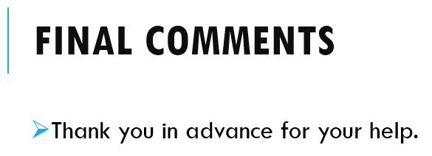
REQUESTS
I would be grateful if you could…
I wonder if you could…?
Do you think I could have…?

Slide 8
CLOSING
I look forward to your reply
I am looking forward to…..
I would be grateful if you could reply as soon as possible
Salutation
Best regards,
Sincerely yours,
Your faithfully,

Slide 9
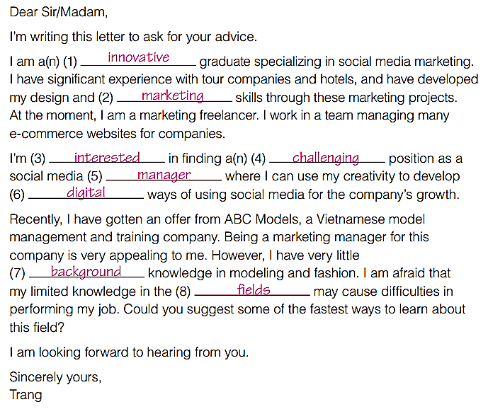
Complete the letter with the words in the box
challenging
digital
fields
innovative
interested
background
manager
marketing

Slide 10
Brainstorming
What qualifications, training, and experience do you have?
What other skills do you have?
What full-time or part-time job are you interested in?

Slide 11


