Slide 1
grammar
UNIT 11 - CAREERS

Slide 2
What advice can you give to Marcy?
prepare herself with certificates and degrees as well as soft skills
Macy should …….
Use should to give advice
Should + V_Inf.
Had better + V_Inf.
Maybe/perhaps/I think + should/had better

Slide 3
What advice can you give to Marcy?
prepare herself with certificates and degrees as well as soft skills
Macy should …….
Examples:
Should + V_Inf. => something is/isn’t a good idea to do
You should choose a career that fits your personality.
You shouldn’t apply for an office job if you don’t like to be inside all day.

Slide 4
What advice can you give to Marcy?
prepare herself with certificates and degrees as well as soft skills
Macy should …….
Had better + V_Inf. => something bad could happen if the advice isn’t followed.
You had better prepare well for your interview.
He’d better practice his English before he goes.
Maybe/perhaps/I think + should/had better => make the advice sounds gentler and friendlier
Maybe you should become a healthcare worker.

Slide 5
F. Complete each sentence with an advice modal
1. You ___________ listen to your boss!
2. Juan ___________ finish the course so he can get his degree.
3. The employees _____________ leave early when the boss isn't there.
4. Perhaps you _____________ look for a job as an assistant first.
5. Martha _____________ do the training program if she’s not interested in the job.
should
must
shouldn’t
shouldn’t
shouldn’t

Slide 6
G. Complete the sentences in pairs. Use your own ideas.
Career Advice
If you want to become a successful business owner, you should _____________, but you shouldn't ______________
If you want to get a degree, you had better ______________
You should ______________ if you want to get some work experience. Good luck!

Slide 7
Suggested answer
If you want to become a successful business owner, you should have a clear business plan and focus on building a strong customer base, but you shouldn't overlook the importance of financial management and risk assessment.
If you want to get a degree, you had better start planning early and choose a field that aligns with your interests and career goals. However, you shouldn't rely solely on your degree to guarantee success, and should also gain practical experience through internships and extracurricular activities.
You should consider doing an internship or volunteering if you want to get some work experience. Good luck! This can help you gain valuable skills and make connections in your desired industry. However, you shouldn't expect immediate financial gain and should be willing to invest your time and effort in learning and growing.

Slide 8
H – Pair work
Read one of the problems out loud to a partner.
Your partner will give you friendly advice using 'maybe', 'perhaps', or 'I think'.
1. I don’t know what career to choose.
2. I don’t have any experience.
3. I want to get a better job.
4. My job doesn't pay very well.
5. My job application was rejected.
6. I need an assistant to help me at work.

Slide 9
Suggested answer
I don’t know what career to choose
Partner: What's the problem that you'd like me to give advice on?
Me: I'm not sure what career to choose.
Partner: Maybe you can start by identifying your strengths and interests, and researching careers that align with them. Perhaps you can also talk to people who work in those fields and gain insights into the day-to-day work and job prospects. I think it's important to take your time to explore your options and make an informed decision.

Slide 10
Suggested answer my job doesn’t pay very well
Partner: What's the problem that you'd like me to give advice on?
Me: My job doesn't pay very well.
Partner: Perhaps you can consider negotiating a raise with your employer, highlighting your contributions and value to the company. Maybe you can also look for other job opportunities that offer better compensation and benefits. I think it's important to not settle for a job that doesn't adequately compensate you for your time and efforts.

Slide 11
Suggested answer
I need an assistant to help me at work
Partner: What's the problem that you'd like me to give advice on?
Me: I need an assistant to help me at work.
Partner: Maybe you can first make a list of all the tasks that you need help with and the qualifications required for the assistant. Perhaps you can then advertise the job opening through online job portals or social media channels, and conduct interviews to find a suitable candidate. I think it's important to clearly communicate the job responsibilities and expectations to the assistant, and provide proper training and support to ensure their success in the role.

Slide 12
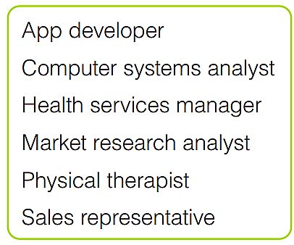
Goal check
Look at the careers in the box. What training, experience, and other qualifications are needed for each career? Choose three and write notes.
In pairs, discuss each career.
Would you choose any of these careers? Why?

Slide 13


