Slide 1
listening
UNIT 11 - CAREERS

Slide 2
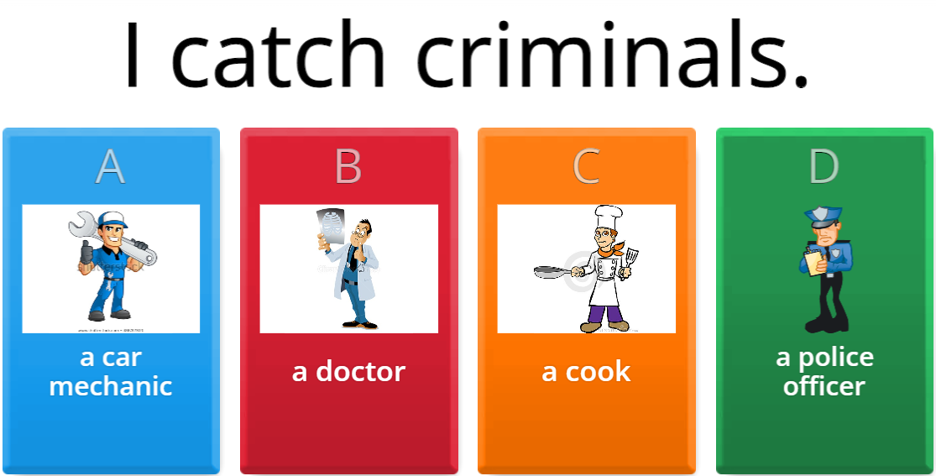
Warm-up
√

Slide 3
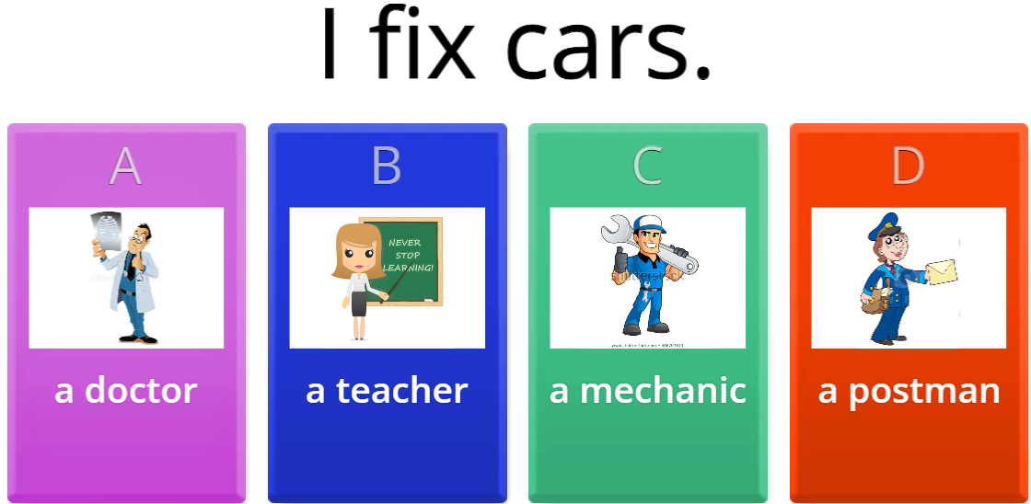
Warm-up
√

Slide 4
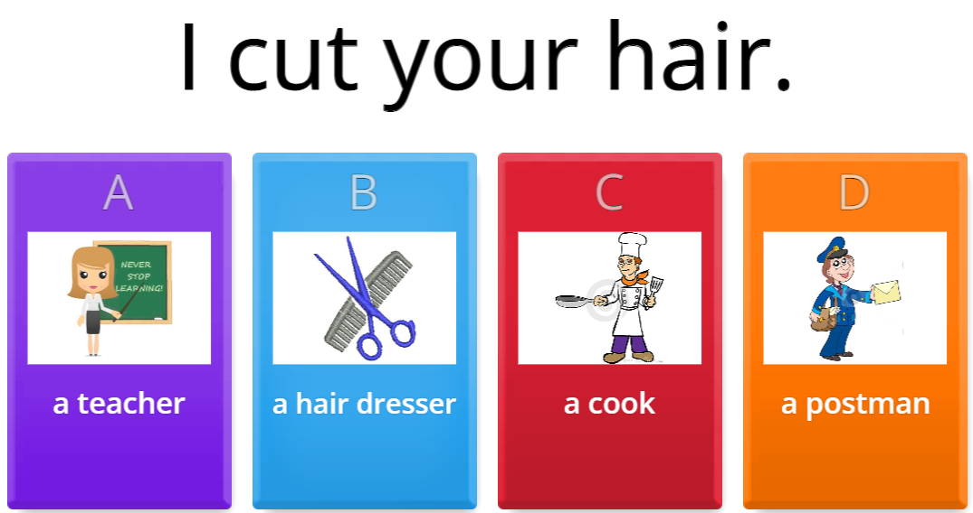
Warm-up
√

Slide 5
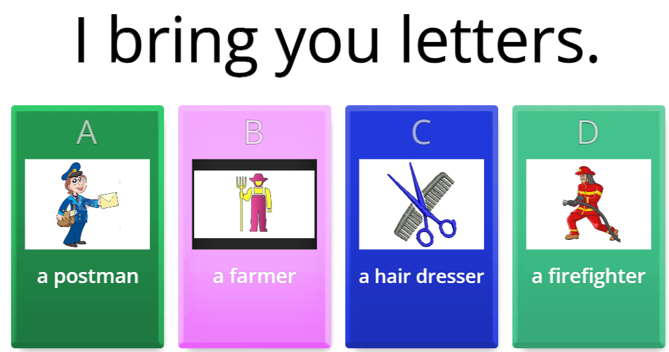
Warm-up
√

Slide 6
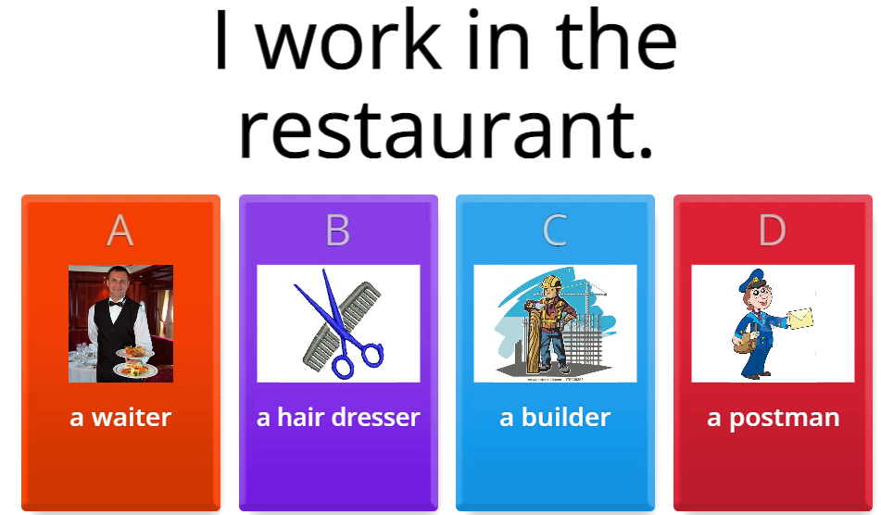
Warm-up
√

Slide 7
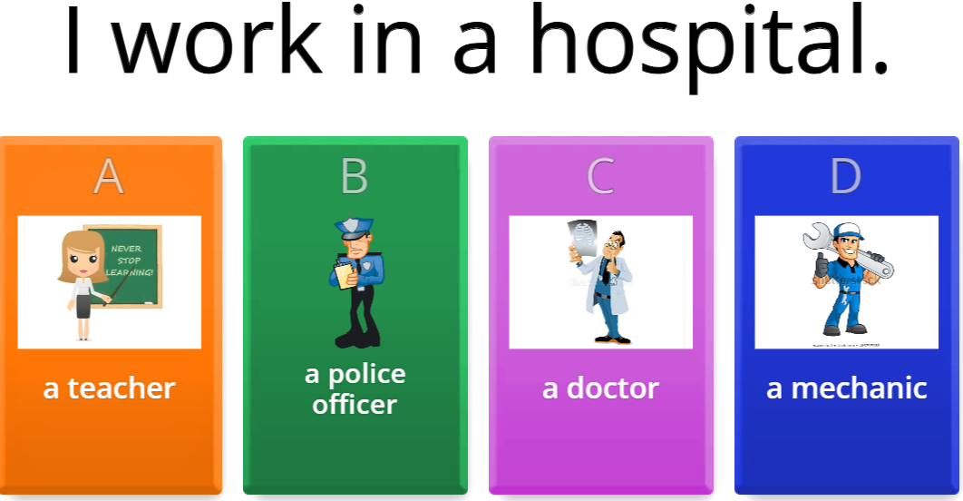
Warm-up
√

Slide 8
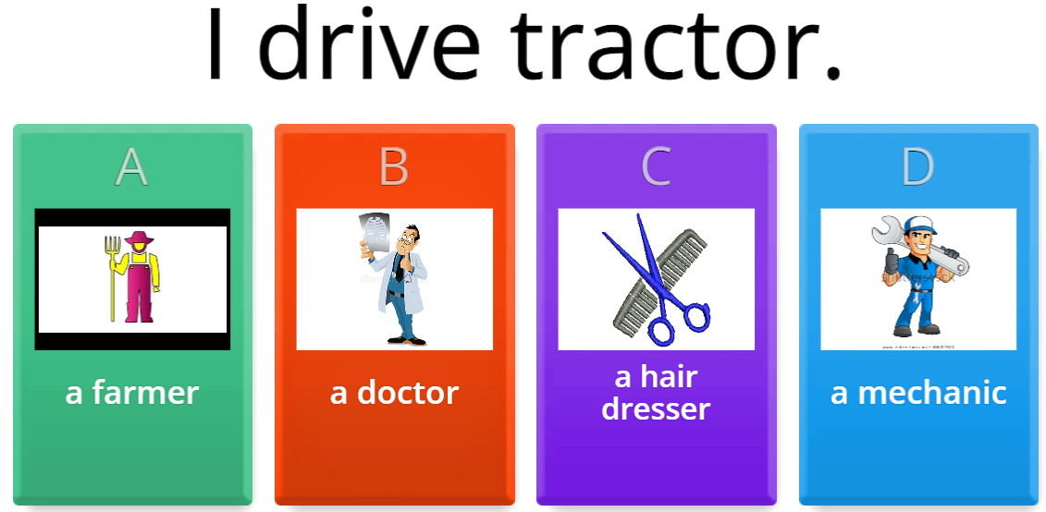
Warm-up
√

Slide 9

Warm-up
√

Slide 10
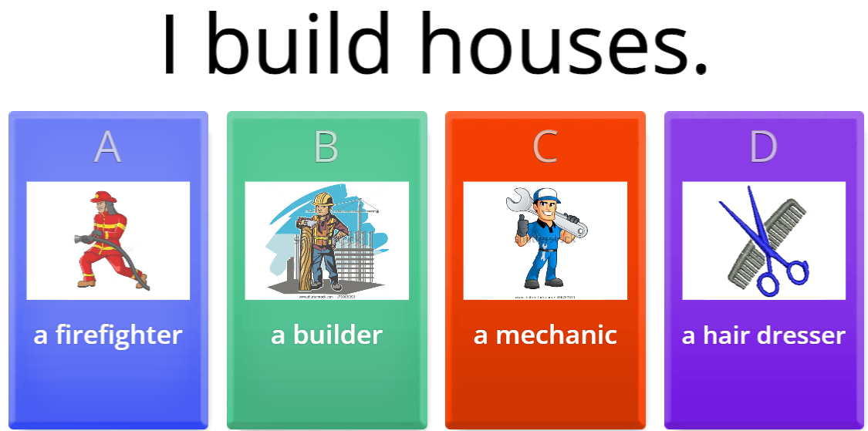
Warm-up
√

Slide 11
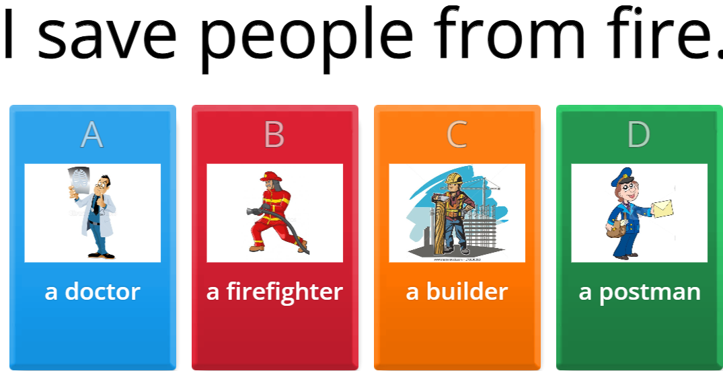
Warm-up
√

Slide 12

Warm-up

Slide 13
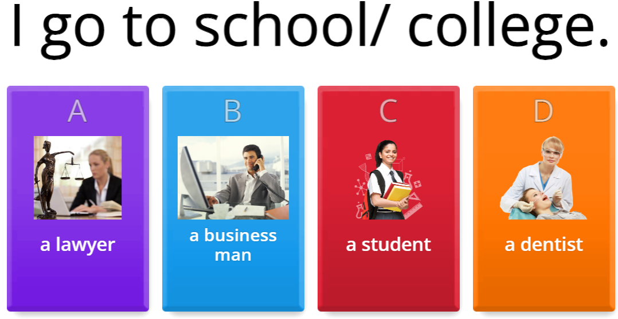
Warm-up
√

Slide 14
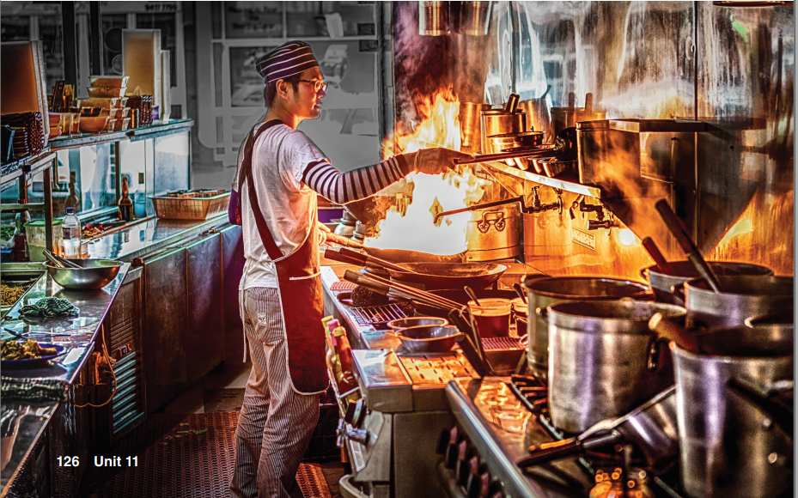
Have you eaten Thai food before?
Is Thai food popular in your country?

Slide 15

a – Listen to an interview
Listen to an interview with a restaurant owner.
Why did he start his own business?
He wanted to be his own boss.
He’s the boss/ He’s the owner.

Slide 16
B - Listen again and answer the Questions
1. When did Mr. Sangumram open the New Thailand restaurant?
2. Who is the cook at the restaurant?
3. What kind of food is served at the restaurant?
4. How far from the owner's home is the restaurant?
5. How many employees work at the restaurant?
6. What does Mr. Sangumram's wife do for a living?
1998
his nephew
native Thai dishes
It is downstairs
Four, besides his nephew
She is a sales representative for a drug company

Slide 17
C. What makes a good job?
Rank the following from 1 (most important) to 6 (least important).
Share your answers in pairs.
_____ amount of vacation time
_____ wage or salary level
_____ working alone or with others
_____ distance from home
_____ long-term employment
_____ interesting job duties

Slide 18
C. What makes a good job?
Suggested answers:
_____ amount of vacation time
_____ wage or salary level
_____ working alone or with others
_____ distance from home
_____ long-term employment
_____ interesting job duties
4
2
3
5
6
1

Slide 19
D. MY WORLD
What is your dream job?
Why do you want to do that job?

Slide 20
D. MY WORLD
Become a teacher is my dream job.
I want to become a teacher for several reasons:
Passion for education: Many individuals have a deep love of learning and a desire to share their knowledge and enthusiasm for a subject with others.
Making a difference: Teaching provides an opportunity to positively impact the lives of students, help them reach their full potential, and contribute to society.
Sense of purpose: The profession can provide a sense of purpose and meaning, as teachers have the opportunity to help shape the minds of future generations.
Personal growth: Teaching can be a challenging and rewarding profession that allows individuals to continually learn and grow in their field.
Job security: Education is a necessary and essential field, so teaching provides a stable and secure career path.
Creativity: Teachers have the autonomy to design and implement their own lesson plans and teaching methods, allowing for creative expression and innovation.
Work-life balance: Teaching can offer a balance between work and personal life, as many educators have summers and holidays off, along with flexible schedules.

Slide 21


