Slide 1
Pronunciation
& Communication
UNIT 11 - CAREERS

Slide 2
Warm-up: Tongue twisters
Green glass globes glow greenly.
A flea and a fly flew up in a flue.
I scream, you scream, we all scream for ice cream!
She sells seashells by the seashore.
Peter Piper picked a peck of pickled peppers. How many pickled peppers did Peter Piper pick?
I thought a thought. But the thought I thought wasn’t the thought I thought I thought. If the thought I thought I thought had been the thought I thought, I wouldn’t have thought I thought.

Slide 3
Warm-up: Tongue twisters
If practice makes perfect and perfect needs practice, I’m perfectly practiced and practically perfect.
If you must cross a course cross cow across a crowded cow crossing, cross the cross coarse cow across the crowded cow crossing carefully.
Susie works in a shoeshine shop. Where she shines, she sits, and where she sits, she shines.
Betty bought butter but the butter was bitter, so Betty bought better butter to make the bitter butter better.

Slide 4
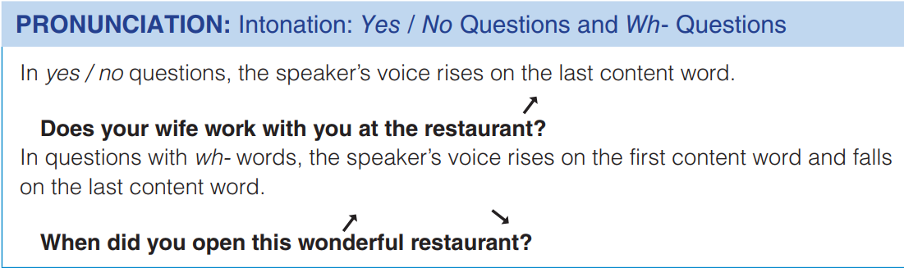

Slide 5

E. Listen and repeat, then ask & answer
1. What do Mr. Sangumram's children do?
2. Does his wife work at the restaurant?
3. What does his nephew do?
4. Does the restaurant serve Chinese food?
5. Where do Mr. and Mrs. Sangumram live?
6. Does Mr. Sangumram enjoy his job?
They have their own careers.
No, she doesn’t.
He is the cook.
No. It serves Thai food.
They live upstairs.
Yes, he does.

Slide 6
Communication
When you are looking for a job, what do you want to know?
Write a question for each one.
What I want to know about: | Questions I can ask:
Salary
Training opportunities
Vacation time
Travel opportunities
Hours
What is the starting salary?
Do you give training courses?
How much vacation time is there?
Are there any opportunities to travel?
How many hours a week is the job?

Slide 7
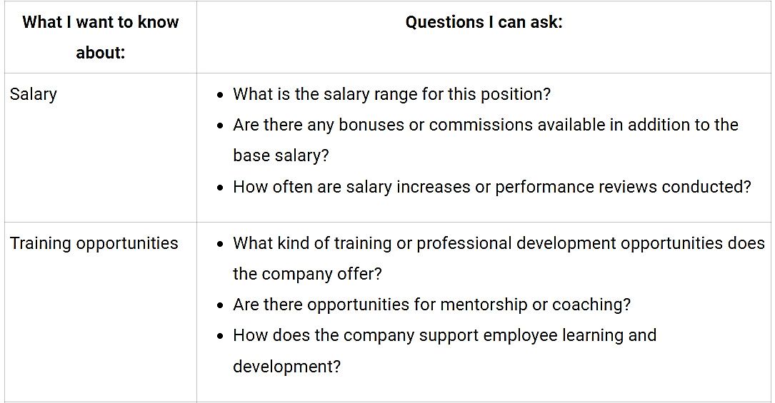
Suggested answers

Slide 8
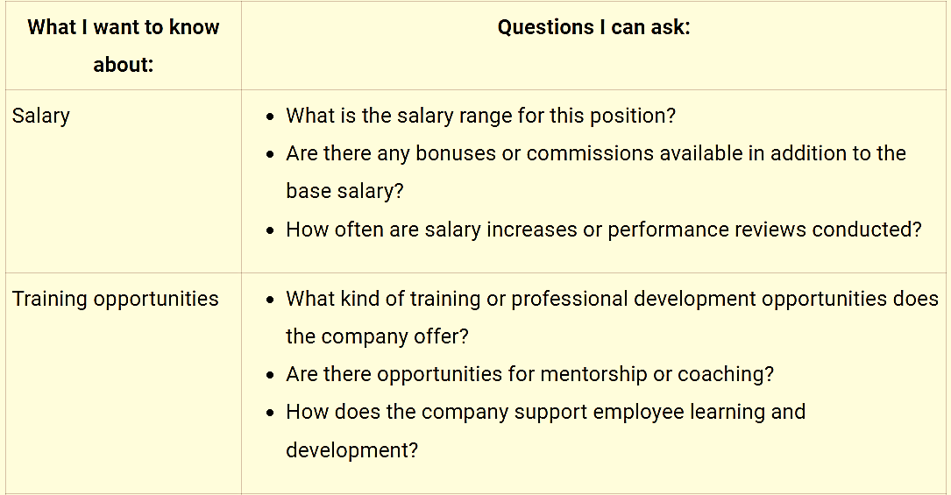
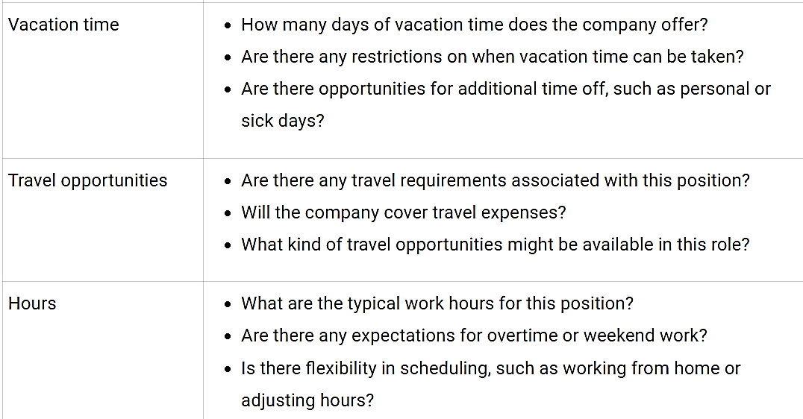
Suggested answers

Slide 9
G choose a job and explain why
Diving Instructor
Understands and teaches the use of scuba equipment.
Works outdoors.
Should be a strong swimmer.
Salary is paid by season.
Commercial Pilot
Knows about airplane mechanics, weather, and radio communication.
Works long hours.
Often works far away from home.
Market Research Analyst
Should be interested in psychology and behavior.
Works under pressure.
Should have strong organizational and communication skills.

Slide 10
Suggested answers
Diving Instructor
Understands and teaches the use of scuba equipment.
Works outdoors.
Should be a strong swimmer.
Salary is paid by season.
I would choose the job of a Diving Instructor because I have always been fascinated by the underwater world and love to swim.
Teaching others how to scuba dive and explore the ocean would be an exciting and rewarding experience.
Also, the opportunity to work outdoors and be surrounded by nature is very appealing to me. While the salary is paid by season, the chance to share my passion for scuba diving with others and help them discover the beauty of the ocean would be very fulfilling.

Slide 11
Suggested answers
I would choose the job of a Commercial Pilot because I have always been interested in aviation and the science behind it.
As a pilot, I would have the opportunity to travel to different places and experience different cultures.
The job also requires knowledge about airplane mechanics, weather, and radio communication, which I find fascinating.
Although the hours can be long and the job may require being away from home for extended periods, the chance to fly a plane and be responsible for the safety of passengers and crew would be a great honor and responsibility.
Overall, the idea of being a pilot and exploring the world from a bird's-eye view is very exciting to me.
Commercial Pilot
Knows about airplane mechanics, weather, and radio communication.
Works long hours.
Often works far away from home.

Slide 12
Suggested answers
I would choose the job of a Market Research Analyst because I have a strong interest in human behavior and psychology, and I enjoy analyzing data and drawing insights from it.
As a Market Research Analyst, I would be able to help companies understand their customers better and make informed decisions about their products and services.
Additionally, the job requires strong organizational and communication skills, which I believe are some of my strengths.
While the job can be stressful at times, the challenge of working under pressure and finding solutions to complex problems is something that I find motivating.
Market Research Analyst
Should be interested in psychology and behavior.
Works under pressure.
Should have strong organizational and communication skills.xx`

Slide 13
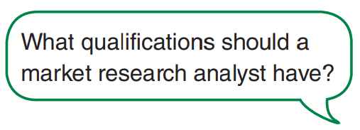
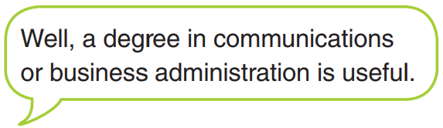
Goal check
Join another pair
Ask and answer each other's questions in F about the different jobs.

Slide 14


