Slide 1
reading
UNIT 11 - CAREERS

Slide 2
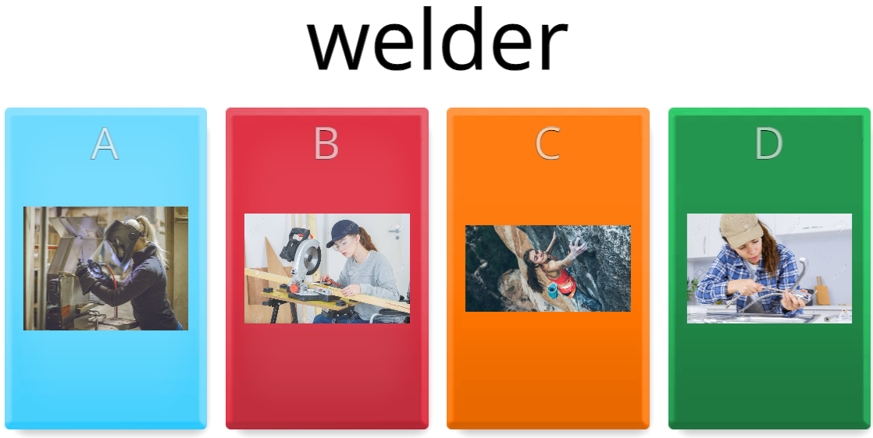
warm-up
√

Slide 3
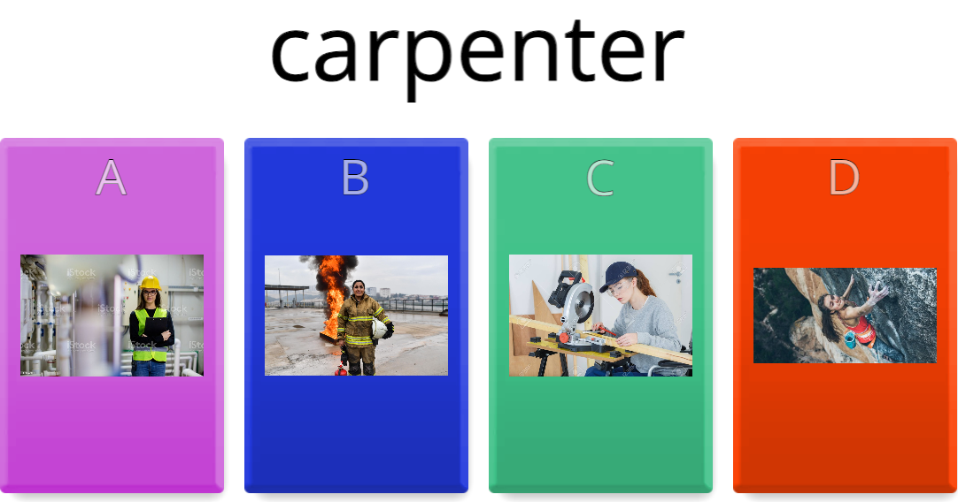
warm-up
√

Slide 4
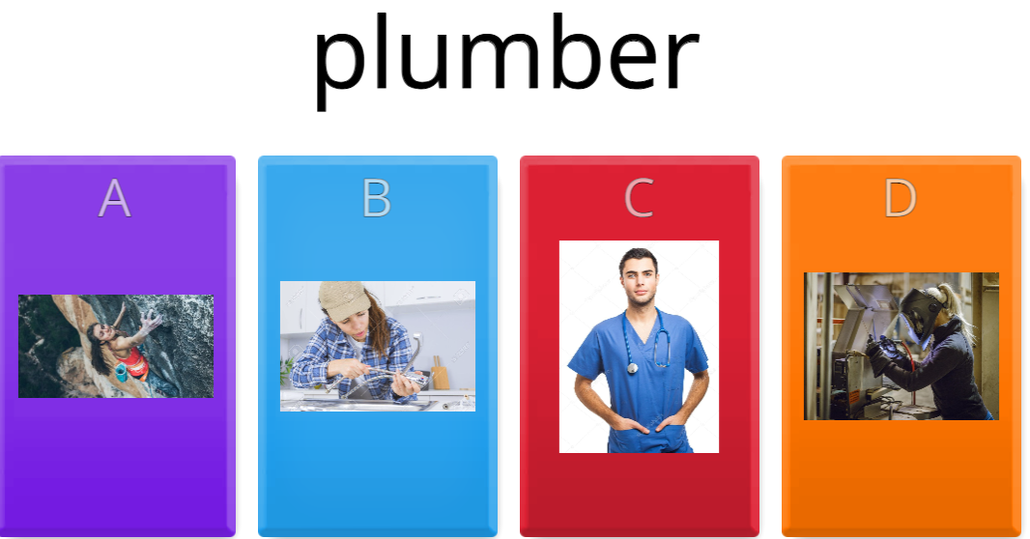
warm-up
√

Slide 5
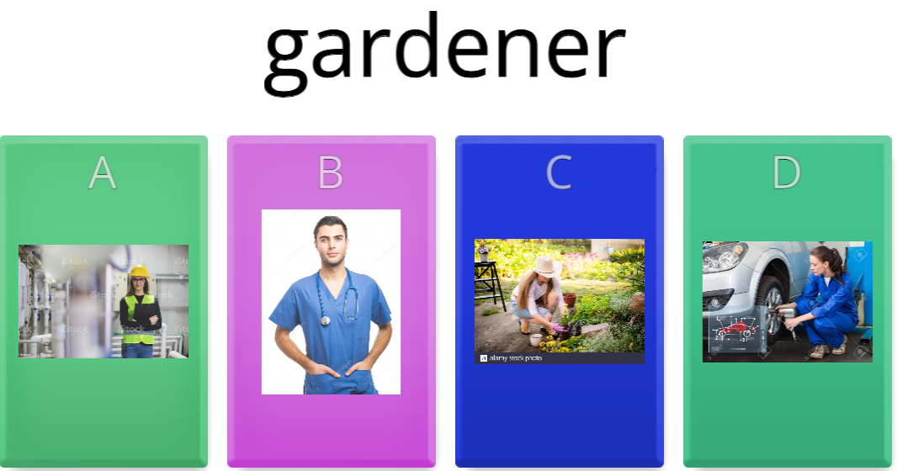
warm-up
√

Slide 6
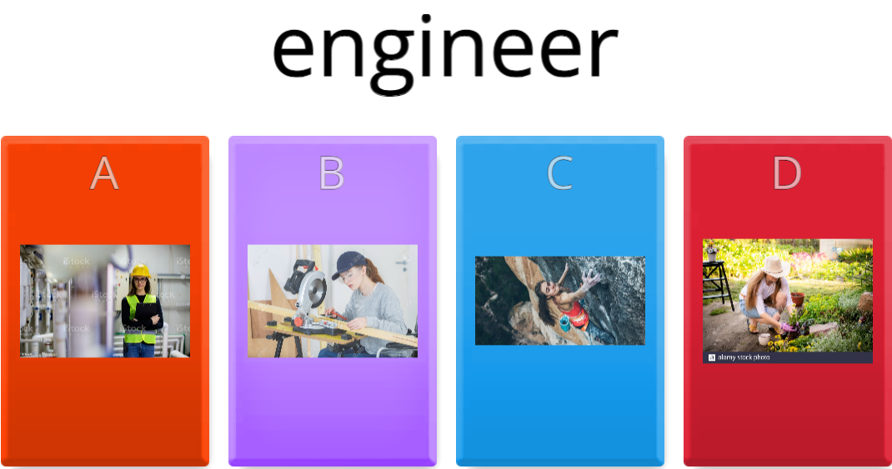
warm-up
√

Slide 7
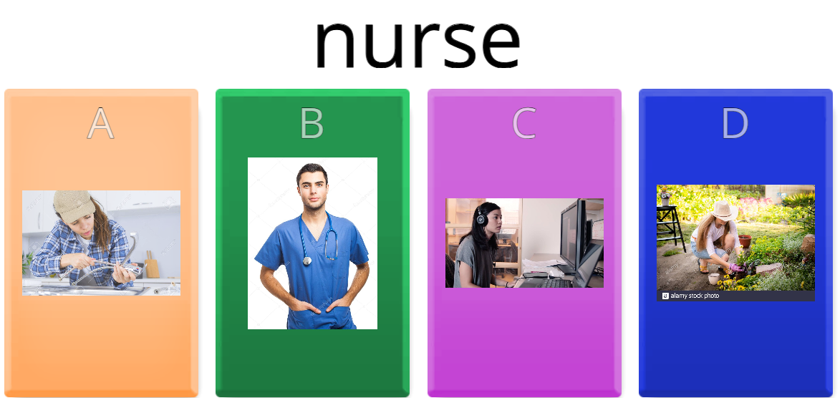
warm-up
√

Slide 8
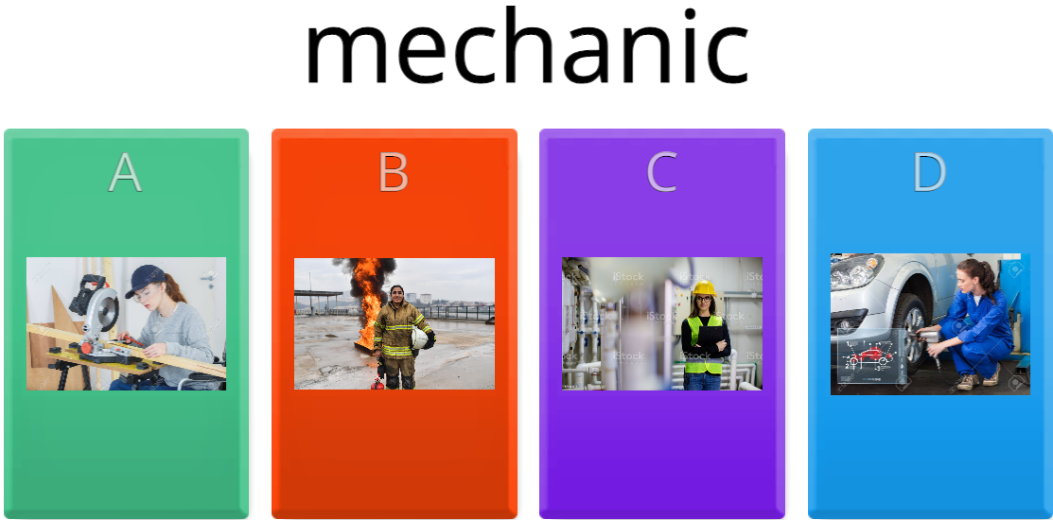
warm-up
√

Slide 9

warm-up
√

Slide 10
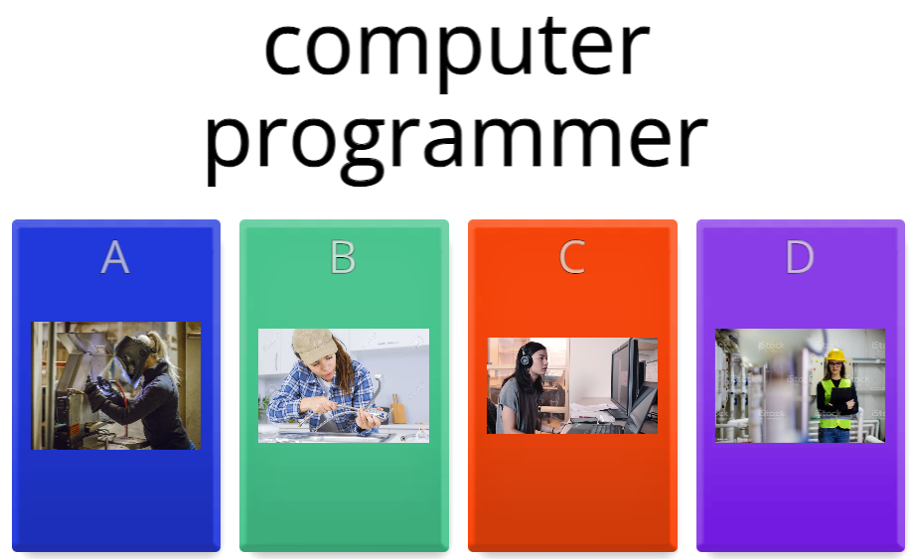
warm-up
√

Slide 11
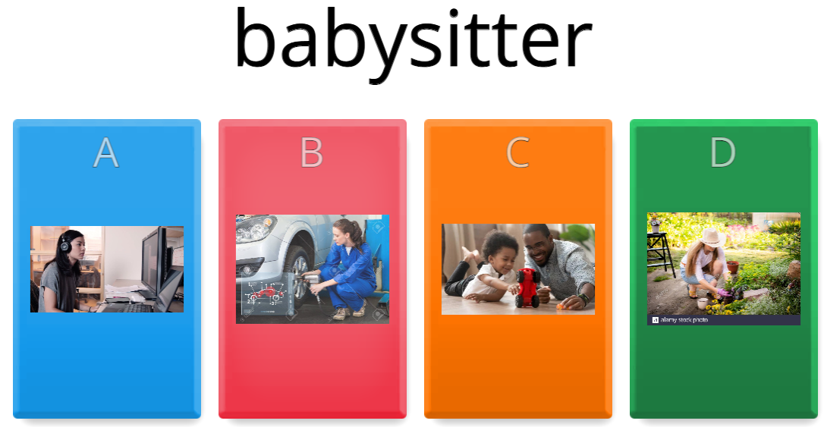
warm-up
√

Slide 12
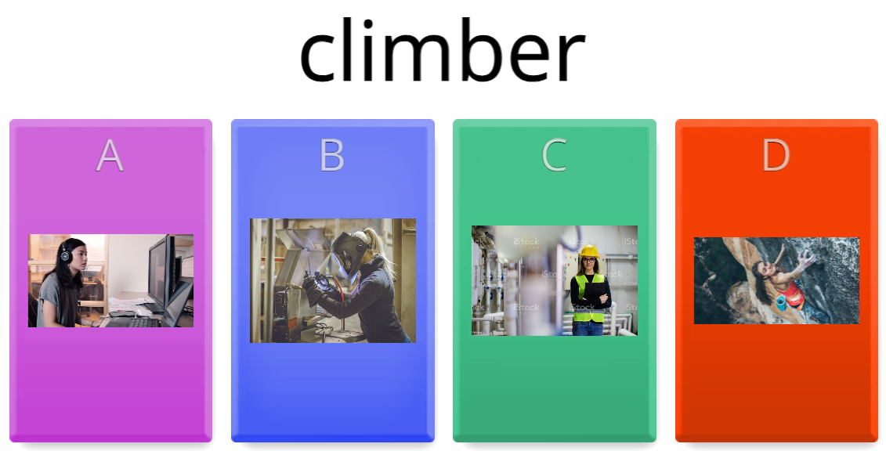
warm-up
√

Slide 13
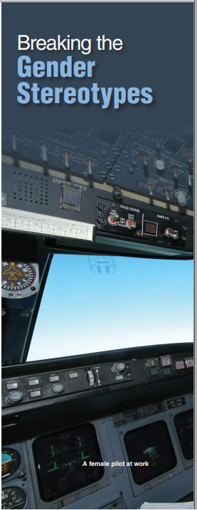
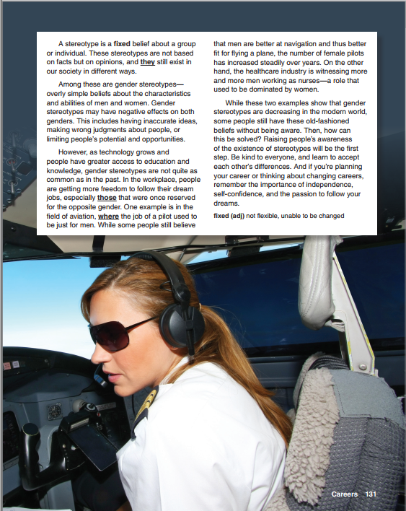
What jobs do people usually expect women to do on an airplane?
What skills and knowledge does she need for this job?
What qualifications, training, and experience do you think she might have?
Would you like this job? Why or why not?
A female pilot at work

Slide 14
About the Photo
This photo shows a female pilot at work. According to statistics, as of 2023, the number of female pilots accounts for approximately one-third (29.3%) of the total pilots in the US.
There was a gender pay gap for pilot as well. Female pilots on the whole earned less than their male counterparts (only 83% of what male pilots earned in 2021).

Slide 15

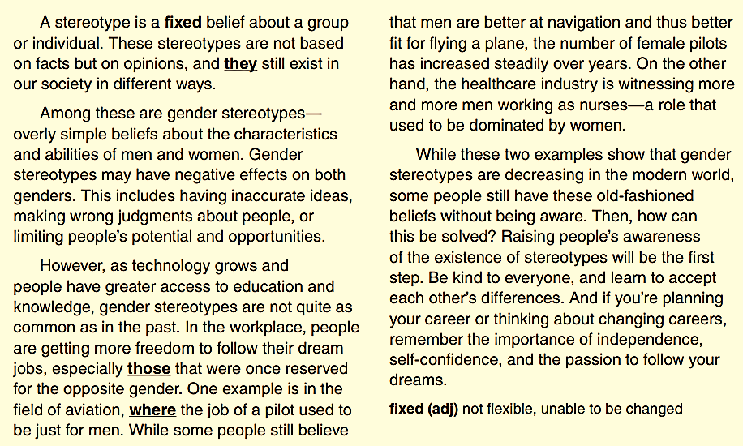
Breaking the Gender Stereotypes

Slide 16
vocabulary
stereotype (n) /ˈsteriətaɪp/ khuôn mẫu
job duty (n): nhiệm vụ/nghĩa vụ trong công việc
fixed (adj) sẵn có, cố định
navigation (n) (sự) định hướng, điều khiển
witness (v) chứng kiến
dominate (v) thống trị
independence (n): sự độc lập, tự do
self-confidence (n) sự tự tin

Slide 17
A. some examples of stereotypes
Women are not good at math.
Men are not emotional and don't cry.
Asians are good at math and science.
Black people are good at sports.
LGBTQ+ individuals are promiscuous.
Older people are not capable of learning new things.
Middle Eastern people are terrorists.
Women are not fit for leadership roles.
Men are the sole breadwinners of the family.
People with disabilities are helpless and dependent on others.

Slide 18
b. skim to find main idea
a. Job duties are changing the world's values.
b. The decrease in gender stereotypes gives people more job opportunities.
c. New gender stereotypes should be developed to suit new careers.
d. Independence and confidence are important in a career choice.

Slide 19
C. Read the article. Complete the ideas.
Gender stereotypes may negatively affect _____________________________________________
Gender stereotypes are becoming less ____________________________
As old limitations and stereotypes in many careers no longer exist, people are free to ____________________________
More and more ________ are joining the healthcare industry as nurses.
both genders / both men and women
common
follow their dream jobs
men

Slide 20
D. Read the article. What do these words refer to?
they (paragraph 1)
those (paragraph 3)
where (paragraph 3)
stereotypes
jobs
(the field of) aviation

Slide 21

Goal check
Choose a career from the box and answer the questions. Write notes.
What do you think this career involves?
What specific skills would you need?
What are the common gender stereotypes in these careers?
Share your ideas in groups.

Slide 22
1. What do you think this career involves?
Web developer
Web developers design, create, and maintain websites.
They use programming languages such as HTML, CSS, and JavaScript to build and develop websites that are both user-friendly and visually appealing.

Slide 23
2. What specific skills would you need?
Web developer
A web developer would need a strong understanding of programming languages, design principles, and problem-solving skills.
They should also be able to work well in a team and be able to communicate effectively.

Slide 24
3. What are the common gender stereotypes in these careers?
Web developer
In the past, web development was often considered a male-dominated field, leading to the stereotype that women are not interested or capable of coding or developing websites.
However, this stereotype is changing, and more and more women are entering the field.

Slide 25


