Slide 1
Unit 1: food for life
Period 2: The Simple Present vs. The Present Continuous; Stative Verbs

Slide 2
Warm-up
MIMING
Rule
Pick up a verb and try to act out. The audience should guess what he/she is doing.
Climb the mountain
Drink water
Carry a cell phone
Cook a meal

Slide 3
Simple present and present continuous
What are the differences between the two sentences
1. I drink 2 liters of water every day.
2. Now, I am drinking coffee

Slide 4
Simple present and present continuous

Slide 5
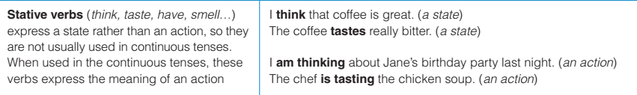
Simple present and present continuous
Stative verbs
He looks clean
He is looking at the sky.
A stative verb

Slide 6
Practice
Exercise C: Discuss the statements below in pairs. Which things does the speaker usually do (U)? Which is the speaker doing now (N)? And which statement describes a state (S)
N
a. I am eating an apple.
b. I eat breakfast at 9.
c. I often buy fruits at the grocery store.
d. I am making coffee for you.
e. The apples look fresh.
f. I am looking at the apples on the shelf.
U
U
N
S
N

Slide 7
Practice
Exercise D: Complete each sentence with the simple present or present continuous form of the verb.
1. My mother and I ………..…. (prepare) a meal together every afternoon.
2. Right now, my mother and I …………… (make) a dish called enchiladas.
3. I really like enchiladas. Sometimes I …………….. (have) them for breakfast!
4. We …………… (enjoy) at least one meal together every day.
5. Please call later. We …………….. (have) dinner now.
6. The kids …………………. (look) at the worm on the leaf.
7. Wow, the dishes ………………… (taste) incredible
prepare
are making
have
enjoy
are having
are looking
taste

Slide 8

Production
Activity E: Work in pair to talk about
- What you usually eat for breakfast or lunch
I usually have ……… for breakfast.
I never eat …………………..
01
00
59
58
57
56
55
54
53
52
51
50
49
48
47
46
45
44
43
42
41
40
39
38
37
36
35
34
33
32
31
30
29
28
27
26
25
24
23
22
21
20
19
18
17
16
15
14
13
12
11
10
09
08
07
06
05
04
03
02
01
00

Slide 9
Production
Activity E: Work in pair to talk about
Three activities which your friends are doing now
Lan is talking to Hoa now.
01
00
59
58
57
56
55
54
53
52
51
50
49
48
47
46
45
44
43
42
41
40
39
38
37
36
35
34
33
32
31
30
29
28
27
26
25
24
23
22
21
20
19
18
17
16
15
14
13
12
11
10
09
08
07
06
05
04
03
02
01
00

Slide 10
Production
Activity F: Interview and report
“How often do you ….?”
Carry a cellphone Climb a mountain Eat fruit for breakfast Eat lunch in a cafeteria | Check your email Practice English grammar Talk with a classmate Try new foods Wear athletic shoes

Slide 11
WRAP-UP
Grammar practice https://www.liveworksheets.com/bv1700jq

