Slide 1
Unit 1: food for life
Class period 4:
Communication and pronunciation

Slide 2
Warm up
Food quiz
Rule:
There are 5 questions about special foods in Vietnam. Students play individually interactively in class. The two best students will be the winners.
https://quizizz.com/admin/quiz/5f2ab6d1a9ec85001d0c474a?source=quiz_share

Slide 3
communication
List some of the foods that grow well in your part of the world. They can be crops or seafood.

Slide 4
communication
Work in group of 4
Read the clue cards and look up new words
Build complete sentences
Do not tell your group what dish you are going to table

Slide 5
communication
Pho The most famous Vietnamese dish. Ingredients: a broth, rice noodles, and slices of beef or chicken. Other ingredients: sprouts, lime, herbs, and chili Taste special and delicious | Banh Mi Vietnamese sandwich Ingredients: baguette, grilled pork, pate, pickled vegetables, cilantro, and chili. a popular choice for a quick and satisfying meal.
Bun Cha Ingredients: Grilled pork patties and slices of pork belly, rice noodles, fresh herbs, and a sauce. A sauce: fish sauce, sugar, garlic, and other spices before being grilled, giving it a smoky and savory taste. | Banh Chung Traditional Vietnamese rice cake During the Lunar New Year, also known as Tet in Vietnam. Ingredients: Glutinous rice, mung beans, and pork. boiled for several hours until the rice becomes soft and sticky.

Slide 6
communication
GAME: GUESS WHAT?
Take turns to describe your dish / food.
Ask other members to guess your dishes.
Those who guess the most will be the winner.
5 minutes

Slide 7
communication
Describe your favorite dish or regional food.
Name of the dish
Ingredients
Why you like it
In class

Slide 8
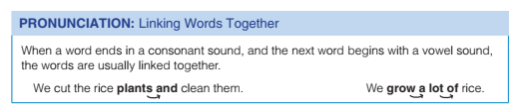
pronunciation

Slide 9

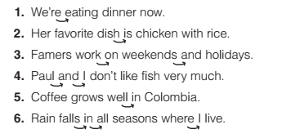
pronunciation
Exercise F: Link sounds

Slide 10
WRAP-UP
Record your talk about favorite regional food
Keep practicing linking sounds

