Slide 1
Unit 1: food for life
Class period 6: Reading

Slide 2
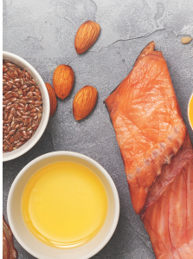
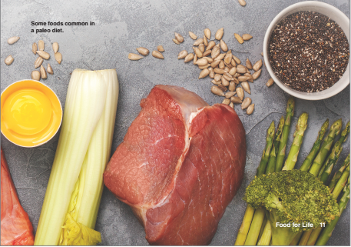
Warm-up
Picture description

Slide 3
Warm-up
Picture description
The photo shows (in order from left to right) flax seeds, olive oil, almonds, fish, sunflower seeds, egg, celery, meat, asparagus, broccoli, and chia seeds.

Slide 4
Warm-up
Discussion
Which foods in the photo do you usually eat?”
Are these healthy foods? Why?
Processed foods?
unprocessed foods?

Slide 5

Warm-up
Discussion
Read the title and the first sentence of each paragraph.
Which of these popular diets is / are mentioned in the article?
Paleo diet

Slide 6
vocabulary
Experience | to have something happen to you
Health problems | any health condition that affects the physical or mental well-being
Diet | food and drinks consumed by an individual (follow a diet)
A solution to | A way to deal with a problem
Dairy food | products that are derived from the milk of mammals
Legume | A kind of plant
Peanut | an oval-shaped seed of a plant,
Beans | a seed, or the pod containing seeds, eaten as a vegetable
Ancestors | parents, grandparents, and other people who lived before you
Truth | facts, not things that are imagined or invented

Slide 7
Vocabulary checking
tap the board

Slide 8
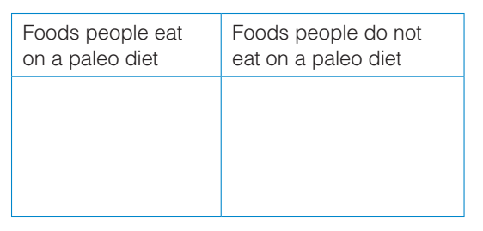

Reading exercises
Exercise C: Read the article. Write examples of different foods in the correct columns

Slide 9
Reading exercises
Exercise D: Read the question at the end of the first paragraph. Match each answer below with the correct person. There is one extra answer
Question: Could the food we eat be causing some of these problems?
X
1. Maybe, because there are many choices at the supermarket
b
2. No, because not eating certain kinds of food isn’t healthy or natural.
a
3. Yes, because not eating foods from farmers is more natural
a. A person who is following a paleo diet
b. Dr. Peter Ungar

Slide 10
Goal check
Exercise C: Read the article. Write examples of different foods in the correct columns
breakfast
lunch
What do you often eat for …?
Which of your food is ok for paleo diet?
dinner
Snack
Work in groups

Slide 11
WRAP-UP
Review vocabulary from reading text
Talk about your diet. Is it healthy or unhealthy?

