Slide 1
UNIT 2: EXPRESS YOURSELF
Class period 10: Grammar

Slide 2

How long have we known each other?
Warm-up
When did you first meet me in our class?

Slide 3
Today, we will learn to distinguish these two tenses.

Slide 4
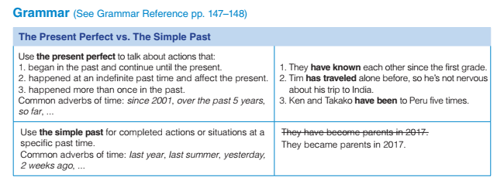
Grammar

Slide 5
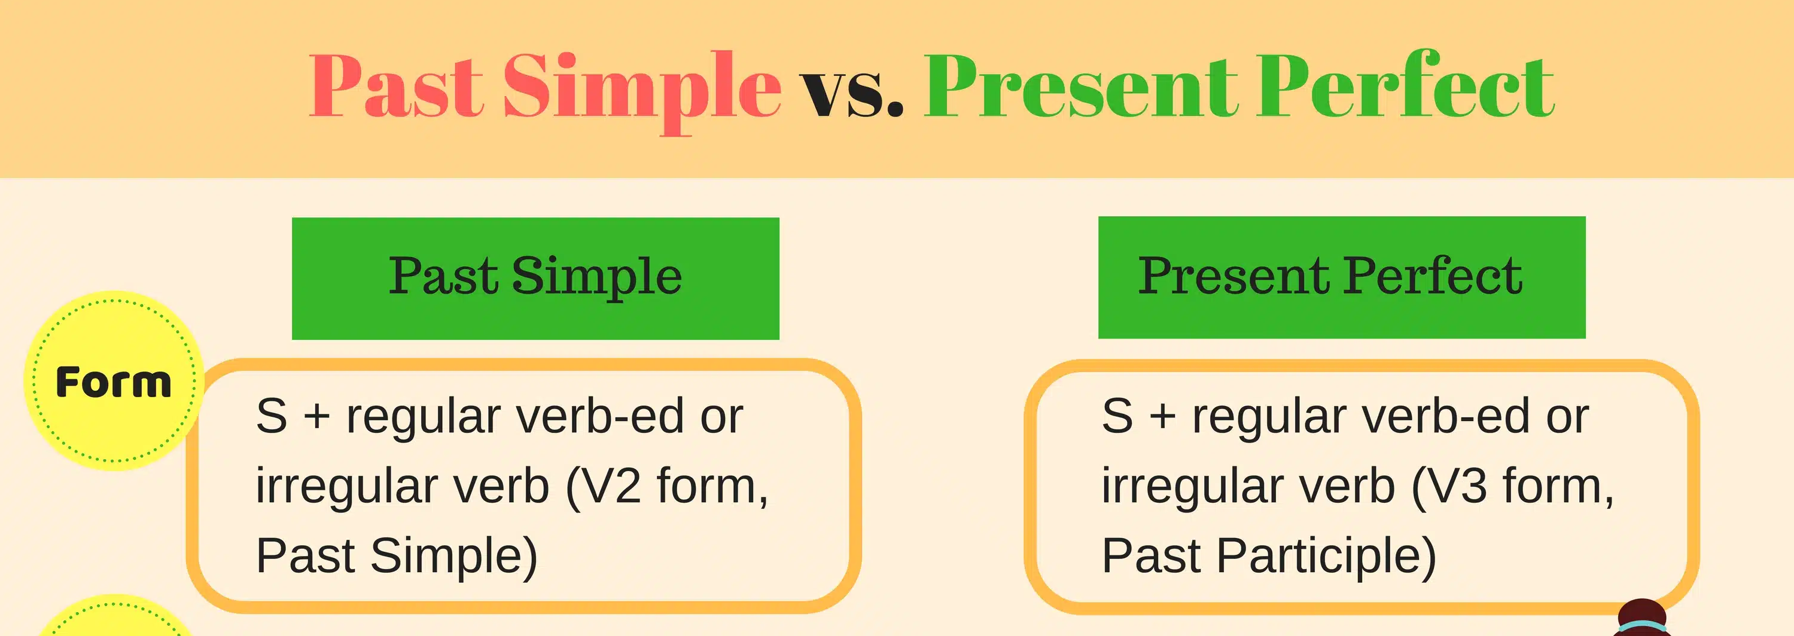
Grammar

Slide 6
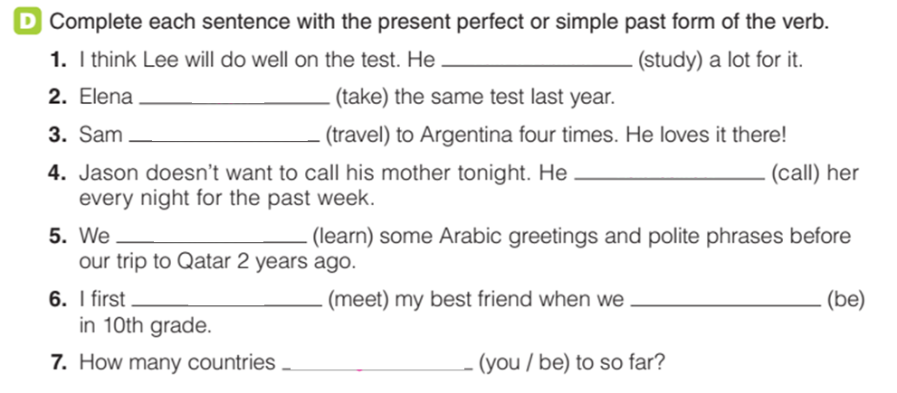







Grammar

Slide 7
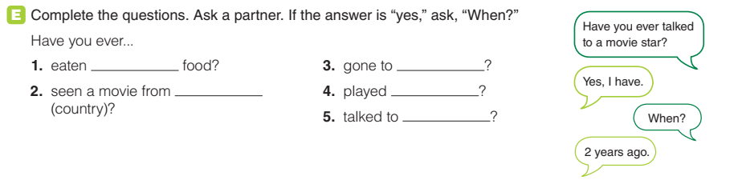
Grammar

Slide 8
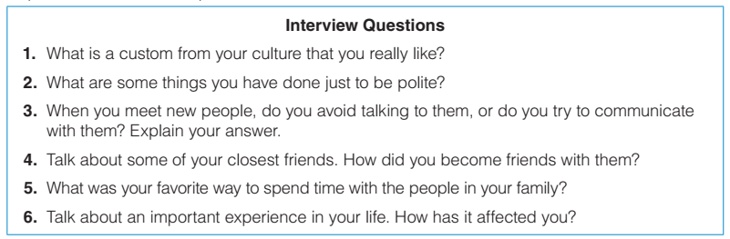
Interview
Go around the classroom to find partners for an interview

Slide 9
Exercise A: reading the text
Look at the photo and answer some questions: What are they doing? What are they telling us about themselves? Do you usually take selfies?

Slide 10
Homework
Complete the grammar exercise
https://www.liveworksheets.com/w/en/english-second-language-esl/2116124

Slide 11


