Slide 1
UNIT 2: EXPRESS YOURSELF
Class period 11: LISTENING

Slide 2

Rules: When music is on, pass the ball. When music is off, those who are holding the ball will stand up and answer
Think of a classmate and kinds of things you talked about when you first met
Warm-up
GAME: MUSIC BALL

Slide 3
Today, we will learn to listen about first time meeting
When you first meet someone, what are you going to talk about?

Slide 4
Vocabulary
Website design
Take a class
Apartment:
Apartment building:
Neighborhood:
Thiết kế trang web
Tham gia lớp học
Căn hộ
Chung cư
Hàng xóm

Slide 5

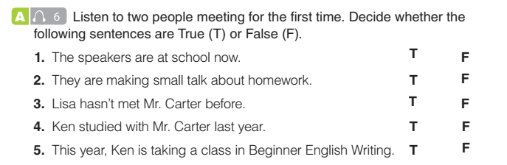
Listening exercise A
Listen to two people meeting for the first time. Decide whether the following sentences are True (T) or False (F)

Slide 6
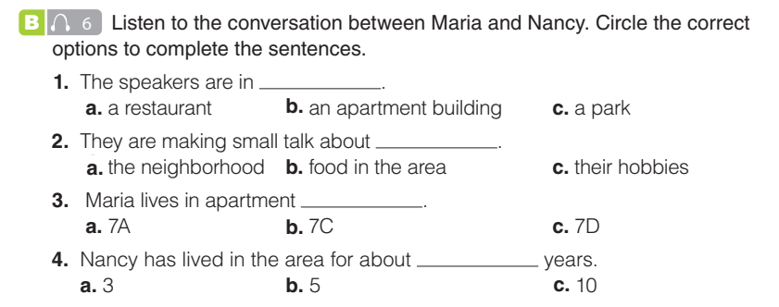
Listening exercise B

Slide 7
Role play
Conversation 1
Ken: Hi, my name is Ken Tanaka.
Lisa: It’s nice to meet you. I’m Lisa Ortiz.
Ken: Nice to meet you, too, Lisa. So... are you studying English here?
Lisa: No, not this term. I’m taking a computer class.
Ken: Really? Which class are you taking?
Lisa: I’m taking the website design class. The teacher’s name is Mr. Carter. I haven’t met him yet, though.
Ken: I’ve heard that he’s a great teacher. One of my friends took his class last year and she really enjoyed his lessons.
Lisa: That’s good! It’s a difficult subject, but it’s really interesting. What about you? What are you studying?
Ken: Well, this term I’m taking Advanced English Writing.
Lisa: Wow! That sounds difficult, too!

Slide 8
Role play
Conversation 2
Nancy: Hi. Are you the new neighbor?
Maria: Yes, I am. My name is Maria Andrews. I’m in apartment 7C.
Nancy: Nice to meet you, Maria. I’m Nancy Chun. I live in 7A.
Maria: Nice to meet you, too. So, have you lived here long?
Nancy: Oh, about ten years.
Maria: Wow! I guess you really like this part of the city!
Nancy: It’s a great place to live. There are lots of stores, and the park is so relaxing.
Maria: Are there any good restaurants near here?
Nancy: Sure! What kind of food do you like?

Slide 9


