Slide 1

UNIT 3: CITIES
Class period 17: Unit opener and vocabulary

Slide 2
Warm up
Name famous cities around the world

Slide 3
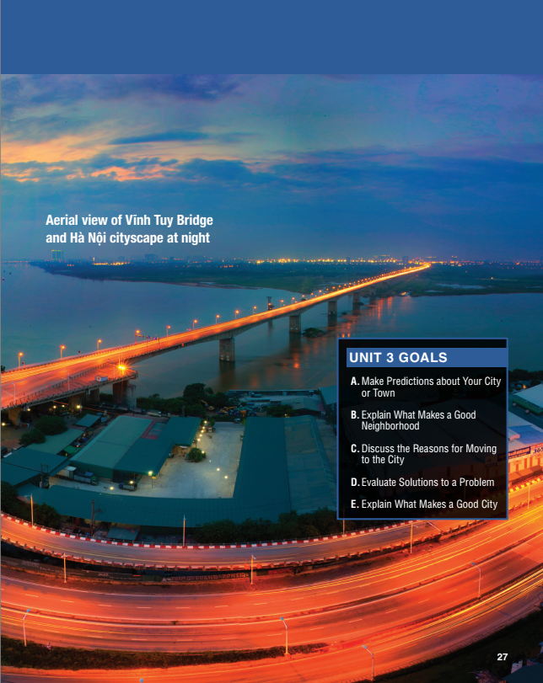
Warm up
This photo shows the Vĩnh Tuy Bridge across the Red River in Hà Nội, Việt Nam. The bridge was officially inaugurated in 2009 as one of the commemorative projects of the Millennial Anniversary of Hà Nội and became the country’s widest bridge at the time (19.2 m). It is an important transportation network of Hà Nội, connecting Hai Bà Trưng and Long Biên districts across the Red River

Slide 4
Warm up
Discuss the questions in pairs
1. Is it important that a city be beautiful?
2. Does your city have landmarks like bridges and rivers?
Lead in: In Vietnam, our cities are changing constantly. Let’s find out more about it.

Slide 5
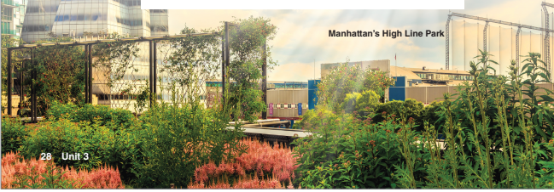
discussion
Let’s read a text to find down
What changes should be made in big cities?

Slide 6
vocabulary
Apartments building:
Make sense:
Rooftop:
Traffic light:
Pedestrian:
Neighborhood:
Public transportation:
Chung cư
Hiểu
Tầng thượng
Đèn giao thông
Người đi bộ
hàng xóm, khu vực xung quanh
Giao thông công cộng

Slide 7
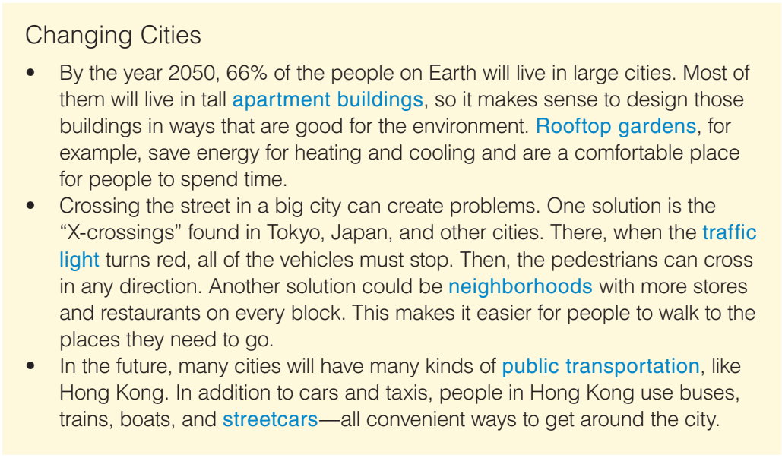
Reading
Read the article and answer “What changes are described?”
More buildings that are good for the environment with gardens on top of them,
Safer pedestrian crossings
More shops and restaurants nearby
More public transportation

Slide 8
VOCABULARY
Look at to the words in blue and identify the parts of speech
Compound nouns

Slide 9
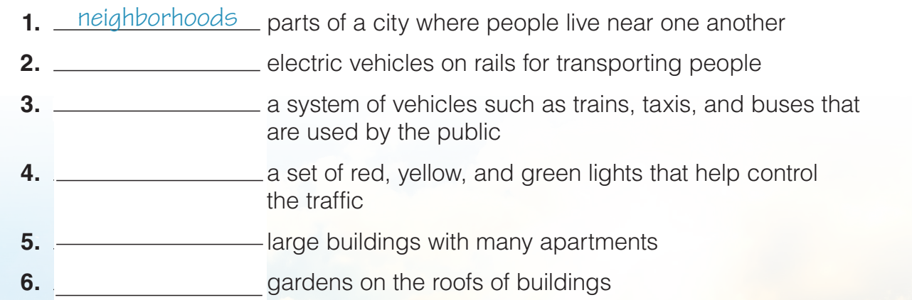
VOCABULARY
Exercise B: Write each word in blue next to the correct meaning
Street cars
Public transportation
Traffic light
Apartment buildings
Rooftop gardens

Slide 10
Reading
Reading comprehension
1. What percentage of the world's population is projected to live in large cities by the year 2050?
a) 66% b) 33% c) 50% d) 75%
2. How can rooftop gardens benefit tall apartment buildings?
a) They provide an ideal place for people to spend time.
b) They save energy for heating and cooling.
c) Both A and B
d) None of the above

Slide 11
Reading
Reading comprehension
3. What is the purpose of "X-crossings" in big cities like Tokyo?
a) To create problems for pedestrians
b) To allow pedestrians to cross in any direction when the traffic light turns red
c) To encourage more vehicles to stop at red lights
d) None of the above

Slide 12
Reading
Reading comprehension
4. How can neighborhoods with more stores and restaurants on every block improve city life?
a) It makes it easier for people to walk to the places they need to go.
b) It decreases the need for public transportation.
c) It increases traffic congestion in the streets.
d) None of the above
5. What are some forms of public transportation not mentioned in the passage
a) Cars and taxis
b) Buses, trains, boats
c) Ferries
d) Streetcars

Slide 13
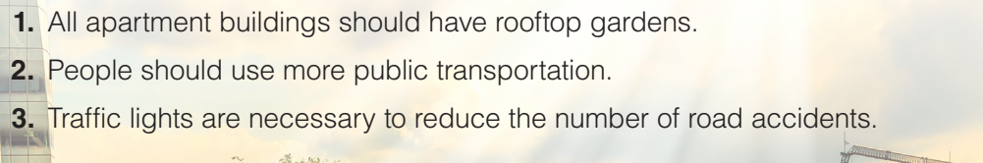
Reading
Exercise C: You agree or disagree with the following statements? Discuss in pairs
Example: Why should people use more public transport? - It is cheaper than driving a car. - It helps reduce traffic congestion. - It reduces air pollution.

Slide 14
HOMEWORK
Learn new words in the lesson Choose 5 words to make complete sentences

