Slide 1

UNIT 3: CITIES
Class period 18: Grammar

Slide 2
brainstorm
Dream

Slide 3
Warm up
Make complete sentences using will
I will ………………

Slide 4
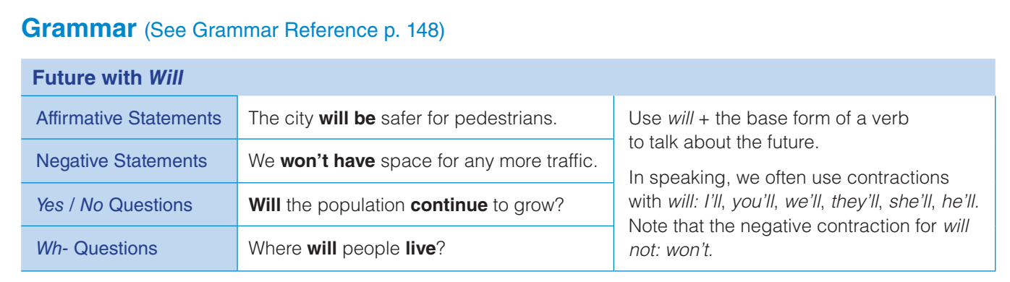
grammar

Slide 5
Grammar
Look at the text on page 28
What year is the text talking about? Is it now or in the future?
By the year 2050
have gardens on top of them
Buildings will ……………………..

Slide 6
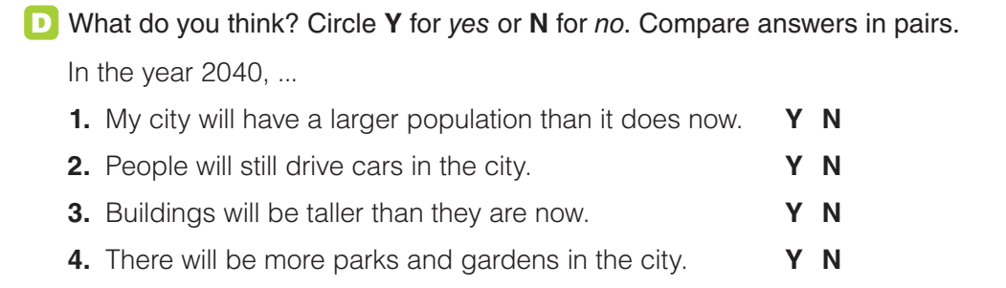
practice
Exercise D: Complete each sentence with the present perfect or simple past form of the verb

Slide 7
practice
Exercise D: Complete each sentence with the present perfect or simple past form of the verb

Slide 8
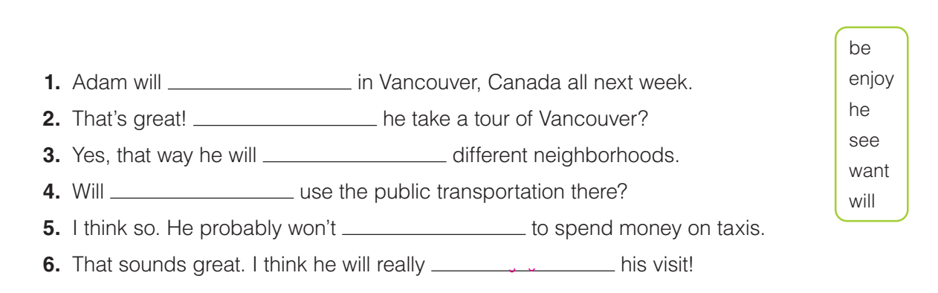
practice
Exercise E: Complete the sentences with words from the box
be
will
see
he
want
enjoy

Slide 9
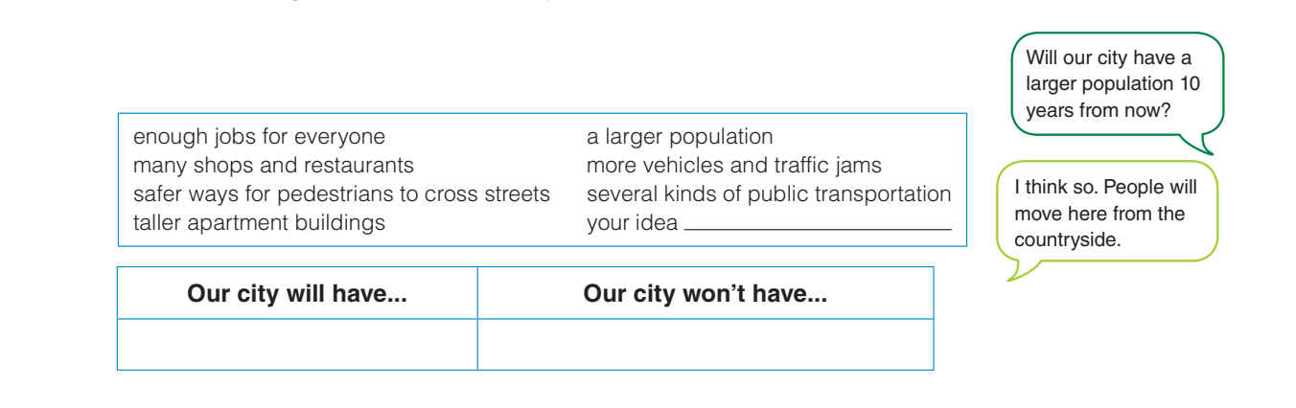
practice
Exercise F: In pairs, think about the city or town you are in now. What will it be like 10 years from now?

Slide 10
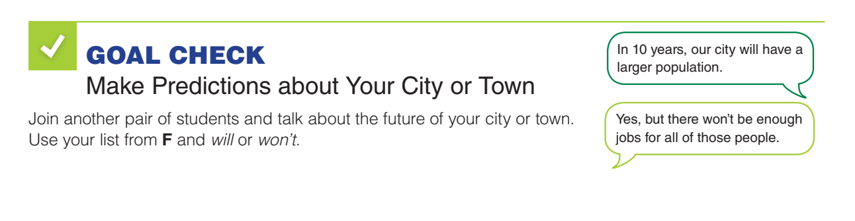
Goal check
Hanoi city will continue its rapid growth and development, attracting more tourists with its rich history and culture. The city's economy will thrive in the next 5 years.

Slide 11
HOMEWORK
Complete grammar exercises at home ((see grammar reference page 148)

