Slide 1

UNIT 3: CITIES
Class period 20: Pronunciation and conversation

Slide 2
Warm-up
Game: Whispering
Rules: Two groups of 8-10 people stand in 2 lines. Teacher lets the last students of each line see the lists of words. They have to remember and whisper to the next ears. The first students of each line go to the board and write down what they hear. The group with more correct answers will be the winner.

Slide 3
List of words
1. population 2. Transportation 3. Pronunciation
4. pollution 5. Emotion 6. attention

Slide 4
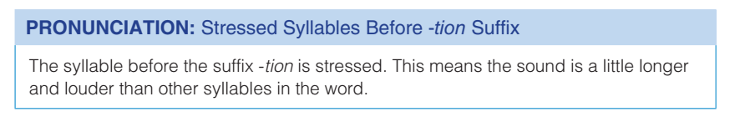
Pronunciation

Slide 5
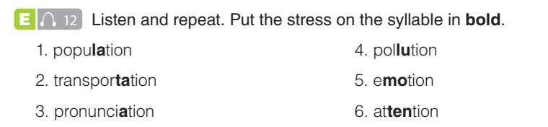

Pronunciation

Slide 6
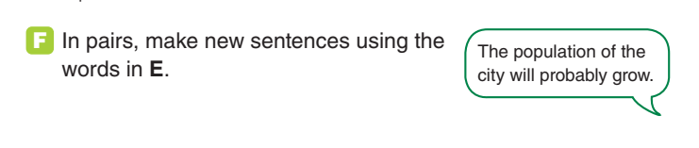
Pronunciation

Slide 7
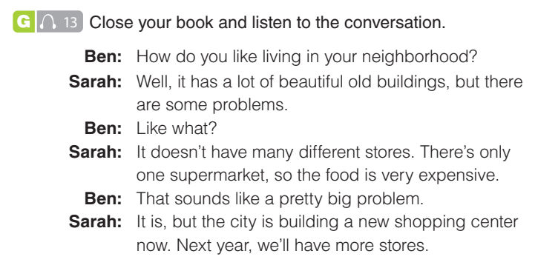
conversation
Exercise G, H: Practice the conversation

Slide 8
conversation
Exercise G, H: Practice the conversation
1. What is good about the neighborhood? What is bad?
➔ good: beautiful old buildings; bad: not many stores, only one supermarket
2. How will the neighborhood be different in the future?
➔ The city is building a new shopping center. There will be more stores

Slide 9
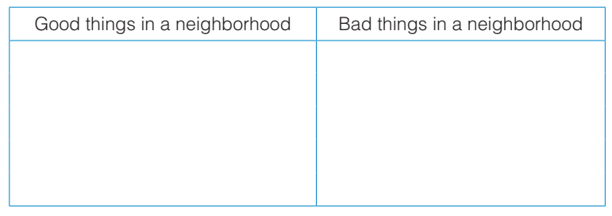
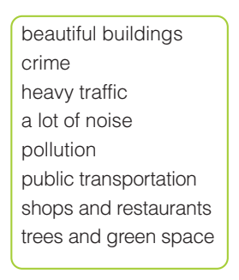
conversation
Exercise I, J: Write the words or phrases from the box in the correct column. Add two more ideas to each column and make a conversation

Slide 10
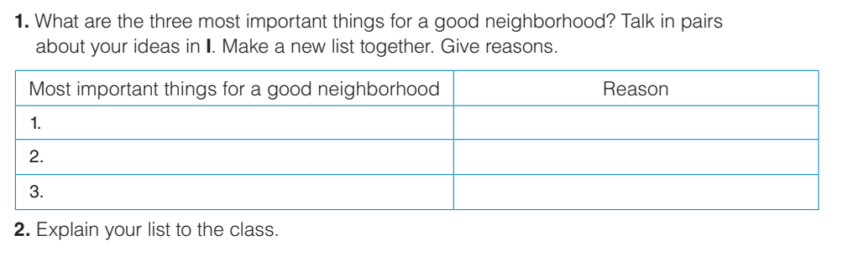
Homework
Goal check page 31
Explain What Makes a Good Neighborhood

