Slide 1

UNIT 3: CITIES
Class period 21: Language expansion

Slide 2
Warm-up
Discussion
Cities
Why do you think people want to move to the cities?

Slide 3
Vocabulary
Art museums | Places where exhibit, and collect various forms of art, such as paintings, sculptures
Concert halls | Places where host musical performances, including orchestral concerts
Government | Group of people who officially control a country
Movie theaters | Places where films are shown on a big screen for public viewing
Sports arenas | Places where host sports events, such as basketball games, football matches

Slide 4
discussion
Exercise A: Look at the list. Discuss the questions in pairs
1. Which places might you visit for entertainment?
2. Which places might you visit for relaxation?
3. Which places might you visit for some other purpose?

Slide 5
discussion
What public places do you visit in your neighborhood?
Are there any places on the list where you have never been to?
What are the most popular places to visit

Slide 6
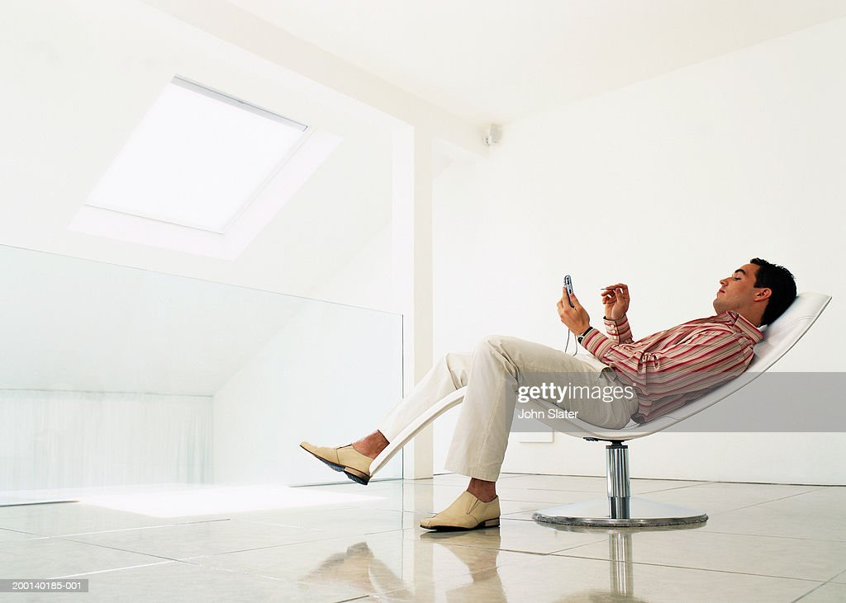
grammar
What was John doing after mowing the lawn?

Slide 7
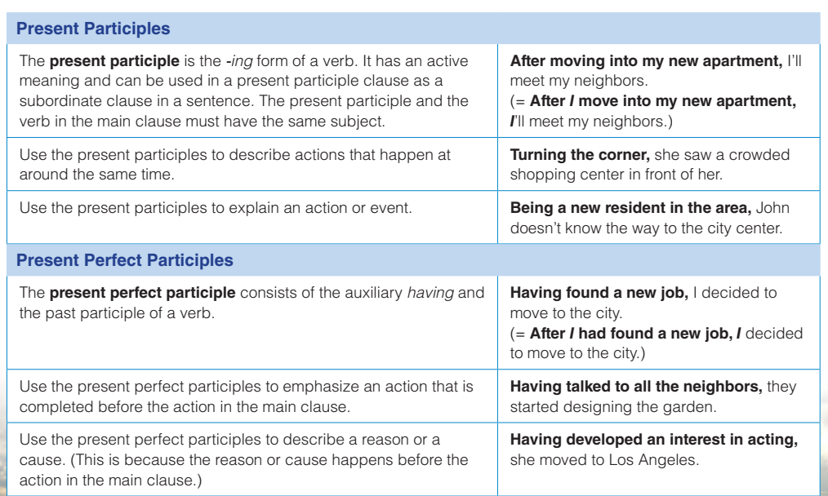
grammar
Grammar chart

Slide 8
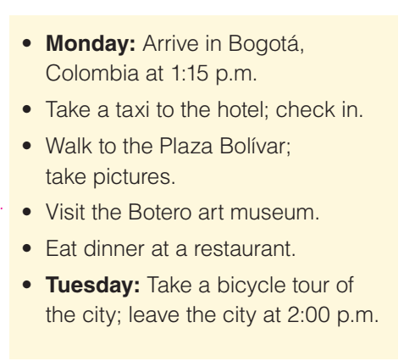
grammar
Exercise C: Ask and answer the questions in pairs. Use present participle clauses and the family’s plan for their city vacation
Look at the vacation plan
1. What time will they arrive?
2. What day will they visit the Botero museum?

Slide 9
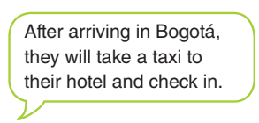
grammar
Exercise C: Ask and answer the questions in pairs. Use present participle clauses and the family’s plan for their city vacation
1. What will they do after they arrive in Bogotá?

Slide 10
grammar
Exercise C: Ask and answer the questions in pairs. Use present participle clauses and the family’s plan for their city vacation
2. What will they do after they check in at the hotel?
After checking in at the hotel, they’ll walk to the Plaza Bolívar and take pictures
3. What will they do after they walk to Plaza Bolívar?
After walking to the Plaza Bolívar, they’ll visit the Botero art museum.

Slide 11
grammar
Exercise C: Ask and answer the questions in pairs. Use present participle clauses and the family’s plan for their city vacation
4. What will they do before they eat dinner at a restaurant ?
Before eating dinner at a restaurant, they will visit the Botero art museum
5. What will they do before they leave Bogotá ?
Before leaving Bogotá, they will take a bicycle tour of the city.

Slide 12
grammar
Exercise D: Combine the sentences using the present participle or the present perfect participle
1. Sofía lives in a suburb. She enjoys the quiet neighborhood
2. Sofía will visit the city next Saturday. She will go to the new shopping center with Hana
3. Hana has finished her class. She is going to have lunch with Sofía
4. Hana has completed her project. She can visit Sofía in the suburbs.

Slide 13
grammar
Key
Exercise D: Combine the sentences using the present participle or the present perfect participle
1. Living in a suburb, Sofía enjoys the quiet neighborhood. / When visiting the city next Saturday, Sofía will go to the new shopping center with Hana.
2. Having finished her class, Hana is going to have lunch with Sofía. / After finishing her class, Hana is going to have lunch with Sofía.
3. Having completed her project, Hana can visit Sofía in the suburbs. / After completing her project, Hana can visit Sofía in the suburbs

Slide 14
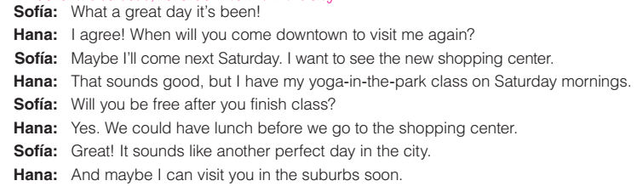
Role play
Close your book and listen to the conversation. Where does each speaker live?
Sofía: the surbubs, Hana: downtown / in the city

Slide 15
Role play
Practice conversation

Slide 16

Homework
Goal check page 31
Discuss reasons for moving to the city

