Slide 1
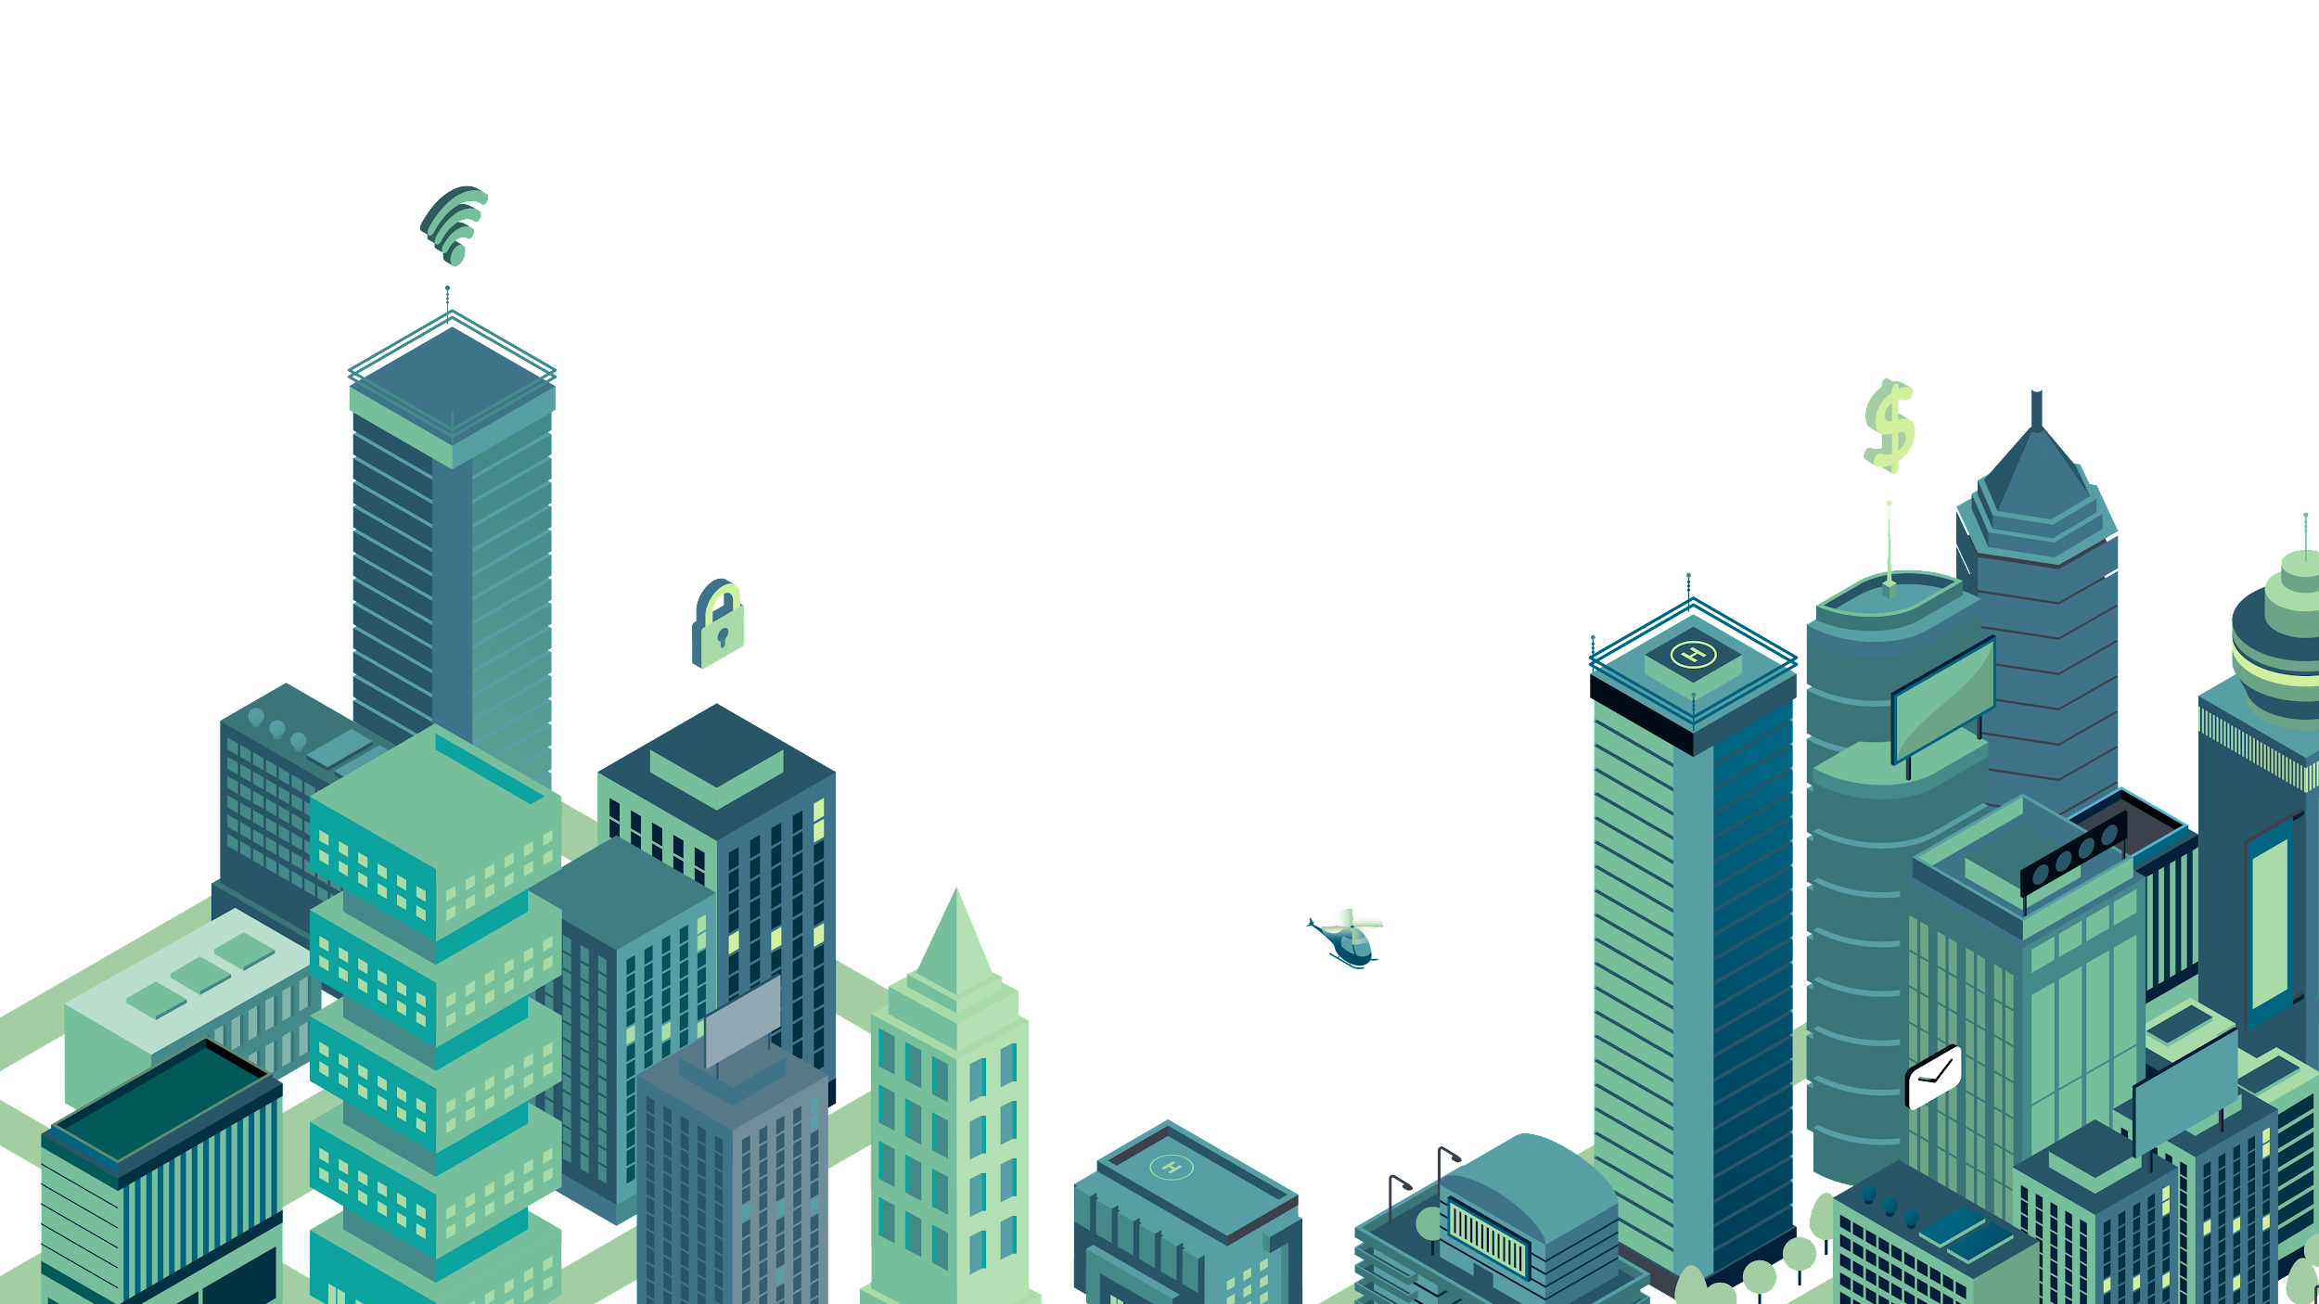
UNIT 3: CITIES
Class period 22: reading

Slide 2
Warm-up
Brainstorm
forms of transportation to get around the city

Slide 3
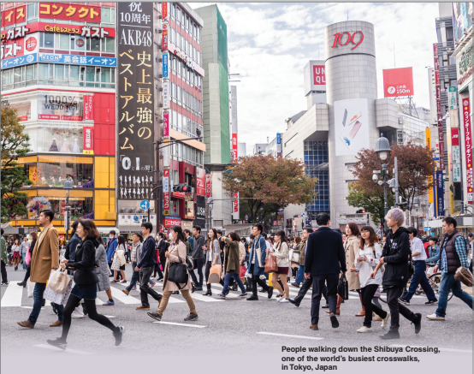
Warm-up
Photo description
About the Photo This photo shows the famous Shibuya Crossing near the Shibuya Train Station in Tokyo, Japan. Often called the busiest intersection in the world, it is an example of an “X-crossing” in which traffic stops in all directions so that pedestrians can fill the streets. More than 2 million passengers pass through Shibuya Station each day, which contributes to the crowded nature of the area. The neighborhood also has a large shopping mall, office buildings, and a variety of restaurants.

Slide 4
Vocabulary
Eat out (v) | Đi ăn ngoài
Get around (v) | Đi dạo xung quanh
Pedestrian (n) | Người đi bộ
Accident (n) | Tai nạn
Sidewalk (n) | Vỉa hè
Crosswalk (n) | Lối qua đường dành cho người đi bộ
Lane (n) | Làn đường
Permit (n) | Giấy phép
Stop sign (n) | Biển dừng
Speed limit (n) | Hạn chế tốc độ

Slide 5

Reading
Exercise B: Scan the reading to find the information
Reading Strategy: Scanning
Scanning is an effective strategy for learners when they need specific information from a text: it allows them to gather that information without having to read and understand every word. This strategy may help reading a longer text seem less overwhelming. Students should be reminded of various reading strategies like this before approaching a text so that they get into the habit of identifying which strategy is best suited to their reading purpose
1. The name of a person:
2. The title of a book:
3. The names of three cities:
David Engwicht
Reclaiming our cities and Towns
Brisbane, Florence, Boston

Slide 6
Reading
Exercise C: Read the article. Circle the correct options
1. Walking in cities can be ……………..
a. slow b. fun c. dangerous
2. Engwicht wants cities to be better for .
a. pedestrians b. vehicles c. tourists
3. Nowadays, people have contact with their neighbors.
a. more b. less c. online
4. is working to make its streets safer.
a. Brisbane b. Boston c. Tokyo

Slide 7
Reading
Exercise D: What do the following words refer to in the article?
1. them (paragraph 2)
2. this (paragraph 3)
3. it (paragraph 5)
Streets
The fact that people stay inside buildings to get away from the crowded sidewalks, the noisy streets, and the dangerous traffic
walking

Slide 8
Reading
Exercise E: Discuss the questions in pairs
1. How much walking do you usually do?
2. Where do you usually walk?
3. Do you feel safe when you are walking? Explain.

Slide 9

Homework
Goal check page 31

