Slide 1

UNIT 3: CITIES
Class period 23: Communication

Slide 2
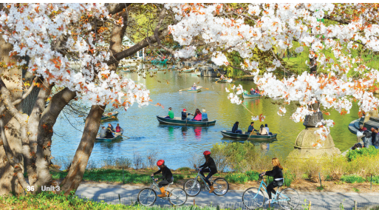
Warm-up
Photo description
Do you think this would be a good city to live in? Why

Slide 3
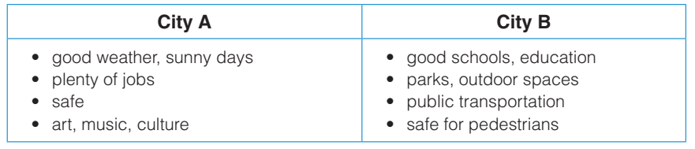

communication
Exercise A: Look at the chart. Discuss the questions below in pairs.
Work in 2 big teams
Team A
Team B

Slide 4
communication
Exercise A: Look at the chart. Discuss the questions below in pairs.
Good weather: Favorable weather conditions can significantly enhance city life. Mild and pleasant weather encourages outdoor activities, such as picnics, sports, and cultural events. It promotes a healthy and active lifestyle by allowing residents to spend more time outdoors.

Slide 5
communication
Exercise A: Look at the chart. Discuss the questions below in pairs.
Job opportunities: A city with ample job opportunities attracts talent, drives economic growth, and reduces unemployment rates. Good job opportunities provide residents with financial stability, career growth prospects.

Slide 6
communication
Exercise A: Look at the chart. Discuss the questions below in pairs.
Good school and education: A city with good schools and educational institutions provides its residents with access to quality education, which is essential for personal and professional growth. This helps create a knowledgeable and skilled workforce

Slide 7
communication
Exercise A: Look at the chart. Discuss the questions below in pairs.
Park and outdoor space: Parks and outdoor spaces contribute to a higher quality of life by providing places for relaxation, recreation, and exercise. Access to green spaces can improve mental well-being, reduce stress, and promote a healthier lifestyle for residents.

Slide 8
communication
Exercise A: Look at the chart. Discuss the questions below in pairs.
Public transportation: It reduces traffic congestion and air pollution by encouraging people to use public transportation instead of private vehicles.

Slide 9
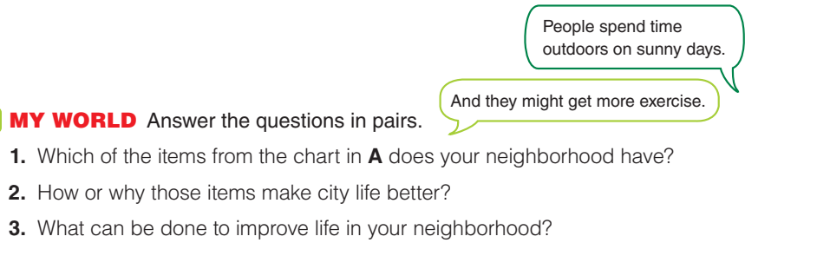
Communication
Exercise B: Discuss the questions in pairs

Slide 10
Communication
10 minutes
Role play and interview
Work in groups of 5. Invent a scenario (a talk show/ an interview …) and assign roles, then interview.

Slide 11

Homework
Record a video your groups’ scenario

