Slide 1

UNIT 3: CITIES
Class period 24: Writing

Slide 2
Warm-up
Discussion
Brainstorm the reasons why they like to live in the cities
There are several reasons why I like to live in the cities.
1.
2.
3.
Topic sentence

Slide 3
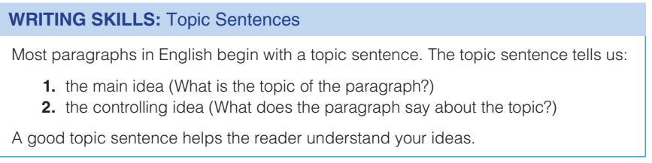
Writing strategy

Slide 4
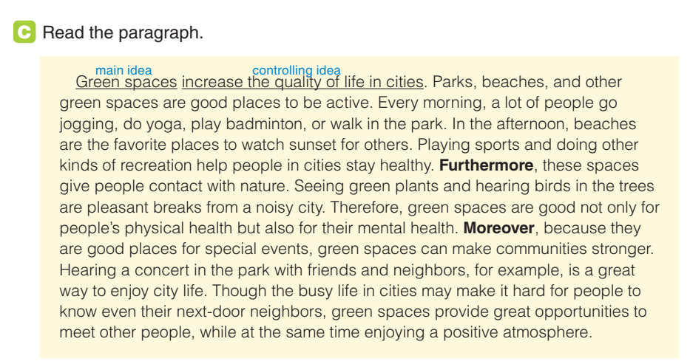
Writing skills
Exercise C: Read the paragraph and answer the questions
What is the paragraph about?
What does the paragraph say about the topic

Slide 5
Writing skills
Exercise D: Discuss the questions in pairs
1. Where is the topic sentence located?
2. What are the three ways green spaces increase the quality of life?
3. What other details does the writer include?
at the beginning of the paragraph
They help people stay healthy, give people contact with nature, make communities stronger
Examples of green spaces (parks, beaches), examples of nature (plants, birds, trees), example of a community event (concert in the park with friends and neighbors)

Slide 6
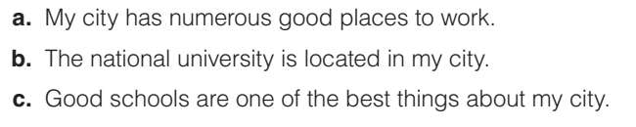
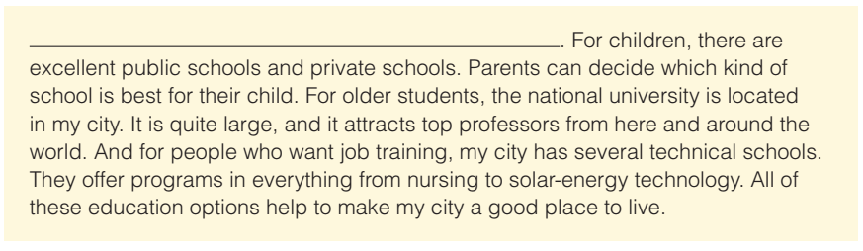
Writing skills
Exercise E: Choose the best topic sentence for the paragraph below

Slide 7
Writing skills
Exercise E: Choose the best topic sentence for the paragraph below
Which is the main idea and which is the controlling idea?
Is this paragraph about the writer’s city? The national university? Good schools?

Slide 8

Writing skills
15 minutes
Write a passage (150–180 words). Remember to start the passage with a good topic sentence and end it with a brief conclusion
Divide the class into groups of 4
brainstorm and writing a short paragraph

Slide 9

Homework
Record a video your groups’ scenario

