Slide 1
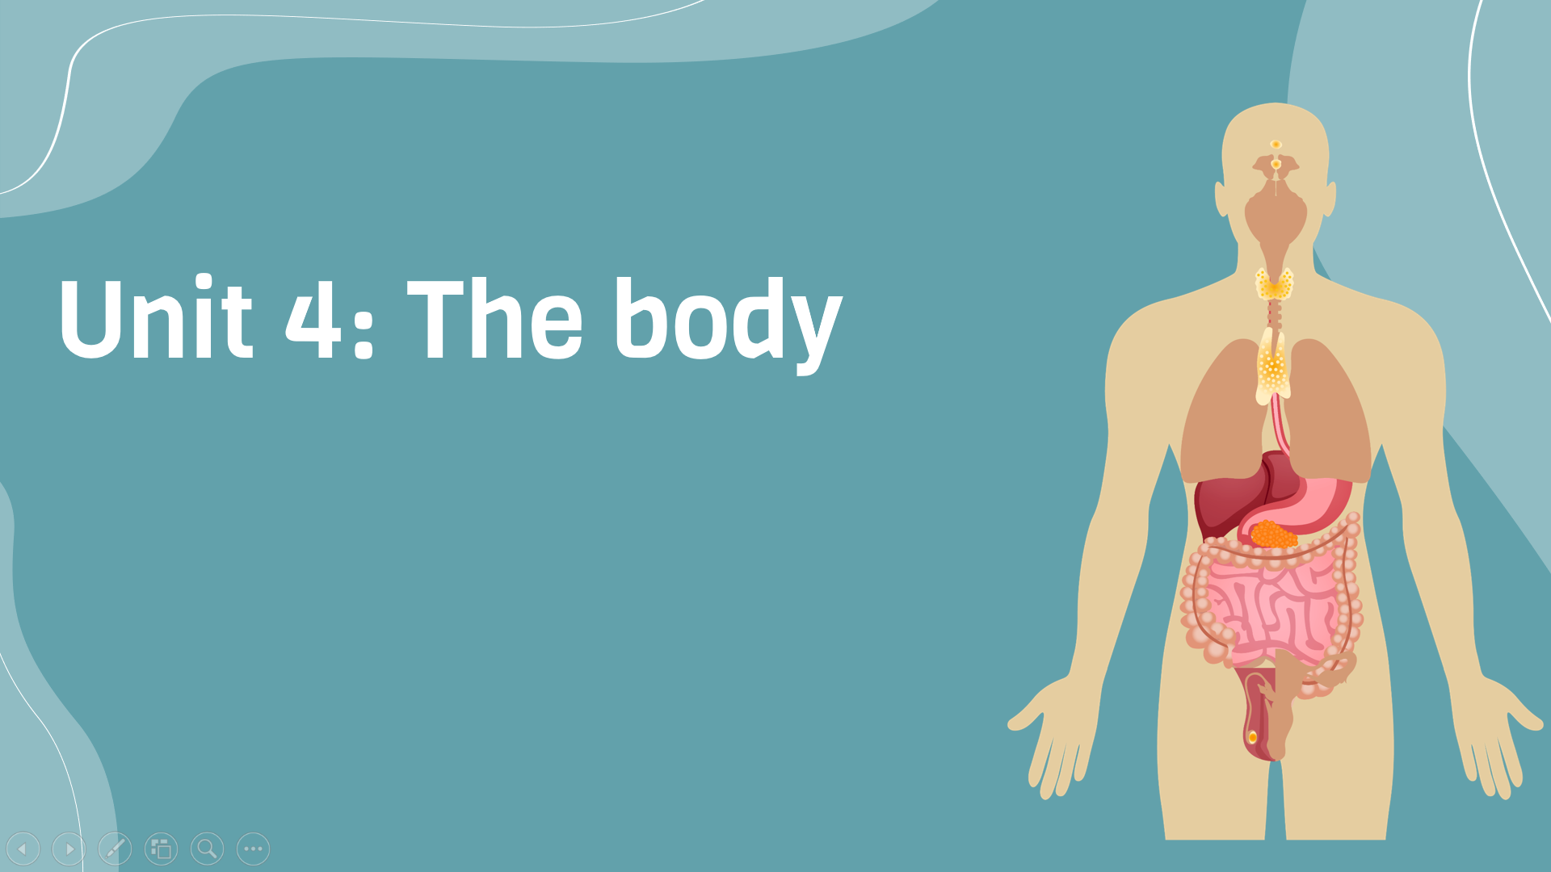
Period 27:
Unit opener and vocabulary
v
Here is where your presentation begins

Slide 2
Warm-up
1. Did anyone do morning exercise today? 2. What sport or exercise do you often do?
Look at the title and photo

Slide 3
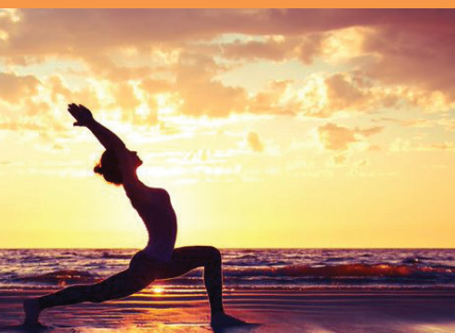
Warm-up
Focus on parts of the body and health of our bodies.
What is she doing with her body? What is she doing with her arms? Her legs?
She is doing yoga
She has her arms out and her legs stretched.

Slide 4
About the photo
This photo shows a woman practicing yoga near the beach. Yoga is a Sanskrit word which means yoke or union. This originated in India over 5,000 years ago. There are many different types of yoga, but they all combine physical poses, deep breathing, meditation, and concentration. Their main purpose is to form a union of the body, mind, and soul. Regular practice of yoga is also believed to improve flexibility and balance.

Slide 5
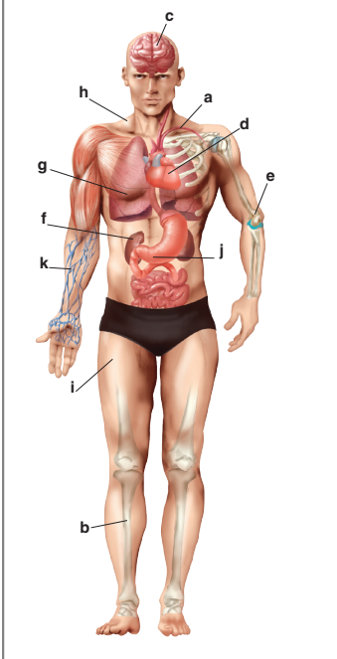
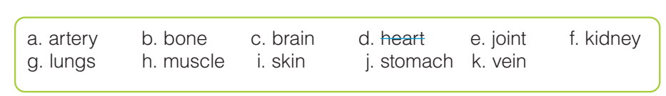
Vocabulary
Match words with human parts in the picture
1. This pushes your blood through your body:
2. These carry blood around your body:
3. These bring air into your body:
4. This covers the outside of your body:
5. These make your body move: ,
6. This lets you think and remember:
7. This is one of the organs that cleans your blood:
8. This digests food:
9. This supports your body
heart
vein
lungs
lungs
skin
joint
brain
stomach
bone

Slide 6
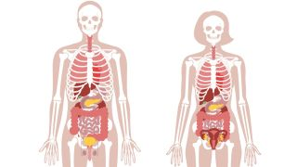
Vocabulary
Listen and repeat
artery
brain
joint
Kidney
lungs
muscle
skin
stomach
vein
Động mạch
Não
Khớp
Thận
Phổi
Cơ
Da
Dạ dày
tĩnh mạch

Slide 7

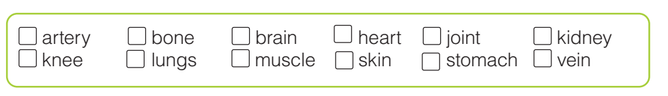

Vocabulary
Listen and check the words you hear (track 16)

Slide 8
Vocabulary
In pairs, discuss the functions of different body parts. Use the information in A to help you.
Hot seat Divide class into 2 teams. Assign a leader who will sit on hot chairs. Two teams take turns to describe the functions of the body parts, which are shown, on the screen. If the leaders can get the right answer, their team gets points.

Slide 9


