Slide 1
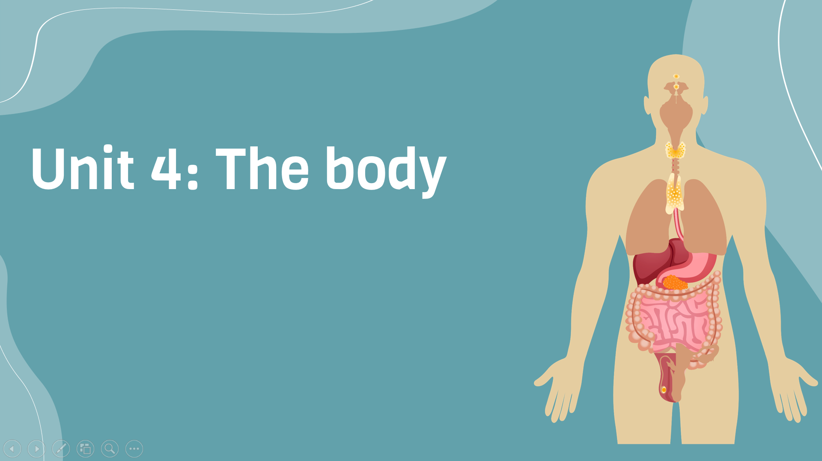
Period 28: Grammar
v
Here is where your presentation begins

Slide 2
Warm-up
Game: Miming
3 leaders from 3 teams on board to describe a simple sentence The leaders look at the sentences and describe the sentences for the team. The team should guess the whole sentence
90 seconds

Slide 3
Warm-up
Game: Miming
The teacher says eating healthy food is good. My dad says running is fun My friend is good at jogging
Give comments on positions and functions of the words in red

Slide 4
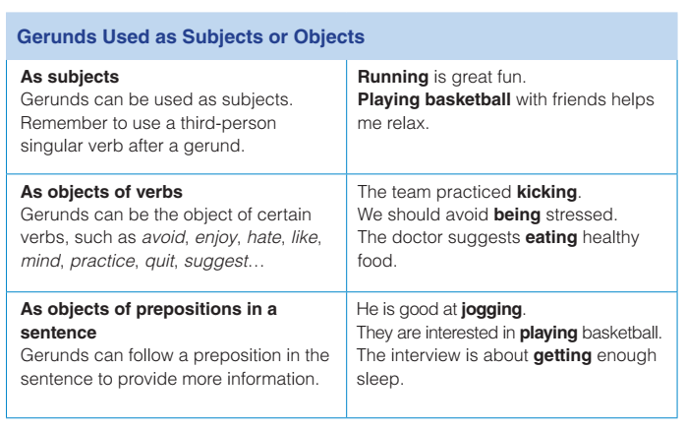
Grammar

Slide 5
Exercise D (6 minutes) Complete each sentence with the present perfect or simple past form of the verb
1. (walk) for exercise is better than (run).
2. We should always avoid (stay) up late.
3. (get) enough sleep is as beneficial as (get) enough exercise.
4. Everyone should learn about the importance of (eat) healthy food.
5. People are more interested in (keep) fit these days.
6. The doctor emphasizes (drink) plenty of water every day.

Slide 6
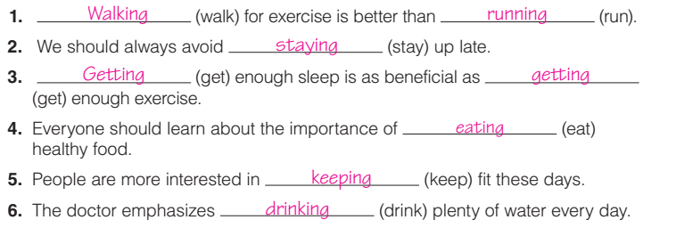
Exercise D (6 minutes) Complete each sentence with the present perfect or simple past form of the verb

Slide 7
Rewrite the following sentences with the meaning unchanged
1. Shall we go for a walk ?
➔ What about ………………………………….?
2. Why don’t we visit our teacher ?
➔ I suggest …………………………
3. I am very pleased that we shall meet again soon.
➔ I’m looking ……………………

Slide 8
Rewrite the following sentences with the meaning unchanged
4. It is really quite easy to learn English .
➔ Learning ……………………….
5. I don’t want to go to the movie tonight.
➔ I don’t feel like ………………………………
6. Complaining about the matter is useless now.
➔ It is ……………………

Slide 9
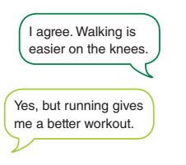
Exercise E: Do you agree or disagree with the statements above? Discuss in pairs, using gerunds in your sentences

Slide 10
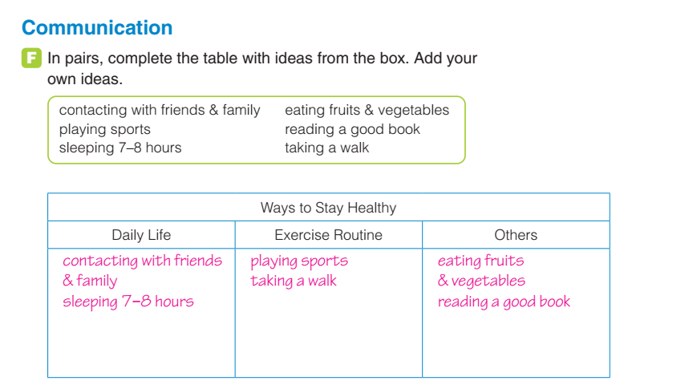
Exercise F: In pairs, complete the table with ideas from the box

Slide 11

Homework:
Complete grammar exercises (page 149, 150)

