Slide 1
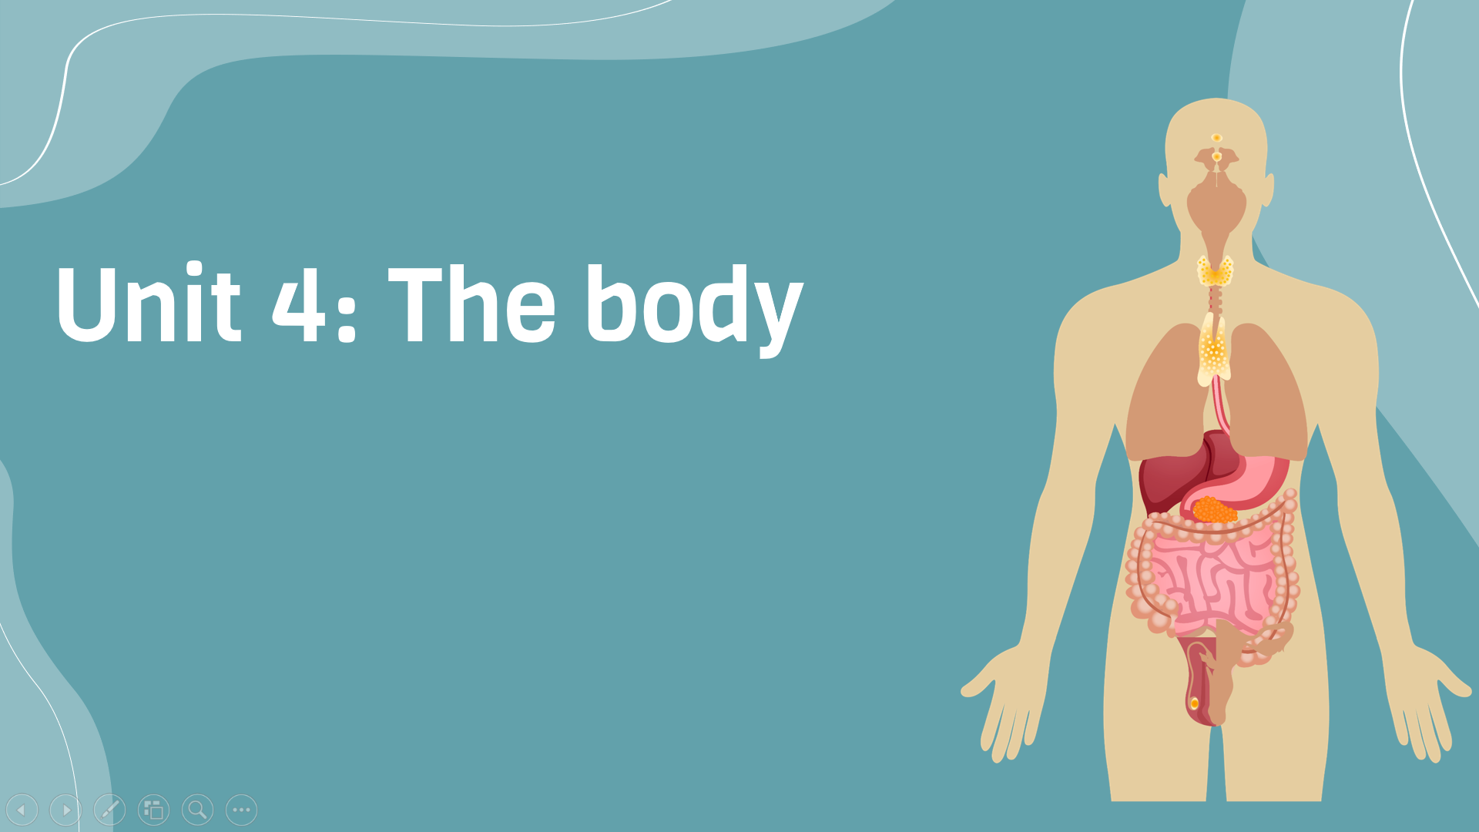
Period 29: Listening
v
Here is where your presentation begins

Slide 2
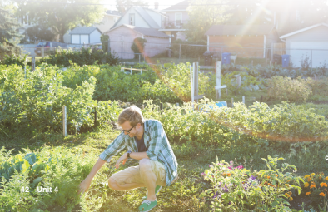
Warm-up
Describe photo
Do you think this man is healthy? Why? What is he doing? What do you know about his life?

Slide 3
Discussion
1. Is it important to eat healthy food?
2. What else can you do to stay healthy?

Slide 4
Discussion
1. Is it important to eat healthy food?
2. What else can you do to stay healthy?

Slide 5

Listening
Track 17
Exercise B: Listen to 3 people talking about their healthy lifestyles. Write the letter A-C to match the speaker to the corect topic
Topics | Speakers
1. Exercise
2. Diet
3. Healthy genes
B
C
A

Slide 6
Listening
Track 17
Exercise C: Listen again. Answer each question in your notebook
Speaker A:
1. What kind of exercise does Speaker A get?
2. Which family members does Speaker A mention?
Speaker B:
3. What kind of exercise does Speaker B get?
4. How often does Speaker B get sick?
Speaker C:
5. Why did Speaker C change her diet when she got older?
6. What do some people think about Speaker C’s diet?
1. walking
2. Mother and grandmother
Goes to gym 3-4 times per week
5-6 times/year
Didn’t have any energy
You can’t be healthy if you only eat plant foods

Slide 7
My world
Interview a partners. Then tell the class about your partner’s lifestyle
What kind of exercise do you get?
How often?
What do you usually eat?
5 minutes

Slide 8


