Slide 1
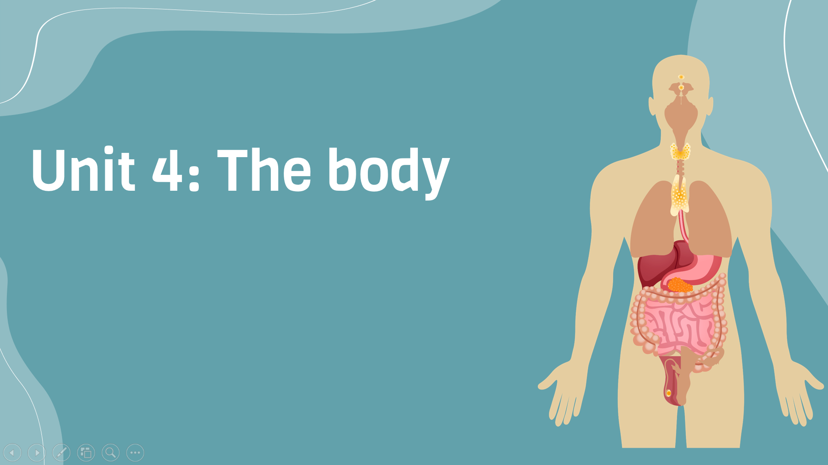
Period 31:
Language expansion and grammar
v
Here is where your presentation begins

Slide 2
Warm-up
Discussion
….
Headache
Common minor health problems?
…..
….

Slide 3
Reading and discussion
What kinds of solutions does the article suggest for everyday ailments? Are they things you buy at the pharmacy or are they natural? Is there a cure for hiccups?

Slide 4
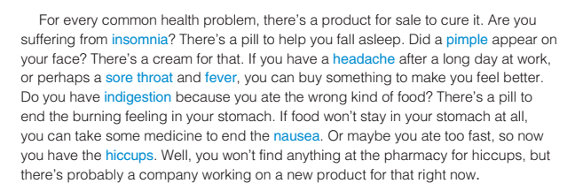
Exercise A: Write the words in blue next to their definition

Slide 5
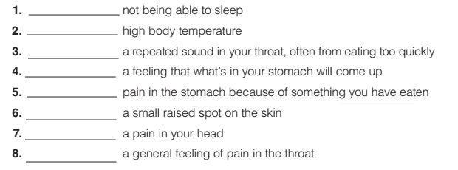
Exercise A: Write the words in blue next to their definition
insomnia
fever
hiccups
nausea
indigestion
pimple
headache
Sore throat
What do you do when you have insomnia?

Slide 6
Read aloud the sentences with stress and intonation
Are you suffering from insomnia? If you have a headache after a long day at work, you can buy something to make you feel better. If food won’t stay in your stomach at all, you can take some medicine to end the nausea. Maybe you are too fast, so now you have the hiccups.

Slide 7
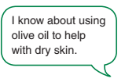

Exercise B: Discussion
What natural remedies do you know about?

Slide 8
Exercise B: Discussion
What natural remedies do you know about?
cumin seeds (for indigestion)
elderberries (to help / prevent the flu)
fennel seeds (for bad breath)
Garlic (to stop earaches)
onion tea (to help colds)
aloe vera plant (to help burns)
arnica gel (to help pain / bruises)
chili peppers (to prevent colds)
clove oil (to stop toothaches)

Slide 9
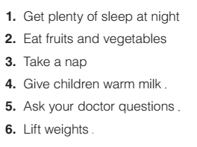
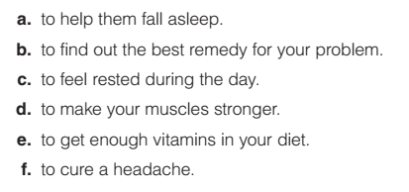
Grammar: infinitive of purpose
Exercise C: Ask and answer the questions in pairs. Use present participle clauses and the family’s plan for their city vacation

Slide 10
Grammar: infinitive of purpose
Exercise C: page 150 Correct the mistake in each sentence
In order lose weight, you should eat less sugar.
You should do more exercise to being healthier.
To avoid stress I do yoga everyday.
Drink honey and lemon help a sore throat.

Slide 11
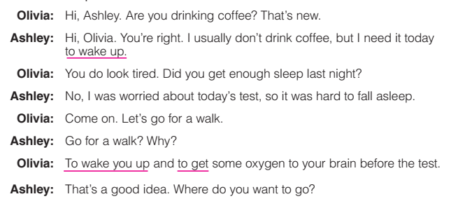
Grammar: infinitive of purpose
Track 20
Exercise F: Close your book and listen to the conversation. What remedies for fatigue do the speakers talk about?

Slide 12


