Slide 1
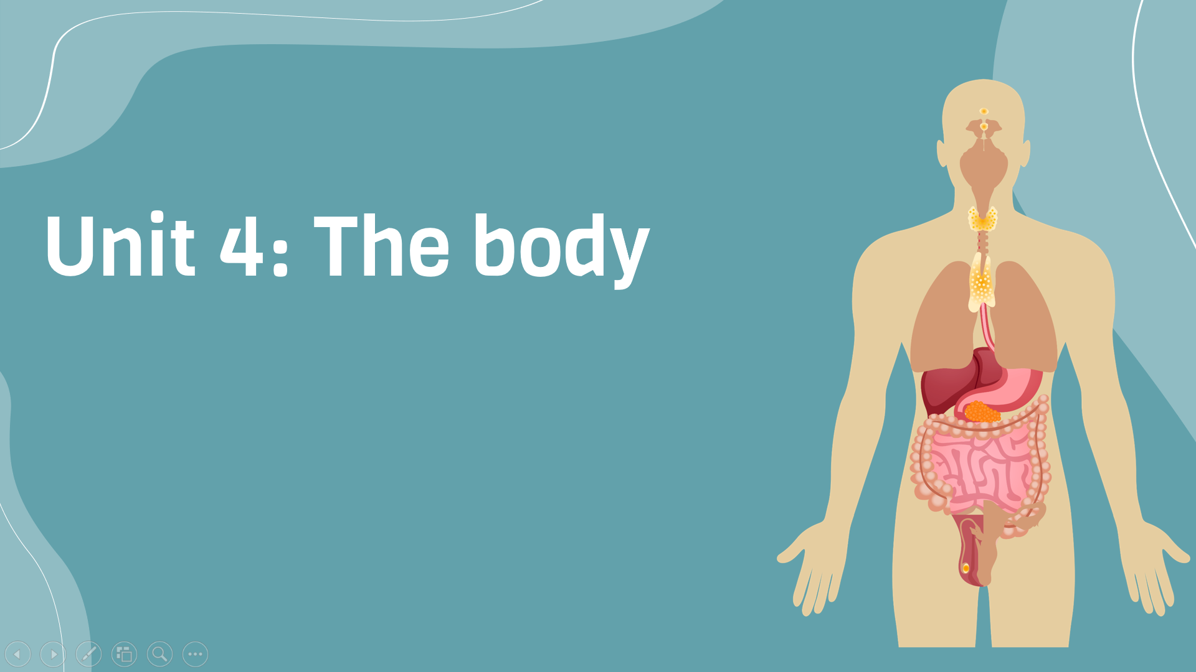
Period 32: Reading
v
Here is where your presentation begins

Slide 2
Warm-up
Discussion
What makes you feel a lot of stress?
What would you do if you experienced stress or got into troubles?

Slide 3
Reading and discussion
Read the title of reading text
Predict what the article will be about.

Slide 4
Vocabulary
Enemy (n) | Kẻ thù
Psychologist (n) | Nhà tâm lý
Participant (n) | Khách thể tham gia nghiên cứu
Harmful to (adj) | Độc hại
Beneficial (adj) | Có lợi
Have an effect on | Có ảnh hưởng đến
Heartbeat | Nhịp tim
Meet a challenge | Đối diện thách thức
Blood vessel | Mạch máu
Babysitting | Việc trông trẻ

Slide 5

Exercise B: Read the text. Circle the correct options
1. What is the main idea of the text?
a. Common sources of stress in modern life
b. The importance of attitude in dealing with stress
c. Helping others as an enjoyable activity
2. What was true about the study at the University of Wisconsin?
a. Researchers asked questions about the participants’ beliefs about stress.
b. All of the participants were alive eight years later.
c. Its number of participants was the highest among three studies.
3. Which study focused on stress and the interaction between people?
a. The University of Wisconsin study
b. The Harvard University study
c. The University of Buffalo study
B
A
C

Slide 6
Exercise C: Circle T for true or F for false. Then correct the false statements
1. For the University of Wisconsin study, participants were asked two questions
2. The way you think about stress affects how your body reacts to stress
3. Stress always causes blood vessels to become narrower
4. People who had a lot of contact with others had a higher risk of dying
T
T
F
F

Slide 7
Exercise D: Complete the list of dos and don’ts with information from the article
Don’t believe that …………….. Do believe that signs of stress …………. Do spend a lot of time ………………….
stress is harmful to your health
prepare you to meet a challenge
helping other people

Slide 8
Goal check
Form a small group with 2–3 other students. Discuss the questions. 1. What do you remember about the three research studies? 2. In each study, why were the participants’ attitudes important 3. Talk about a time when a positive attitude helped you in some way

Slide 9


