Slide 1
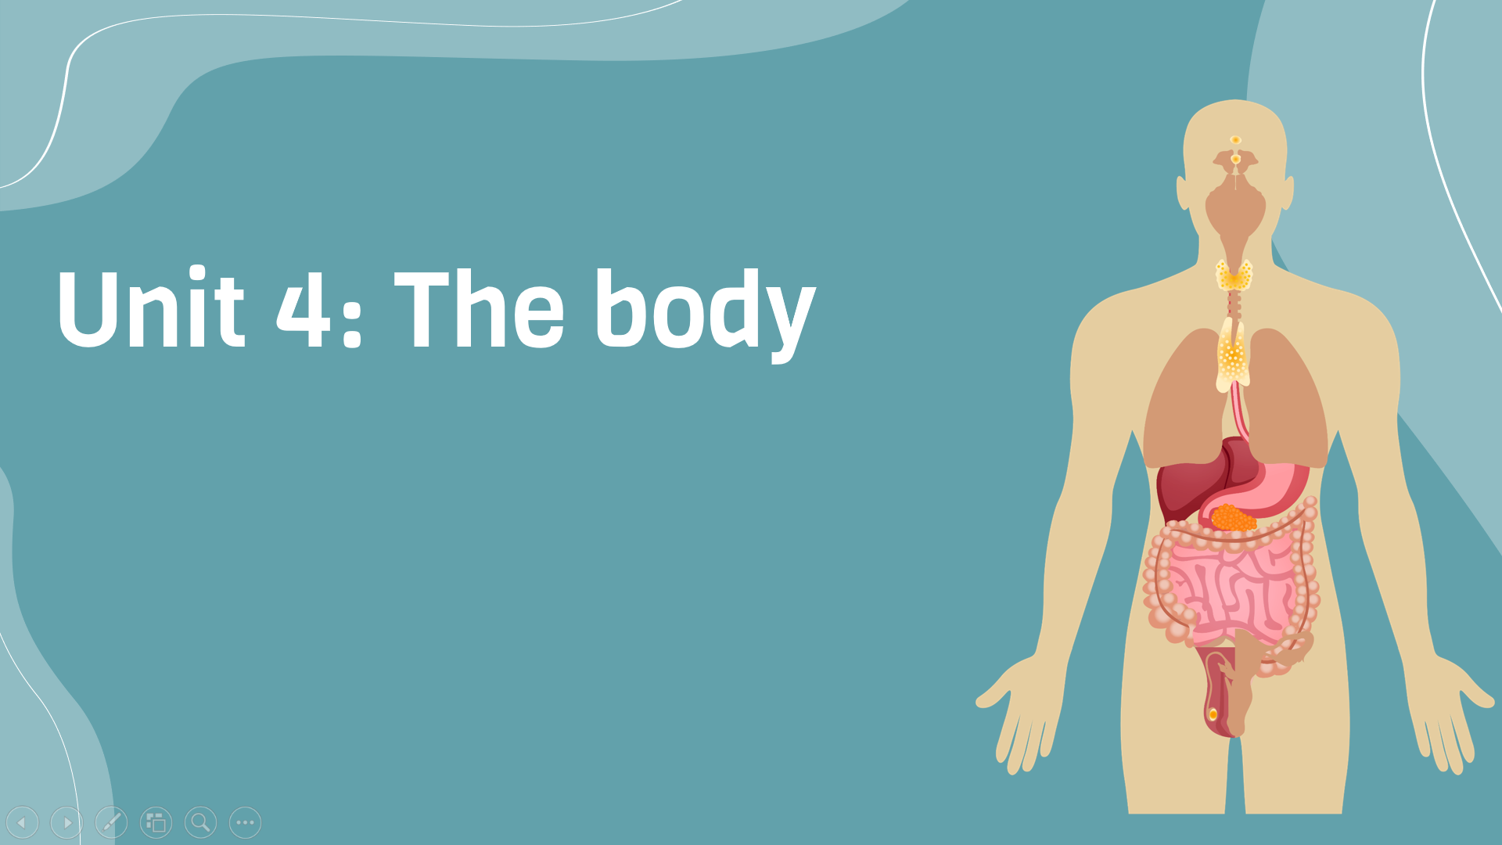
Period 33: Communication
v
Here is where your presentation begins

Slide 2
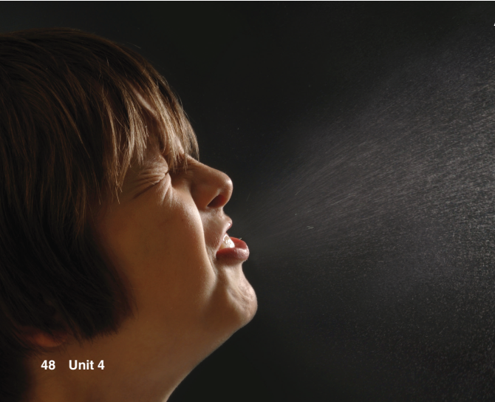
Warm-up
Picture description
What are the effects of this sneeze?
Germs are sent into the air. Other people can get sick

Slide 3
Exercise A: Describe a time when you got sick. Answer the following questions
1. When was it? 2. How did you feel at the time? 3. How did you get better?

Slide 4
Exercise A: Describe a time when you got sick. Answer the following questions
1. I got sick last year during the winter season. 2. At that time, I felt tired, weak, and had a sore throat. I also had a stuffy nose and a fever, which made me feel hot and uncomfortable. I didn't have much energy and felt quite unwell. 3. To get better, I went to see a doctor who prescribed some medication for my symptoms. I also made sure to drink plenty of fluids and get lots of rest. Gradually, my symptoms started to improve, and after a few days, I felt much better and was able to resume my normal activities.

Slide 5
Vocabulary
cover your nose | Che mũi
Coughing | Ho
Sneezing | Hắt hơi
Germ | Vi khuẩn
Remove germs | Tiêu diệt vi khuẩn
Breathe (v) | Thở

Slide 6
Exercise B: Discussion
Discuss the questions in pairs.
1. How can a sick person make other people sick? Think of three ways.
2. The last time you got sick, how do you think you caught the illness?

Slide 7
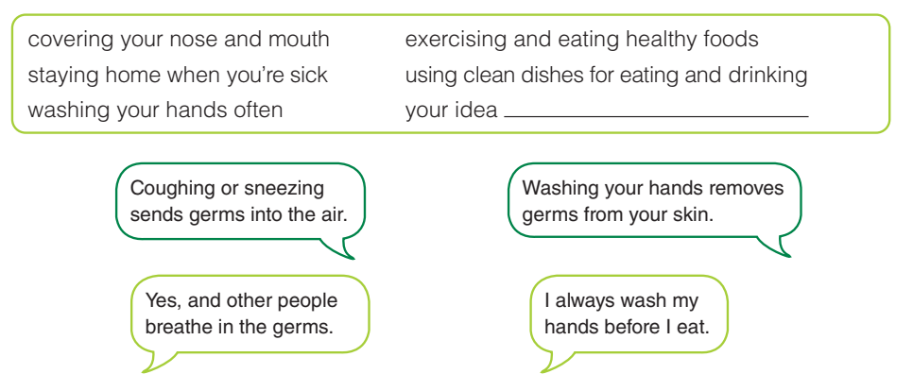
Exercise c: In pairs , discuss how each action can prevent the spread of disease

Slide 8
Role play: a doctor and a patient
Doctor: Hello! What can I do for you?
Patient: Good Morning Doctor. I don’t feel good.
Doctor: Come and sit here.
Doctor: Open your mouth.
Doctor: Since how long are you not feeling well?
Patient: Since yesterday.
Doctor: No problem. Did you have motions yesterday?
Patient: No Doctor. Not so freely.
Patient: Doctor I feel weak and do not feel like eating.
Doctor: Ok. And what else?
Patient: I feel like vomiting.

Slide 9
Role play: a doctor and a patient
Doctor: Do you drink a lot of water?
Patient: No Doctor, I don’t have water too much.
Doctor: Did you took any medicine?
Patient: Yes Doctor, I took a Crocin.
Doctor: who asked you to take it?
Patient: No one Doctor. I took it myself.
Doctor: why did you take it?
Patient: Because I felt a headache.
Doctor: Nothing to be worried at.
Doctor: Do you need quick relief?
Patient: No Doctor. It is enough you give me medicines for now.

Slide 10


