Slide 1
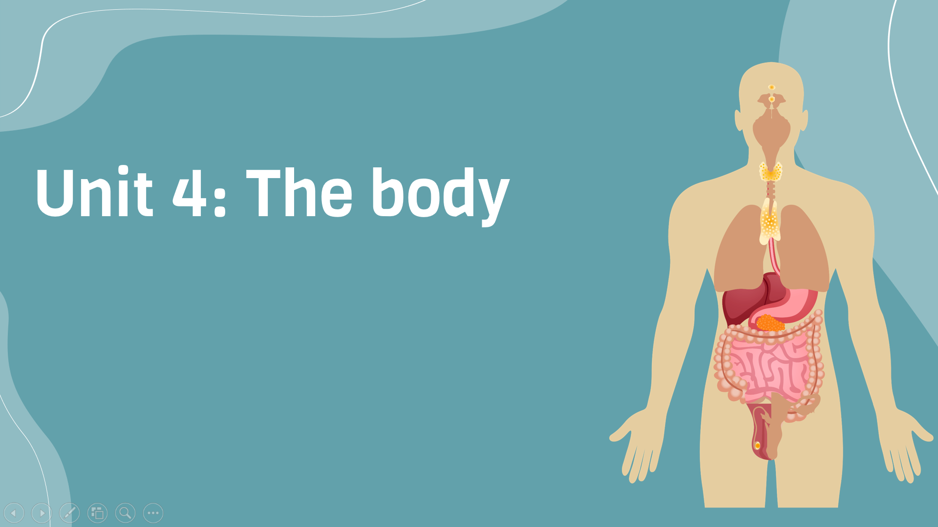
Period 34: Writing
v
Here is where your presentation begins

Slide 2
Warm-up
There are several ways to prevent the spread of disease.”
Topic sentence
What comes after a topic sentence?

Slide 3
Writing strategy: Supporting details
The topic sentence is a very important part of a paragraph, but the paragraph also needs to be developed effectively. Students need to be able to provide explanations, examples, facts, and reasons to support the ideas presented in the topic sentence.

Slide 4
Exercise D
Although there are several ways to prevent the spread of disease, staying home when you are sick may be the best way. First, when you stay home, the germs in your body are kept in your own room or home only. Therefore, no one at school or at work has contact with your germs. It is also easier to clean your home of the germs than a public place. Moreover, when you are sick, covering your mouth when you cough at the school or workplace may be less effective than staying at home.
Some of your germs are still sent into the air when you talk and breathe. Finally, washing your hands after every cough or sneeze may be the least effective way to keep other people healthy. Even with a portable hand sanitizer, it may not be possible to clean your hands that many times in a day and you may also be distracted a lot in doing so.

Slide 5
Exercise D: Read the paragraph
What is the topic of the paragraph?
Staying home when you are sick
What is the controlling idea
Staying home is the best way to prevent the spread of disease

Slide 6
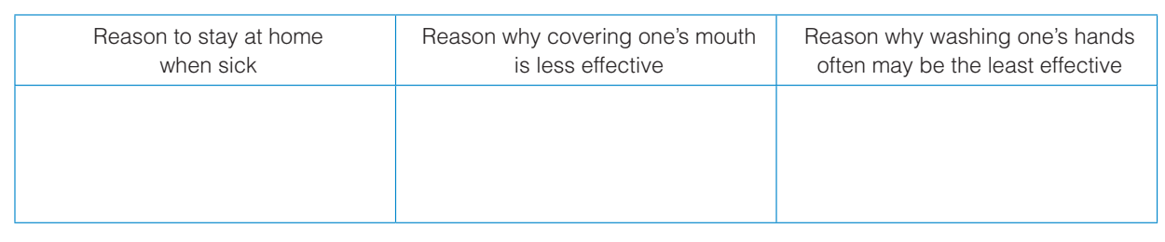

Exercise E: Complete the chart with supporting details from the paragraph in D

Slide 7
Choose one of the topics and write a paragraph (150–180 words) about it. Use your own ideas. Remember to include a good topic sentence and a few details to support it
Exercise
Having appositive attitude
Healthy food
15 minutes

Slide 8
Eating healthy food is important for our overall well-being. It provides us with the necessary nutrients and energy to maintain a healthy lifestyle. When we consume healthy food, such as fruits, vegetables, whole grains, and lean proteins, our bodies function at their best. These foods are rich in vitamins, minerals, and antioxidants, which help support our immune system and promote good digestion. By incorporating more nutritious options into our meals, we can improve our physical and mental health. Remember, small changes can make a big difference. So let's prioritize eating healthy food to feel our best and live life to the fullest.

Slide 9


