Slide 1
UNIT 5: Challenges
Class period 35: Unit opener and vocabulary

Slide 2

Warm-up
Discussion
Have you ever faced any challenges? Which is the biggest one?
Look at the picture on page 50, What do you see? What challenges are they facing?

Slide 3
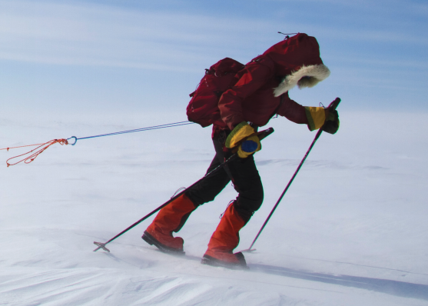
About the Photo
National Geographic Adventurer of the Year 2007 Sarah McNair-Landry has crossed the Greenland ice cap no less than six times. Growing up in the town of Iqaluit on Baffin Island in Northwest Canada, Sarah is no stranger to challenges. Her parents are both Arctic guides, and she and her brother began their adventures in the snow when they were only 10 and 11 years old. Sarah’s achievements include being the youngest person to reach both poles: she skied to the South Pole when she was 18 and traveled to the North Pole by dog sled when she was 19. Sarah is also a documentary filmmaker and a photographer.

Slide 4
Vocabulary
Absolutely (adv):
Feel alive (v):
Set a goal (v):
Achieve the goal (v):
Run a marathon (v):
Chắc chắn, thực sự, vô cùng
Cảm thấy sống có ý nghĩa
Đặt mục tiêu
Đạt được mục tiêu
Chạy đua đường trường

Slide 5
Vocabulary
Make progress (v)
Competitive (adj):
Mental (adj):
Significant (adj):
Convince (v):
Deal with (v):
Hire (v):
Tiến bộ
Cạnh tranh
Về mặt tinh thần
Quan trọng
Thuyết phục
Giải quyết, xử lý
Thuê

Slide 6
Checking Vocabulary
2 students on board
Audience explain the words, 2 students write the words on board.
Those who have more correct answers will be the winner.

Slide 7
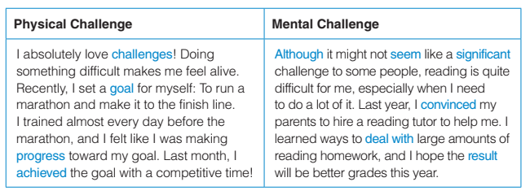
Exercise A: reading the text
trained every day
hired a reading tutor

Slide 8
Exercise A: reading the text
Read the paragraphs and answer these question. How did the person prepare for the physical challenges? What did the person do to face the mental challenge?
trained every day
hired a reading tutor

Slide 9
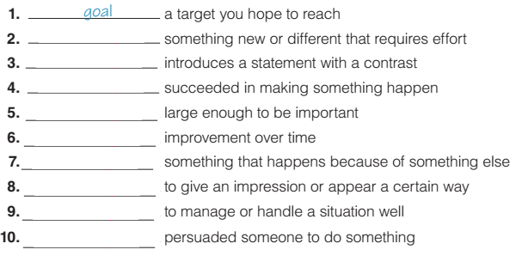
Exercise B: Write each word in blue next to the correct meaning

Slide 10
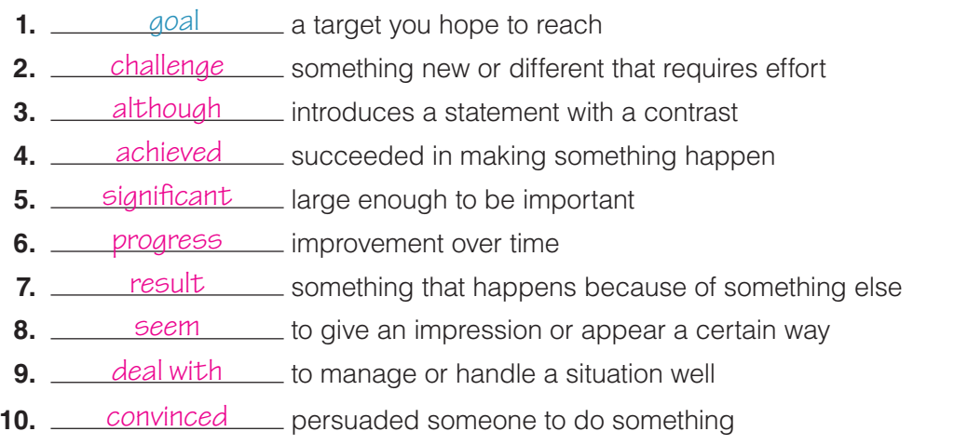
Exercise B: Write each word in blue next to the correct meaning

Slide 11
Building sentences using the word in exercise A and B
1. Goal: A goal is an objective or target that someone aims to achieve. Example: My goal is to save enough money to go on vacation next year. 2. Challenge: A challenge is a difficult task or situation that requires effort and determination to overcome. Example: Running a marathon was a big challenge, but I managed to finish it. 3. Progress: Progress refers to gradual improvement or advancement towards a goal or objective. Example: I've made a lot of progress in learning how to play the piano.

Slide 12
My world
What are your goals for the next five years? Are the goals significant to you? What challenges may you have to overcome to achieve your goals?

Slide 13


