Slide 1
UNIT 5: challenges
Class period 36: Grammar

Slide 2

Warm-up
When did you start learning how to ride a bike?
I got my first teaching job while I was studying English.

Slide 3
Today, we will learn to distinguish past continuous and simple past

Slide 4
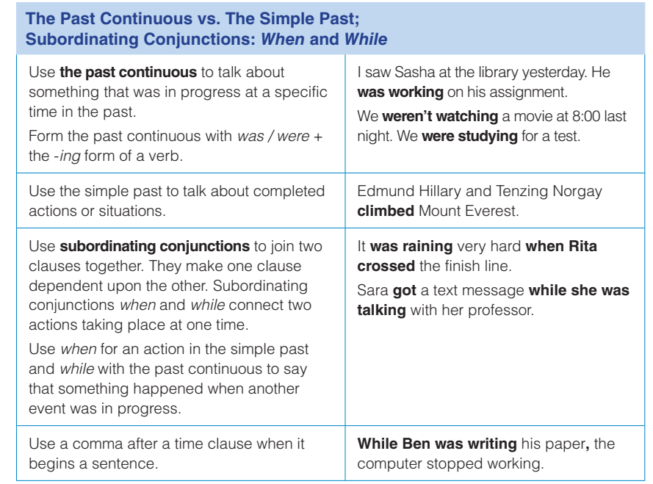
Grammar

Slide 5
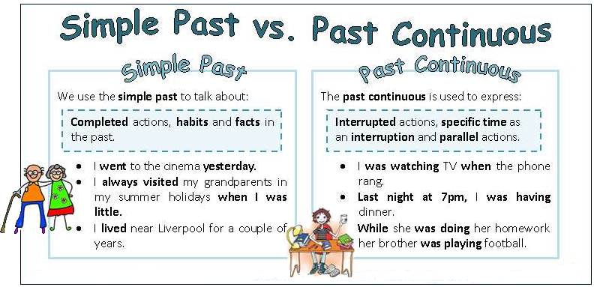
Grammar

Slide 6
Grammar
Exercise D (6 minutes) Complete each sentence with when or while
when
1. Martina was looking for a job _____I met her for the first time.
2. The mountain climbers were resting _______the storm began.
3. My phone rang six times _______ I was working on my project.
4. _______ he was visiting Quito, Justin practiced his Spanish.
when
while
while

Slide 7
Grammar
Exercise E: Complete the sentences. Use the simple past or past continuous form of the verbs.
1. Yesterday, I (convince) my best friend to compete in a 5k race.
2. Maria (deal with) health problems when she quit her job last October.
3. My parents (look) for new jobs when they met.
4. The professor (seem) tired in class last week.
5. We (make) progress with the project when the class ended.
6. At the gymnastics competition, Leo (achieve) the highest score.
convinced
Was dealing with
Were looking
seemed
Were making
achieved

Slide 8
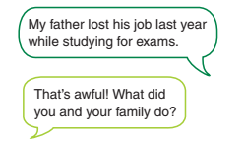
Goal check
Talking about facing challenge
Tell a partner about a challenge you have faced in your life.
1. What was happening in your life at that time?
2. What did you do? Do you think you dealt with the challenge well?

Slide 9
Goal check
Word Bank: Challenges / Achievements earning a degree / diploma getting a promotion at work getting / losing a job learning a new skill overcoming an obstacle passing a test / an exam receiving an award recovering from an illness / injury traveling / living abroad winning a game / contest

Slide 10


