Slide 1
UNIT 5: challenges
Class period 37: Listening

Slide 2
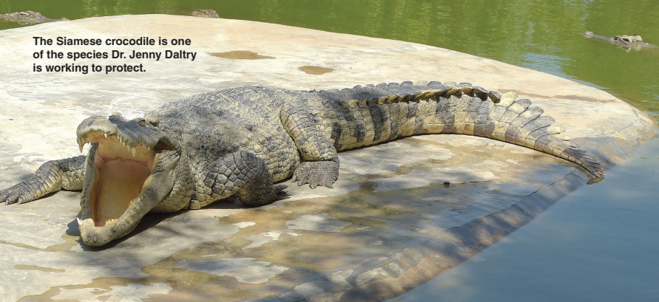
What animal is it?
It has 9 letters
a large reptile with a hard skin
lives in and near rivers and lakes

Slide 3
Why do we need to protect some animals?
Warm-up
endangered

Slide 4
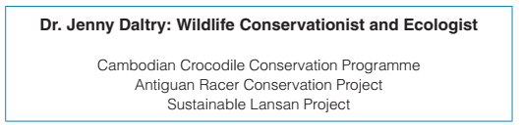
Grammar
A: Read the information in the box. Discuss the questions in pairs.
1. What do you think it means to conserve wildlife?
2. What kinds of wildlife do you think Jenny Daltry is interested in?
3. What kinds of challenges do you think Jenny Daltry might face in her work?

Slide 5

Listening
Exercise B: Listen to the conversation. Circle the correct options
1. What is the man working on?
a. a conservation project b. a presentation assignment
2. What did Daltry convince people in Cambodia to do?
a. to care about the crocodiles b. to kill fewer crocodiles
3. What causes problems for the Antiguan Racer snakes?
a. progress on the island b. people, rats, and bad weather
4. What will Tim probably talk about next?
a. other things he learned about besides crocodiles and snakes
b. other people he wrote about in his presentation

Slide 6
Listening
Exercise C: Listen again. Complete the statements with two or three words you hear
1. The assignment is to learn about someone who ___________
2. As a result of Daltry’s work, the Cambodian government decided to protect _____________ acres of forest.
3. She saved __________, and it’s an animal that most people don’t
even like.
has faced challenges
3 million
an animal

Slide 7
Role play
Female: Hi, Tim... Oh! Sorry to interrupt! Were you working on your presentation?
Male: Yeah, I’m doing my presentation on Jenny Daltry. She’s a wildlife conservationist and ecologist. Daltry studies endangered species—different kinds of animals and plants—and their place in the environment.
Female: We’re supposed to learn about someone who has faced challenges...
Male: And Daltry has faced some real challenges! In Cambodia, she was looking for a kind of crocodile— the Siamese crocodile—and most scientists thought it was extinct.
Female: Extinct? Is it even possible to find extinct animals?
Male: Well, Daltry walked into areas where nobody ever went, and she found a large group of the crocodiles, 200–300 of them, living in the wild! As a result of Daltry’s discovery of the Siamese crocodiles, the Cambodian government decided to protect three million acres of forest.

Slide 8
Role play
Female: That’s wonderful!
Male: Yes, an island called Antigua has a small snake called the Antiguan Racer. It was almost extinct, too, but Daltry led a snake conservation project.
Female: And how is the snake doing now?
Male: Well, although there are still challenges, they’re making progress.
Female: So that’s quite an achievement! She saved an animal species, and it’s an animal that most people don’t even like.
Male: That is part of the problem—people sometimes kill the snakes, and rats also kill and eat the snakes. Even the weather is hard on the snakes... hurricanes and other storms.
Female: Well, you chose an interesting person for the assignment

Slide 9


