Slide 1
UNIT 5: challenges
Class period 38: Pronunciation and communication

Slide 2
Whispering game
Warm-up
Rules:
Two groups of 8-10 people stand in 2 lines.
Teacher lets the last students of each line see the lists of words. They have to remember and whisper to the next ears. The first students of each line go to the board and write down what they hear. The group with more correct answers will be the winner.

Slide 3
Lists of words Helped Listened Start Convinced Protect Discovered Close Need Walked watched

Slide 4
Pronunciation
Daltry decided to protect the crocodile. She worked on conservation projects. She saved a species of snake

Slide 5
Pronunciation
Pronunciation of -ed Endings
After /d/ and /t/, the -ed sound is / d/ (decided, wanted);
After other voiced sounds, the -ed sound is /d/ (lived, played);
After other unvoiced sounds, the -ed sound is /t/ (stopped, washed).

Slide 6

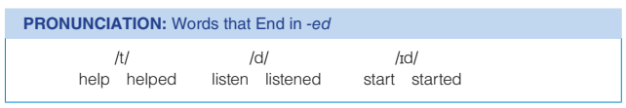
Pronunciation
Listen to these words that end in -ed

Slide 7
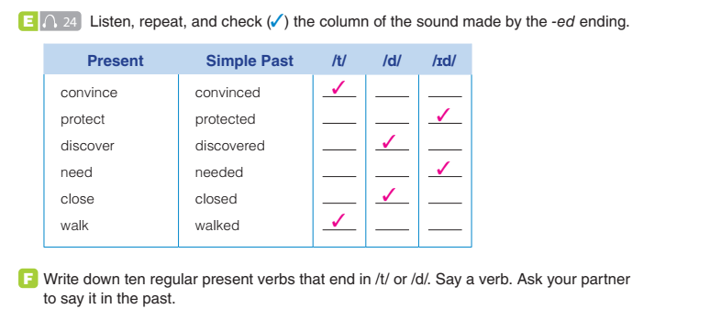
Pronunciation

Slide 8

Communication
G. Use the ideas in the box to talk about Jenny Daltry and her accomplishments.

Slide 9
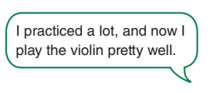
Communication
Describe Past Accomplishments
Tell a partner about your accomplishment.
Give details about how you did it and how you felt

Slide 10
Communication
sample
One of my past accomplishments was learning to swim. It required a lot of patience and practice, but with each lesson, I learned new techniques and improved my swimming skills.
I remember how I felt a mix of excitement and nervousness when I first entered the pool. However, my swimming instructor was very patient and encouraging. She taught me different strokes like freestyle and backstroke, floating and diving.
When I could swim comfortably and confidently, it was a great feeling of accomplishment for me.
Overall, learning to swim was both challenging and rewarding.

Slide 11


