Slide 1
UNIT 5: Challenges
Class period 39: Language expansion + grammar

Slide 2

Discussion
1, Can you name some challenges in Lesson A?
2, What abilities did you need to face these challenges?
Warm-up

Slide 3
Now, voice your opinion and share them with class.
For example: I was fast enough to win the race.

Slide 4
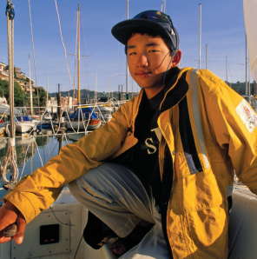
Exercise C : reading the text
Look at this picture and answer these question. How old do you think he is? Where is he? What challenges did Subaru face?

Slide 5
Exercise B : reading the text
Now read the text again and complete exercise B.

Slide 6
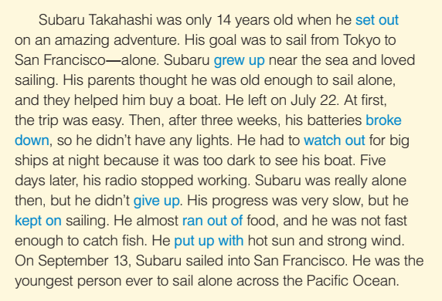
Exercise B : reading the text

Slide 7
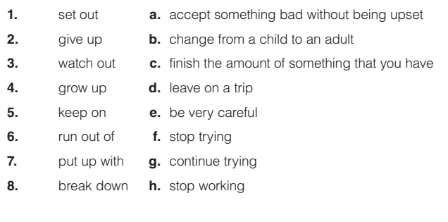

Exercise B : reading the text

Slide 8
Exercise C: Discussion - my world
1, Would you have been brave enough to sail across the ocean alone at the age of 14? 2, What brave things have you done in your life? Discuss in pairs.

Slide 9
Adjective to discuss abilities
brave experienced
fit busy
independent careful
interested challenging
patient complicated

Slide 10
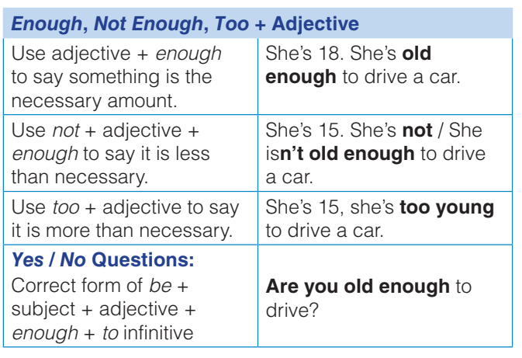
Grammar

Slide 11
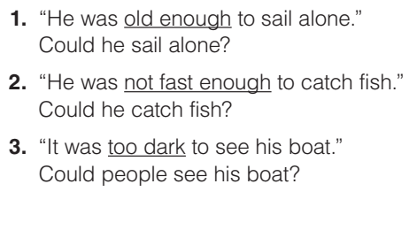

Grammar
Exercise D: Read these sentences and the questions that follow. Circle Y for yes or N for no.

Slide 12
Grammar
Exercise E: Complete the sentences. Use enough, not enough, or too, and the adjective 1. Subaru’s boat was (big) for two people. 2. A boat is (expensive) for me to buy because I don’t have much money. 3. Crossing the ocean alone is (difficult) for most people to do. 4. My parents say I’m (old) to travel alone. I have to wait until I’m 18. 5. I think Subaru’s trip was (dangerous) for a young person. His parents should not have let him go alone. 6. A trip to San Francisco by plane is a fun adventure, and it’s (safe) for my family and me. Maybe we’ll go there for our next vacation.

Slide 13
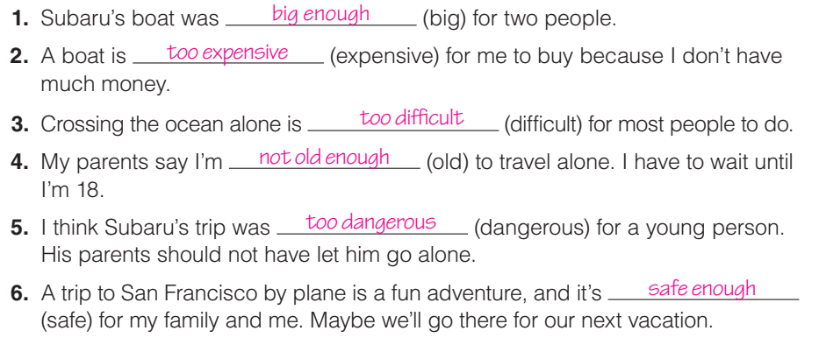
Grammar

Slide 14
Extra exercise
Combine these sentences using “too+ adj. + to –verb” or “adj. + enough + to verb” These oranges are ripe. You can eat them. He is strong. He can carry this table. The house is large. My family can live in it. It was very late. They didn’t go to the movies. The dress is so dirty. She can’t wear it. She is not tall. She can’t reach the stop shelf. Mr. isn’t rich. He can’t buy a car. My grand mother is very weak. She can’t lift the book. The film is very good. The children won’t miss it. Those shoes are large. You can wear them.

Slide 15
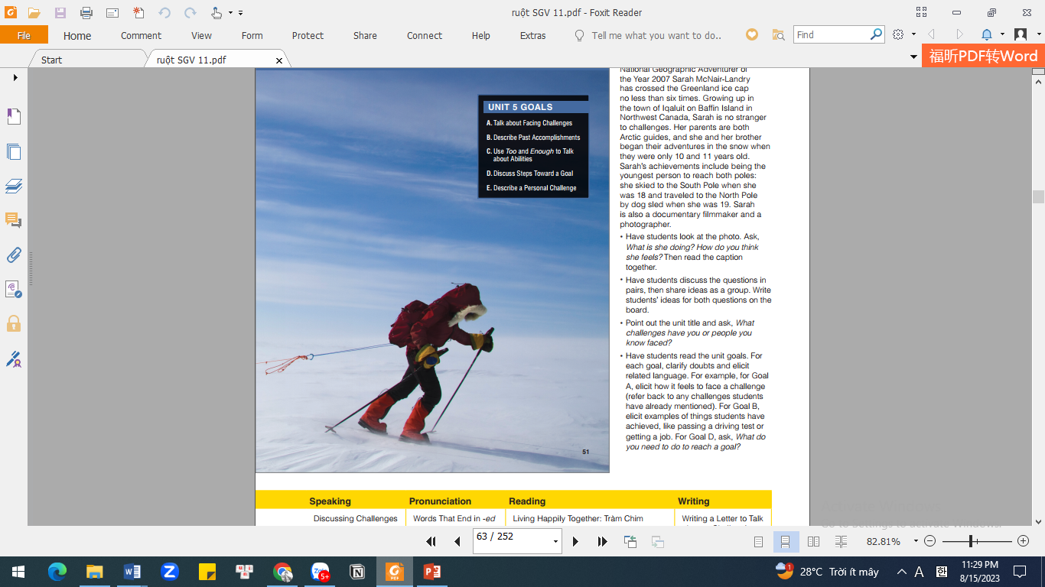
Exercise F: Listen
Close your book and listen to the conversation. What does Lisa need to do before she can climb the mountain?
She needs to get stronger by hiking every weekend

Slide 16
Goal check
Write down six things you want to do. In pairs, discuss whether you can do these things now. Are you old enough to do them? Are they affordable or too expensive?

Slide 17


