Slide 1
UNIT 5: challenges
Class period 40: Reading

Slide 2
Hangman
Warm-up
https://www.hangmanwords.com/play/custom?g=VHJhbSUyMGNoaW0=
Rules
Students try to figure out an unknown word by guessing letters. If too many letters which do not appear in the word are guessed, the player is hanged (and loses)
Clues
It’s a national park.
It has 8 letters
It’s in Dong Thap province

Slide 3
Establish (v) | Thành lập
Home to | Là nơi ở, trú ngụ của
Destination | Điểm đến
Re-crown crane | Sếu Nhật bản
Heron | Chim Diệc xanh
Threaten (v) | Đe dọa
Ponds | Ao
Fertile | Màu mỡ
Floodwater | Nước lũ
Nutrient | Chất dinh dưỡng
Overfishing | Đánh bắt cá quá mức
Ecotourism | Du lịch sinh thái
sustainable | Bền vững
Local specialties | Đặc sản địa phương
Dinghy | Xuồng ba lá
Nocturnal sound | Âm thanh về đêm
Language barrier | Rào cản ngôn ngữ

Slide 4
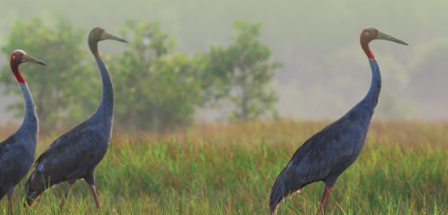
Describe photo
This photo shows red-crowned cranes in Tràm Chim National Park, Đồng Tháp Province, Việt Nam. Located 19 km to the east of the Mekong River, the national park has a diverse wetlands ecosystem and is home to over 130 species of vegetation, 231 species of water birds, 130 species of fish, etc. On May 22nd, 2012, Tràm Chim was designated the 4th Wetlands of International Importance (Ramsar Site) in Vietnam. However, in recent years, its biodiversity has been threatened by many factors, such as overfishing, pollution, invasive species, and climate change. Thus, the local government and people are finding solutions to preserve the environment in the park

Slide 5
Reading strategy
Identifying Topic Sentences
Being able to identify topic sentences when reading (as in B) helps students grasp the main ideas of a text more quickly. Topic sentences also clarify a text’s organization, making it easier for students to locate specific details and examples. Students should look for a topic sentence at the beginning of each paragraph but be aware that it is not always the first sentence.

Slide 6
Reading
Exercise B: Read the article. Answer the questions
1. How do shrimp ponds threaten Tràm Chim National Park?
2. What are some examples of ecotourism services at Tràm Chim?
3. Do you think the farmers and the tourists can understand one another? Why?
They prevent fertile floodwater from entering the park
Some examples are: homestay, birdwatching, enjoying local specialties, going on wooden dinghies
Yes. It is because they can laugh together

Slide 7
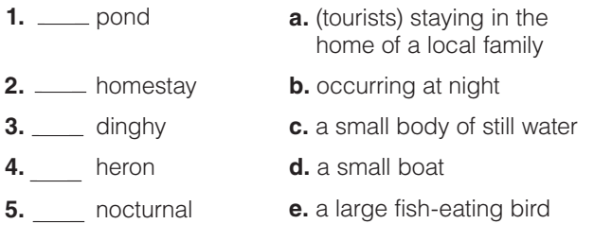
Reading
Exercise C: Match the words with the correct definitions
C
a
d
e
b

Slide 8
Discussion
Exercise D: Work with a small group. Discuss the questions
1. What do you think local people need to participate in ecotourism?
2. What are some possible challenges for them in providing ecotourism services?
3. Would you like to visit Tràm Chim National Park sometime? What could you do to help people there?

Slide 9
Goal check
1. What problem is everyone in your group concerned about? It might be a global problem or a local problem in your country or city.
2. What is a realistic solution to your problem?
3. What are 3–4 steps you could take toward realizing your solution? Make a list.

Slide 10


