Slide 1
UNIT 5: challenges
Class period 41: communication

Slide 2
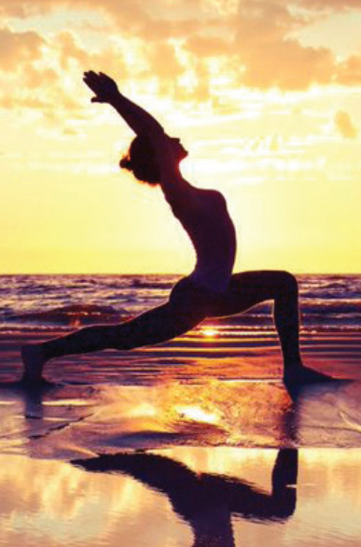
Warm up
Is this activity challenging? Why?
Why do you think she chose to take on this challenge? What will she get from it?
Comfort zone

Slide 3
Communication
Exercise A: Describe a challenge that you had to face in life. In pairs, answer the following questions
1. What was the challenge?
2. When did you face that challenge?
3. What did you do to overcome it?

Slide 4
Vocabulary
Face this challenge
To overcome this challenge
Take steps
Seek help of/from sb
Practice
Prepare

Slide 5
Sample
The challenge I had to face in life was speaking in front of a large audience.
I faced this challenge during my college years when I had to give a presentation in one of my classes.
To overcome this challenge, I took several steps. Firstly, I prepared thoroughly by researching and organizing the content of my presentation. Then, I practiced my speech multiple times in front of a mirror and recorded myself to identify areas where I could improve. Additionally, I sought the help of a friend who was confident in public speaking, and they gave me constructive feedback and shared some helpful tips.

Slide 6
Exercise B page 160
People face challenges for different reasons, but there is usually some reward when they accomplish their goal.
What are three or four challenges in life that cannot be avoided? (For example, it can be a challenge to get along well with all of our family members or neighbors.)
What are the rewards if we face those challenges? Discuss these questions in pairs.
something that you receive because you accomplished something; it could be something physical like a medal, or emotional like feeling good.
rewards

Slide 7
Exercise B page 160
Challenges in life that cannot be avoided
Dealing with changes
Facing personal conflicts:
Dealing with failures

Slide 8
Exercise B page 60
Challenges in life that cannot be avoided
Personal growth
Experience and skills

Slide 9
Exercise C page 60
Tell your partner about two or three challenges in your life that you will choose for yourself. Why do you choose to do those things?

Slide 10


