Slide 1
UNIT 5: challenges
Class period 42: Writing

Slide 2

Warm up
How do you usually contact with friends?
https://take.quiz-maker.com/poll4895449x9DEA44f9-151
Writing emails using specific information and conjunctions.

Slide 3
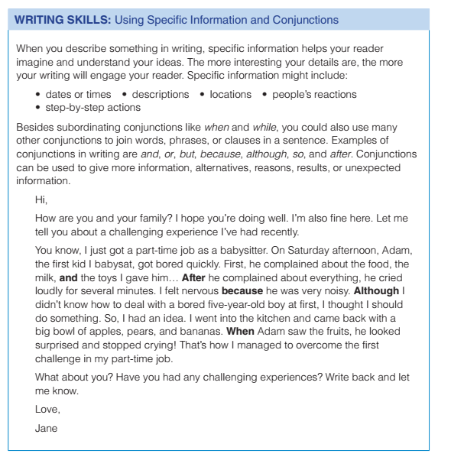

Writing strategy

Slide 4
Exercise D page 61
In pairs, rank the information from 1 (most specific) to 3 (least specific). Discuss your reasons
1. Children two-year-old boys two-year-olds
2. Vehicles airplanes transportation
3
1
2
2
1
3

Slide 5
Exercise E page 61
Circle the correct conjunction to complete each sentence.
1. And / Or / But / Although the employees made a lot of effort, the company didn’t make a good profit last year.
2. I’m focusing on my English study so / because / but / when I want to work as an interpreter in the future.
3. She is a very bright student, or / when / but / so she should be aware that she still has a lot of things to learn.
4. Bob wants to stay in shape, so / because / when / although he goes running every day.
5. Or / Although / After / And he graduated from high school, he went to America to continue his studies.

Slide 6
Exercise F page 61
Choose one of the challenges you told your partner about in A. Follow the steps.
1. Write one sentence to describe the challenge.
2. Under the sentence, list key words about what happened. How did you face the challenge? What happened after that?

Slide 7
Sample
One challenge that I faced in life was learning to ride a bike.
Scary
didn't know how to balance and steer properly
Got a few scratches
Not give up
Parents helped
Able to ride without support

Slide 8
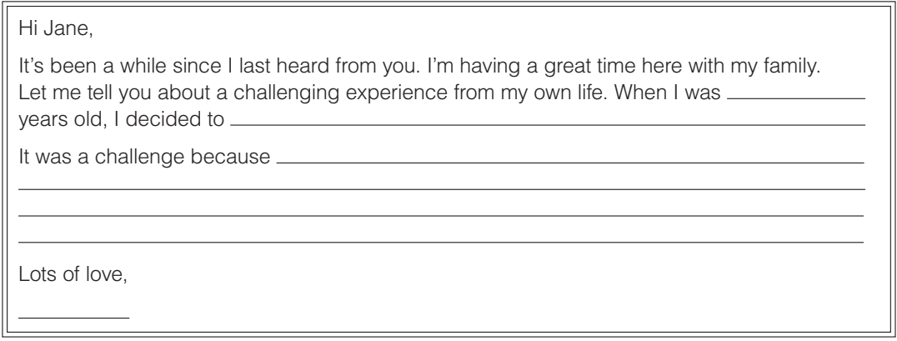
Goal check
Describe a personal challenge
Write an email (150-180 words) to jane, telling her about a challenging experiences from your own life

Slide 9


