Slide 1
UNIT 6: Challenges
Class period 43: Unit opener and vocabulary

Slide 2

Warm-up
Discussion
There are different stages in our lives.
Discuss in groups what big stages are there in your opinions?
Transitions

Slide 3
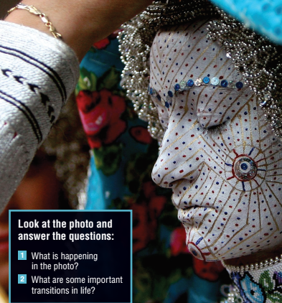
About the Photo
This photo shows a Kosovar Bosnian bride in Donje Ljubinje, a remote village in southern Kosovo. Her face has been painted as part of the wedding ceremony. The tradition of painting brides’ faces so intricately goes back a thousand years. According to tradition, the bride’s face is painted to prevent bad luck, and the symbols in the design have special meanings. The photo was taken by the photographer Valdrin Xhemaj, who is from Kosovo himself.

Slide 4
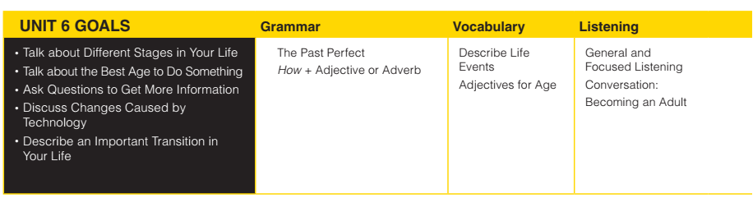
UNIT 6: Challenges

Slide 5
Vocabulary
Astronomer (n):
Attend lectures (v):
Develop (v):
Genetics (v):
Earn a degree (v)
Direction (n)
Rainforest (n)
Schedule (n)
Nhà thiên văn học
Tham gia bài giảng
Phát triển
Di truyền học
Lấy được bằng
Hướng
Rừng nhiệt đới
Lịch trình

Slide 6
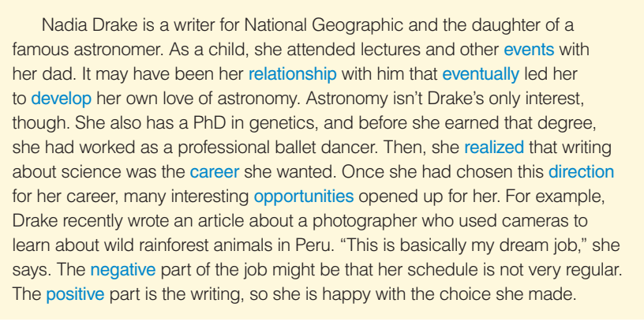
Vocabulary
Exercise B: Write each word in blue next to the correct meaning

Slide 7

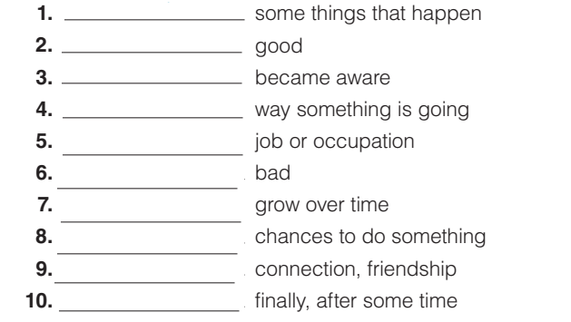
Vocabulary
Exercise B: Write each word in blue next to the correct meaning

Slide 8
Vocabulary
Building sentences using the word in exercise A and B
Astronomer (n):
Attend lectures (v):
Develop (v):
Genetics (v):
Earn a degree (v)
Direction (n)
Rainforest (n)
Schedule (n)
The astronomer gazes at the stars with wonder and curiosity.
I attend lectures to enhance my understanding and knowledge.
She worked hard to develop her skills in her field.
Genetics can determine certain traits and characteristics.
He dedicated years of study and research to earn a degree in astronomy
Having a clear direction in life helps me stay focused and motivated
The rainforest is home to a diverse range of plant and animal species.
I carefully manage my schedule to balance work, study, and personal activities.

Slide 9
Vocabulary
Exercise C: In your opinion, which of the following affects one’s life the most?
personal relationship career
opportunities self-development

Slide 10


