Slide 1
UNIT 5: challenges
Class period 44: Grammar

Slide 2

Warm-up
What did you do last night?
(2 activities)
Which action happened first?

Slide 3
Today, we will learn to review past perfect

Slide 4

Grammar
Watch video
https://player.vimeo.com/video/299259989

Slide 5
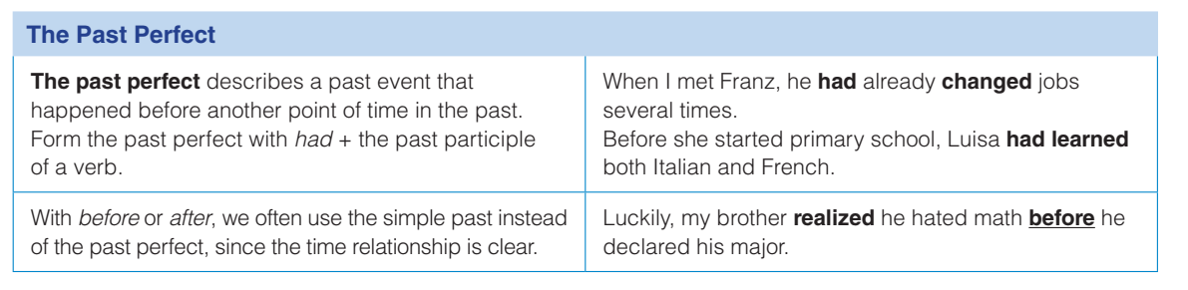
Grammar

Slide 6
Grammar
D. Complete each sentence using the past perfect form of the verb in parentheses.
had been
1. Before Nadia Drake earned her degree, she (be) …………….. a ballet dancer.
2. Her father (love) ……………… astronomy and Nadia also developed a love for it.
3. The teacher (realize) ……………….. the topic was difficult, so she explained it carefully.
4. She (plan) ……………….. to have a different career, but she eventually became a software writer.
5. We weren’t surprised when the road changed direction because we (study) ………………. the map
had loved
had realized
had planned
had studied

Slide 7

Grammar
Grammar game
https://quizizz.com/admin/quiz/5ea06e00f3ec79001e0ba805/past-perfect-simple

Slide 8
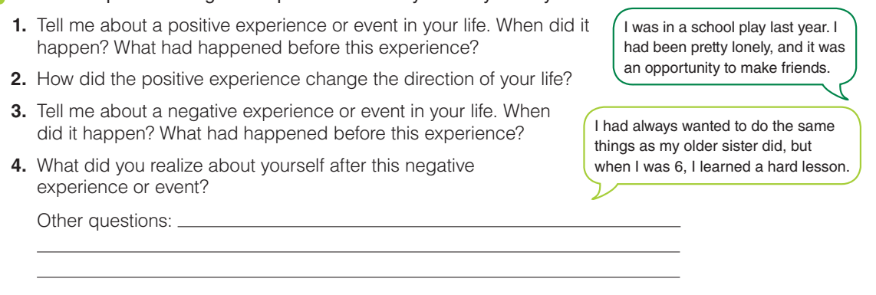
Grammar
Interview a partner using these questions and any others you may have

Slide 9
Grammar
Word Bank: Experiences in Life
an accident
a friendship
getting fired / laid off
getting married / divorced
having a child
an illness / an injury
a job opportunity
leaving home
a loss
a promotion

Slide 10
Homework
Complete grammar exercises at home (see grammar reference page 151, 152)

Slide 11


