Slide 1
UNIT 6: transition
Class period 45: Listening

Slide 2
Guess what?
Warm-up
It has 2 words
It refers to a specific time period in someone's life.
It is often associated with a specific developmental stage or learning process.
It suggests an optimal timeframe for acquiring certain skills or abilities.

Slide 3
The answer is:
Critical period

Slide 4
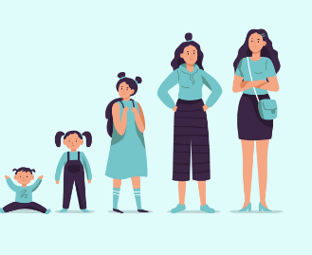
Exercise A: Discussion
Work in pair then add your own ideas if you have. In your opinion, when does someone become an adult? Why? • when they graduate • when they have a child • when they have their own home • when they start their career

Slide 5
Vocabulary
Do one’s taxes (v):
Adulthood (n):
Savings plan (a):
Graduation (n):
take care of (v):
have a positive view of … (v):
finish my education (v):
Đóng thuế
Thời kì trưởng thành
Kế hoạch tiết kiệm
Tốt nghiệp
Chăm sóc
Có thái độ tích cực
Hoàn thành việc học ở trường

Slide 6
Vocabulary checking
2 students on board. Other students read aloud the definitions; these students write the words on board. Those who have more correct answers will be the winner.

Slide 7

Exercise B : Listen the conversation
Listen to a conversation between two friends. Circle T for true or F for false. The man is helping the woman with her savings plan and her taxes. T F 2. The woman hopes to help her parents financially. T F 3. The man will help the woman with her finances again next year. T F
T
F
F

Slide 8
Listening strategies
Listening for Details When listening for specific information, students should listen for words related to the details they need. To do this, they first need to identify what kind of information they require. For example, numbers, dates, place names, or key words related to specific ideas, as in C, where they need to listen for both the man and the woman’s opinions on adulthood and parents.

Slide 9
Exercise C: Listen and fill in the blank
Listen again. Fill in each blank with NO MORE THAN TWO WORDS. The woman thinks she is an adult because she has finished her ___________ and started a career. The man has a different idea about adulthood because he grew up in ____________ The woman thinks her parents ____________ her help with money. The man has a ____________ idea about helping his parents with money.
education
Vietnam
don’t need
positive

Slide 10
Role play
Woman: Thanks for coming over to help me. I never used to worry about my money. I mean, having a savings plan and doing my taxes... But now that I’m an adult and I have a career, I need to think about these things.
Man: That’s interesting... You think of yourself as an adult.
Woman: Well, sure! I’ve finished my education, and even before graduation I had started working. So, why am I not an adult?
Man: Well, I grew up in Việt Nam, and I have a different idea about adulthood. For me—and for a lot of Vietnamese people—you’re an adult when you can take care of your parents.
Woman: Do you mean take care of your parents financially? I know my parents will need my help.
Man: Yeah, probably. If your parents ever have health problems, for example, you’ll have a lot of opportunities to help them.
Woman: Right, or they might need help with cooking or cleaning, but my parents have their own money.
They don’t need me for that.
Man: That’s the difference, I guess. You have a positive idea about helping your parents in other ways, and I have a positive view of helping my parents with money.
Woman: Right... Here are my tax forms and my bank information. You really are nice to help me with this.
Man: I’m just helping you develop the skills. You’ll be able to do this yourself next year.

Slide 11
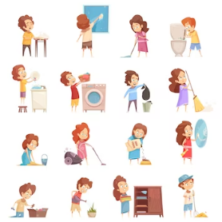
Exercise D: Speaking
In pairs, talk about how people from your culture usually help their parents.

Slide 12


