Slide 1
UNIT 6: Transitions
Class period 46: Pronunciation and communication

Slide 2
Whispering game
Warm-up
Rules:
Two groups of 8-10 people stand in 2 lines.
Teacher lets the last students of each line see the lists of words. They have to remember and whisper to the next ears. The first students of each line go to the board and write down what they hear. The group with more correct answers will be the winner.

Slide 3
Lists of words Infant Lettuce Differently Adult Memory Cultural Population Discovery Favorite Children
schwa and elision of vowels

Slide 4
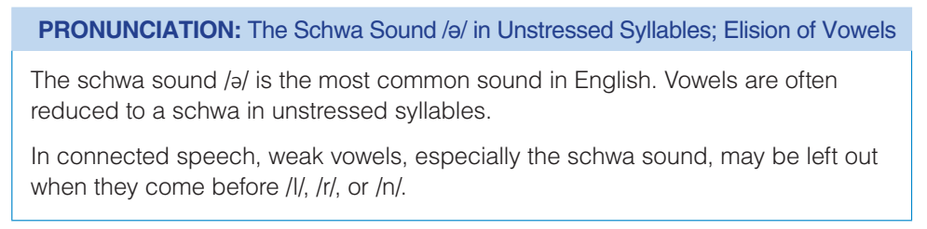
Pronunciation

Slide 5

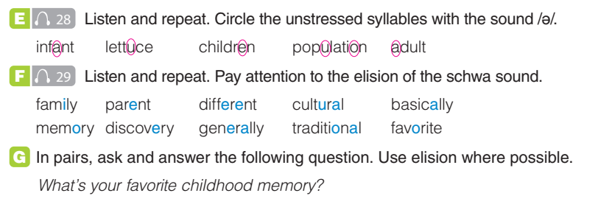
Pronunciation

Slide 6
Pronunciation
One of my favorite memories is from a sunny day at the beach. The sand was warm beneath my feet as I walked along the shore. I could hear the sound of waves. I built sandcastles with my family and we laughed together. We played in the water, splashing and swimming. Later, we had a picnic and enjoyed delicious sandwiches and refreshing drinks. As the sun began to set, we sat on the sand, watching the beautiful colors spread across the sky. It was a perfect day filled with joy and happiness.

Slide 7

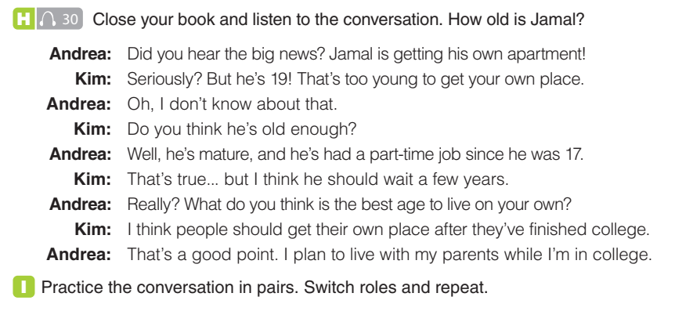
Conversation

Slide 8
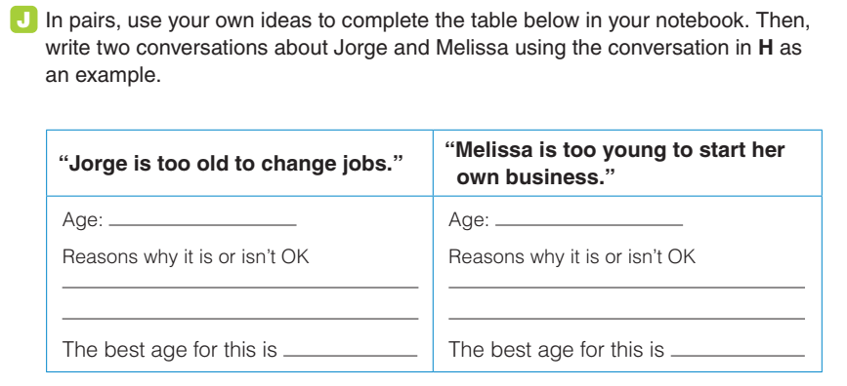
Conversation
50
Very few companies would accept employees at this age.
He has been successful in his current job
22-30

Slide 9
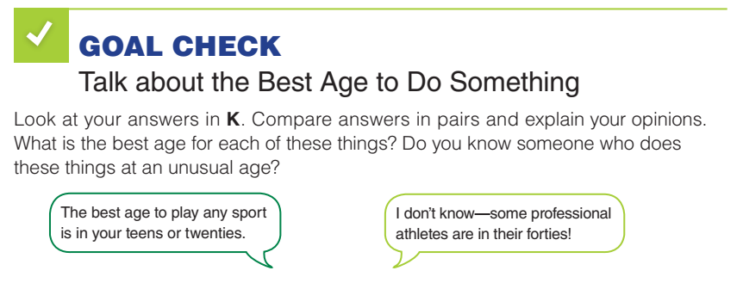
Conversation

Slide 10


