Slide 1
UNIT 6: transition
Class period 47: Language expansion + grammar

Slide 2

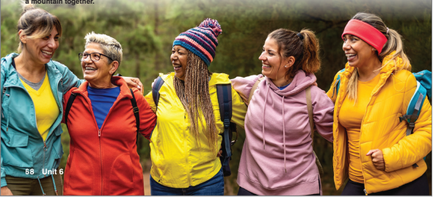
LET’S TALK
Look at the picture and describe it
1, How old do these women look?
Warm-up
Maybe she’s in her twenties; she might be in her sixties

Slide 3
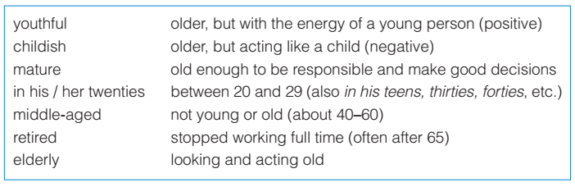
Exercise A: Adjectives for age
Do you know someone who fits any of these descriptions? Who are they? Share your answers in pairs. Use the adjectives in the box to help you
The woman in the middle must be reliable because she looks mature

Slide 4
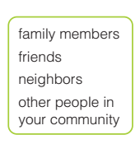
Exercise B : speaking
Talk with a partner about people you know. How old are they? Describe them with adjectives from A

Slide 5
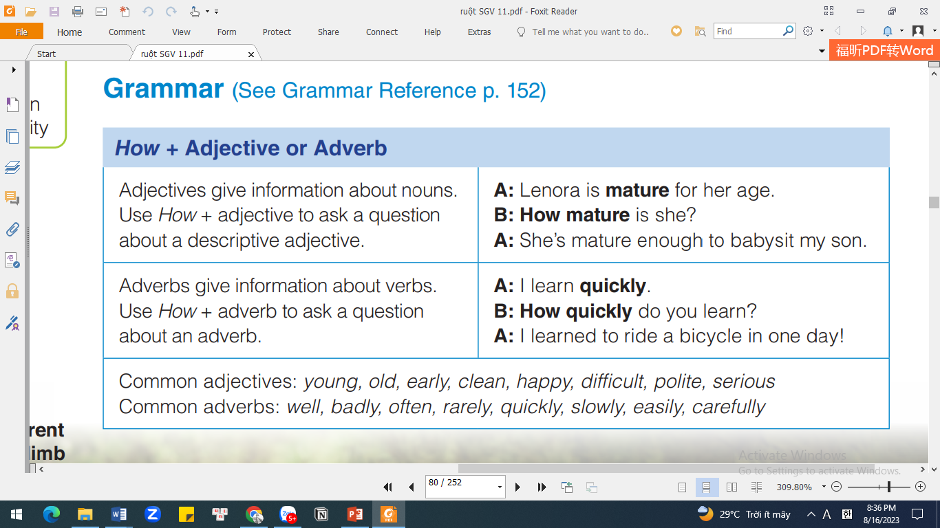
Grammar: How + Adj or Adv

Slide 6
Exercise C: Unscramble the questions
English / how / do / speak / well / you
How well do you speak English?
2. you / how / are / old
How old are you ?
3. can / fast / you / how / type
How fast can you type?
4. you / how / tall / are
How tall are you ?
5. your / family / how / often / move / does
How often does your family move?

Slide 7
Exercise D: Complete the conversation
Write questions using how.
A: I think Mr. Chen is too elderly to live alone
B: He doesn’t look old to me.
How old is she?
A: My brother failed his driver’s license test six times because he drives so badly.
B: Wow!
How badly does he drive?
A: I can’t go to the movie tonight. My first class is very early tomorrow.
B: That’s too bad.
How early is it?
A: I don’t want to get my own apartment. It’s much too expensive
B: Really?
How expensive is it?
A: I haven’t finished reading the assignment for tomorrow. I guess I read too slowly.
B: That’s a problem.
How slowly do you read?

Slide 8
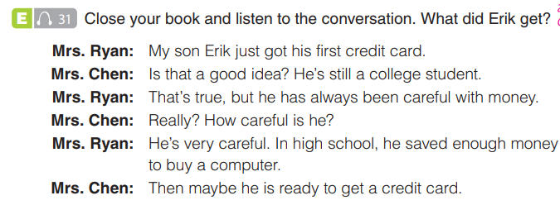
Exercise E: listen the conversation
A credit card

Slide 9
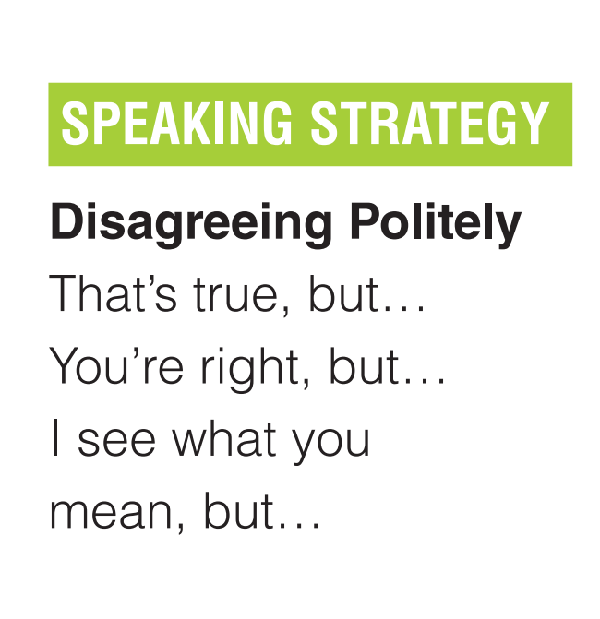

Exercise E: listen the conversation
A credit card

Slide 10
Exercise E: Role play

Slide 11
Exercise F: Practice
In your notebook, write 3–4 adjectives to describe a person you know. Then, write 3–4 things the person does and describe how the person does them.

Slide 12
Homework
Grammar reference page 152 Goal check

Slide 13


