Slide 1
UNIT 6: transition
Class period 48: Reading

Slide 2

Guess what?
Warm-up
It has a compound noun It is a method of education. It utilizes various forms of technology. - It allows individuals to pursue education remotely.

Slide 3
The answer is:
Distance learning

Slide 4
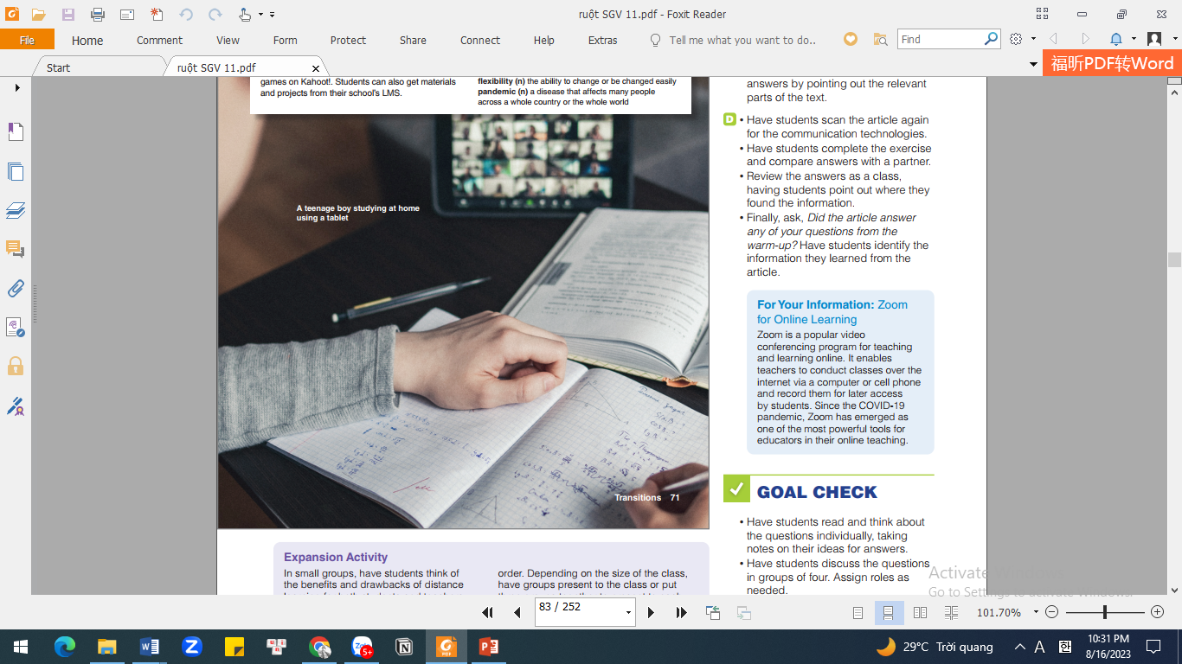
Exercise A: Discussion
Look at the picture and describe what do you see?

Slide 5
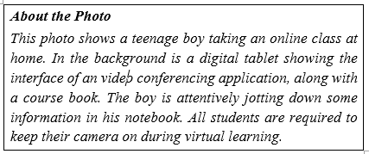
Exercise A: Discussion
Write three questions that you think the article will answer.

Slide 6
Exercise A: Discussion
Write three questions that you think the article will answer. Example How has distance learning improved? How has technology changed education? Why is distance learning important?

Slide 7
Exercise A: My world
In pairs, discuss how these technologies can be used for teaching and learning.
Messaging applications (e.g. Zalo, Facebook Messenger)
Video conferencing tools (e.g. Zoom, Google Meet)
Learning management systems (e.g. Blackboard, Moodle)

Slide 8
Exercise B: Matching
Mach the words with definitions
1.__ innovative a. involvement in something 2.__ interactive b. to change or to suit different situations or uses 3.__applications c. involving communication between people 4.__ engagement d. computer programs 5.__ to adapt e. new and original
e
c
d
a
b

Slide 9
Vocabulary
Distance learning | a way of studying in which you do not attend a school, college, or university, but study from where you live
Approach | Method
Correspondence course | a course of study in which students study at home and receive and send off work by mail or email
Advance | Development
Digital technology | digital devices, systems, and resources
In-person interaction | direct face-to-face communication

Slide 10
Vocabulary
Communication | The exchange of information and ideas between individuals or groups
Learning management systems (LMS) | Web-based platforms or software that provide tools and resources for managing, delivering, and organizing online educational content
Flexibility | the ability to change or be changed easily
Global pandemic | a disease that affects many people across the whole world
School closure | The temporary shutdown of educational institutions

Slide 11

Exercise C: True / False
Read the article again. Circle T for true or F for false. Make the false statements true. A correspondence course is a form of distance learning. T F Students do not go to classrooms when they do distance learning. T F In the past, distance learning was more interactive. T F Distance learning is not flexible. T F Many schools were closed during the COVID-19 pandemic. T F
T
T
F
F
T

Slide 12
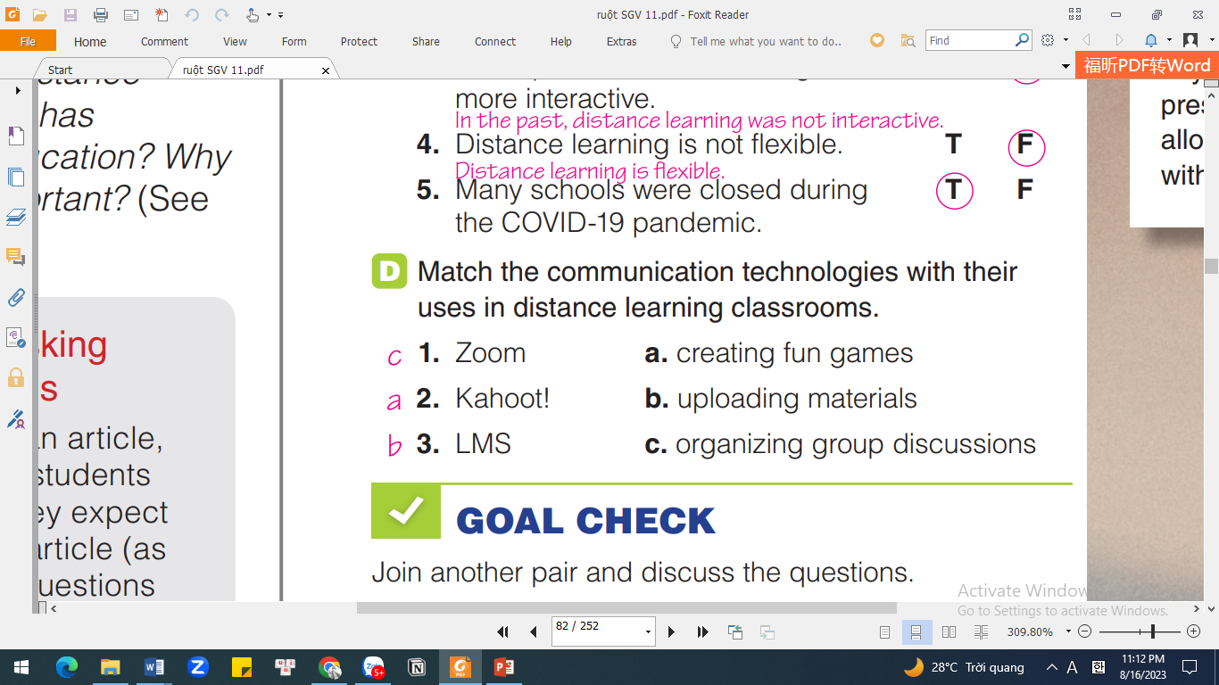
Exercise D: Matching
C
A
B

Slide 13
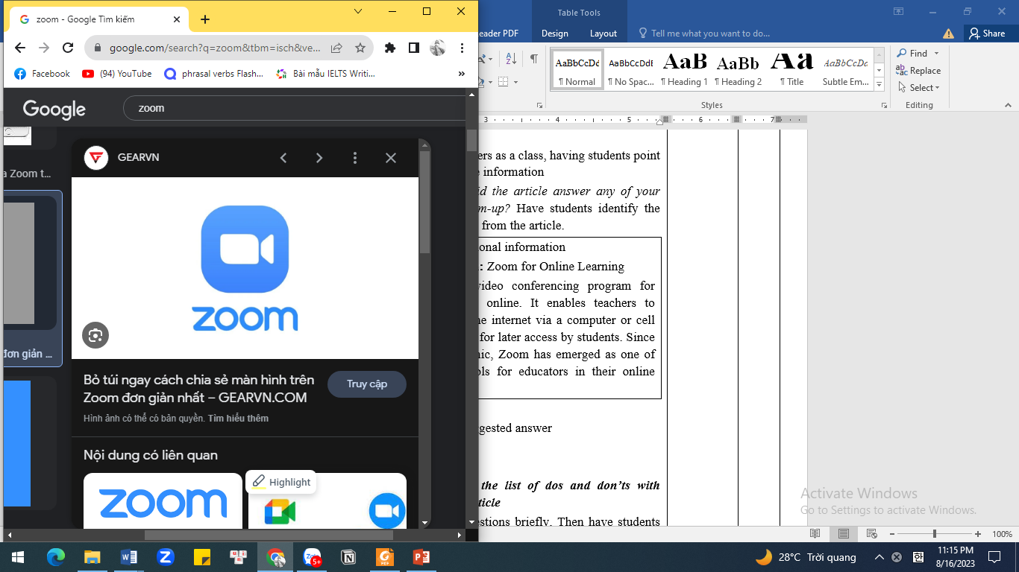
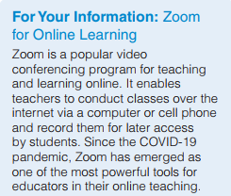
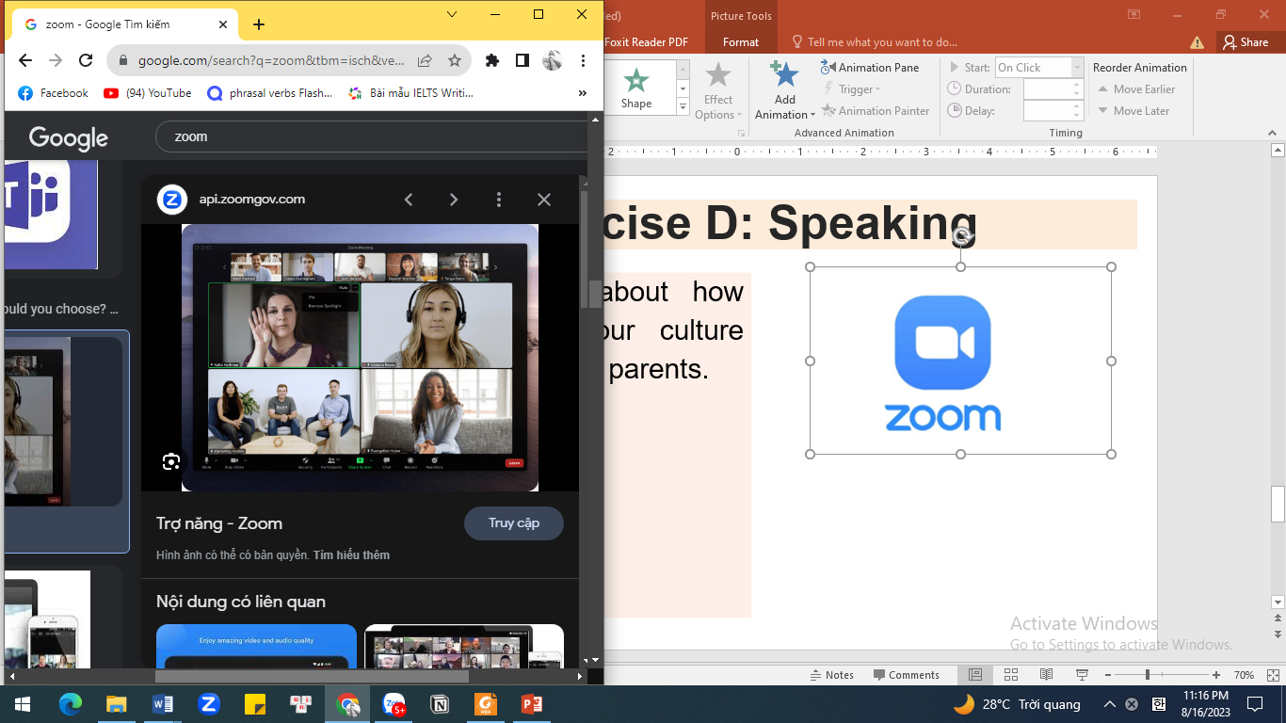
Exercise D: Matching

Slide 14
GOAL CHECK
Join another pair and discuss the questions. 1. Do you think the benefits of distance learning are greater than the benefits of face-to-face learning? 2. What are some drawbacks of distance learning? 3. Is distance learning suitable for you?

Slide 15
GOAL CHECK
In my opinion, the benefits of distance learning are greater than the benefits of face-to-face learning. Firstly, distance learning allows flexibility in terms of time and location. Students can study at their own pace and choose when and where to access the learning materials. This is especially beneficial for individuals with busy schedules or those living in remote areas. Secondly, distance learning offers a wide variety of courses and programs from different institutions around the world.

Slide 16
GOAL CHECK
There are also some drawbacks to consider. Firstly, the lack of face-to-face interaction can lead to a sense of isolation and reduced social connection with peers and instructors. Additionally, technical issues such as poor internet connection or computer problems can hinder the learning experience. Furthermore, distance learning requires self-motivation and discipline. Lastly, some subjects or practical skills may be challenging to learn solely through online platforms without hands-on guidance or practical demonstrations.

Slide 17
GOAL CHECK
Whether distance learning is suitable for you depends on your personal preferences and circumstances. Distance learning can be a good fit if you prefer flexible scheduling and the ability to learn at your own pace. It also allows you to study from the comfort of your own home. However, it requires self-motivation and discipline to stay on track without the structure provided by traditional classroom settings. Consider your learning style and responsibilities before deciding if distance learning is right for you.

Slide 18


