Slide 1
UNIT 6:TRANSITIONS
Class period 49: Communication

Slide 2
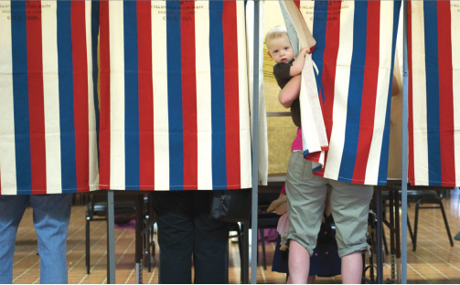
Warm up
Describe the photo
What do you see?
What is happening?
Goal: Describe an Important Transition in Your Life
What transition(s) in life does this photo show?
A child looks out as his mother votes in an election. The ability to vote is often one milestone that marks the transition into adulthood

Slide 3
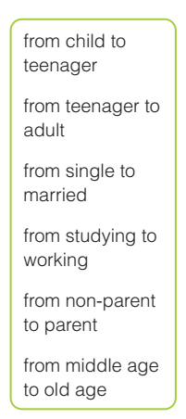
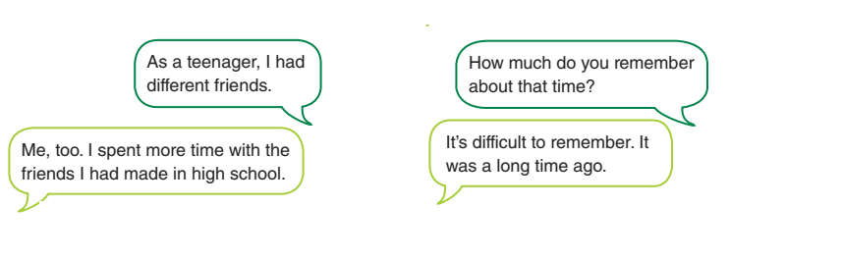
Exercise A
What do you know about each life transition in the box? Tell a partner what you think happens or what you have experienced. Listen carefully while your partner speaks. Ask questions to get more information.

Slide 4
Exercise B: Discuss the questions in pairs
1. Who does the cleaning and other chores at your house?
2. How often do you do your own laundry?
3. When was the last time you bought groceries?
4. Are you old enough to vote?

Slide 5
Extra exercise: Talk about one of the most important transition in life
What happens
What stage
An important transition
Why it’s important

Slide 6
Extra exercise: Talk about one of the most important transition in life
One of the most significant stages Infancy (n) To undergo significant changes/development Physical (adj) Cognitive (adj) Emotional (adj) Weight (n) Height (n) To acquire skills Motor skills: Rolling over, sitting up, crawling, walking. To explore and understand the world around

Slide 7
Extra exercise: Talk about one of the most important transition in life
One of the most significant stages in human life is infancy. Infancy, typically covering the first year of life, is a period of rapid growth and development. I think this is the most important because during the infancy stage, babies undergo significant physical, cognitive, and socio-emotional development. Physically, they experience tremendous growth in their weight, length. They acquire new motor skills, such as rolling over, sitting up, crawling, and eventually walking. Cognitively, infants begin to explore and understand the world around them. They show increasing awareness of their environment, respond to sounds and sights, and start to recognize familiar faces and voices. Language development also begins during this stage, with babies babbling and imitating sounds.

Slide 8


