Slide 1
UNIT 6: TRANSITIONS
Class period 50: Writing

Slide 2
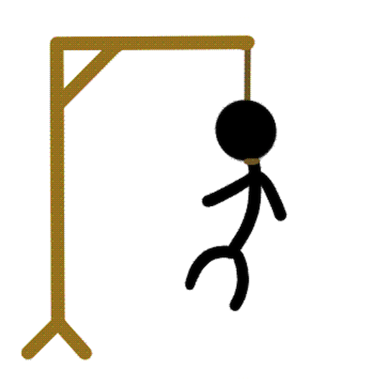
Warm up
Hangman
https://www.hangmanwords.com/play/custom?g=ZWxlY3Rpb24lMEE=
Rule: Students try to figure out an unknown word by guessing letters. If too many letters which do not appear in the word are guessed, the player is hanged (and loses).
Clues It has 8 letters It’s a human right It marks transition into adulthood

Slide 3
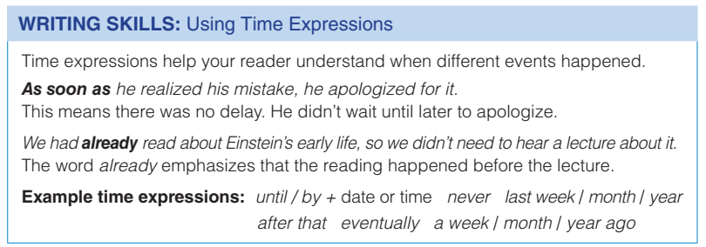

Writing strategy

Slide 4
Writing strategy
Using Time Expressions Time expressions act as signals to the reader that facilitate understanding. They tell the reader when an action or event happened in relation to the other actions / events in the text, connecting ideas and helping to organize the text. Coherence is an important aspect of any text, and students should be aware of and be reminded to use signal words such as time expressions when writing

Slide 5
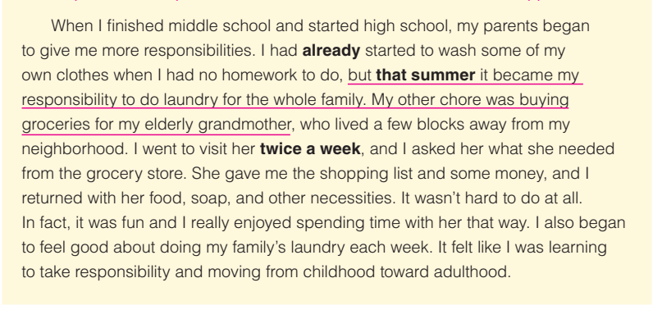
Exercise C: Read the sample paragraph and discuss the questions below with a partner (page 72)

Slide 6
Exercise C: Read the sample paragraph and discuss the questions below with a partner (page 72)
1. What is the topic sentence in this paragraph?
2. What two examples support the topic sentence?
3. How did the writer feel about this transition in his or her life?
4. How do the bolded expressions help you understand the writer’s meaning?

Slide 7
Exercise C: Read the sample paragraph and discuss the questions below with a partner (page 72)
1. What is the topic sentence in this paragraph?
2. What two examples support the topic sentence?
3. How did the writer feel about this transition in his or her life?
4. How do the bolded expressions help you understand the writer’s meaning?
The first sentence
The writer became responsible for doing the whole family’s laundry, and for buying groceries for their grandmother.
It felt like moving from childhood toward adulthood.
The expressions help readers understand when different event happened.

Slide 8
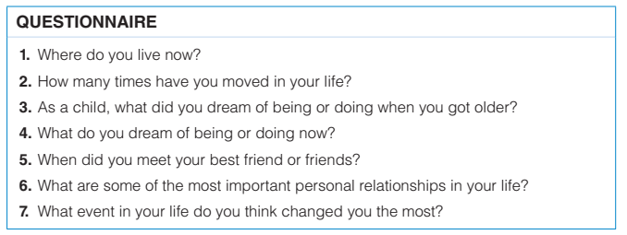
Exercise D: Complete the questionnaire. Write answers in your notebook.

Slide 9
Exercise D: Complete the questionnaire. Write answers in your notebook.
Stand up and interview at least 2 friends

Slide 10
Goal check: Describe an important transition in life
Work in small groups in 15 minutes
Read your answers to the questionnaire—especially to question 7. Write a well-organized paragraph (150–180 words) about a life transition and make sure it includes the following:
    a good topic sentence
    plenty of interesting details
    time expressions to show when things happened
make a brief outline

Slide 11
Goal check: Describe an important transition in life
One of the most significant stages in human life is infancy. Infancy, typically covering the first year of life, is a period of rapid growth and development.
I think this is the most important because during the infancy stage, babies undergo significant physical, cognitive, and socio-emotional development. Physically, they experience tremendous growth in their weight, length. They acquire new motor skills, such as rolling over, sitting up, crawling, and eventually walking.
Cognitively, infants begin to explore and understand the world around them. They show increasing awareness of their environment, respond to sounds and sights, and start to recognize familiar faces and voices. Language development also begins during this stage, with babies babbling and imitating sounds.

Slide 12


