Slide 1
Things that matter
UNIT 7 – OPENER & VOCABULARY

Slide 2
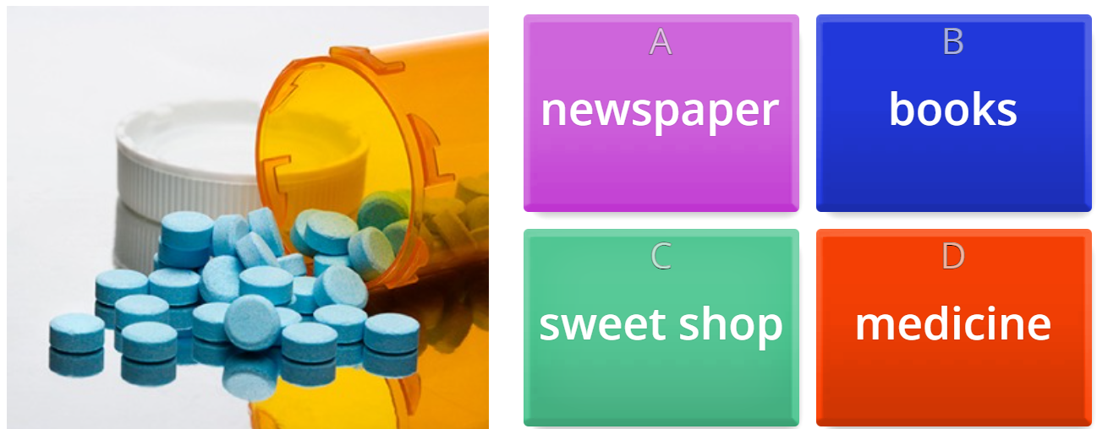

Warm-up: things you buy

Slide 3
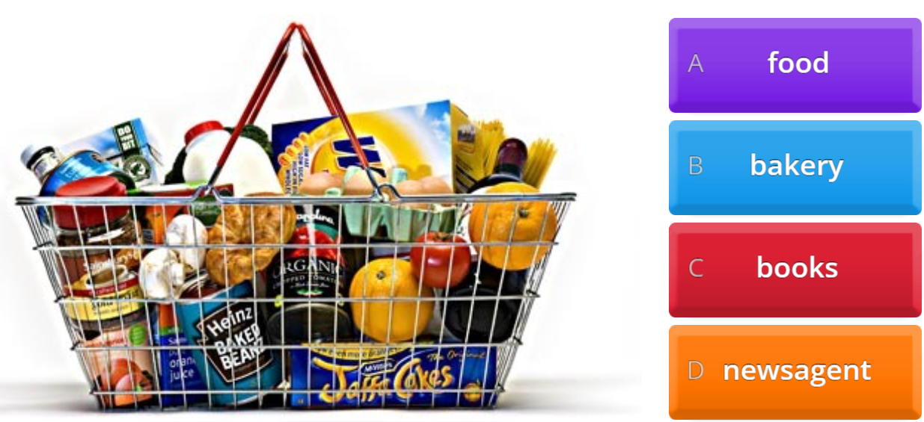
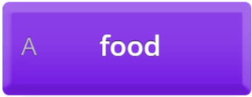
Warm-up: things you buy

Slide 4
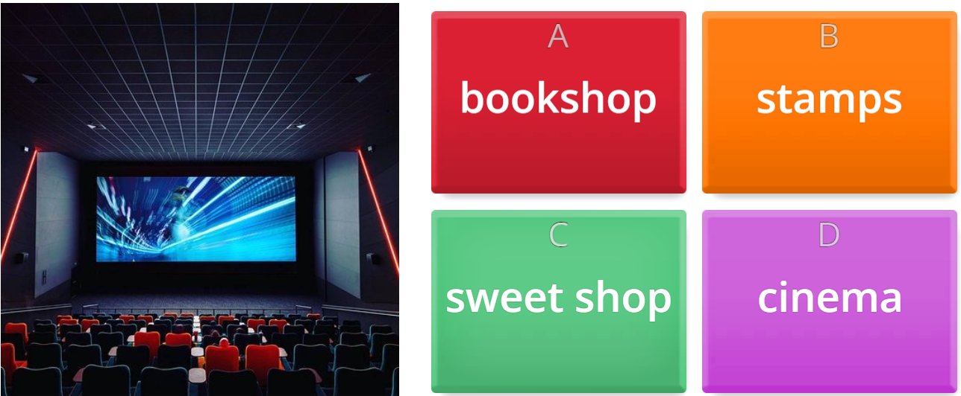

Warm-up: things you buy

Slide 5
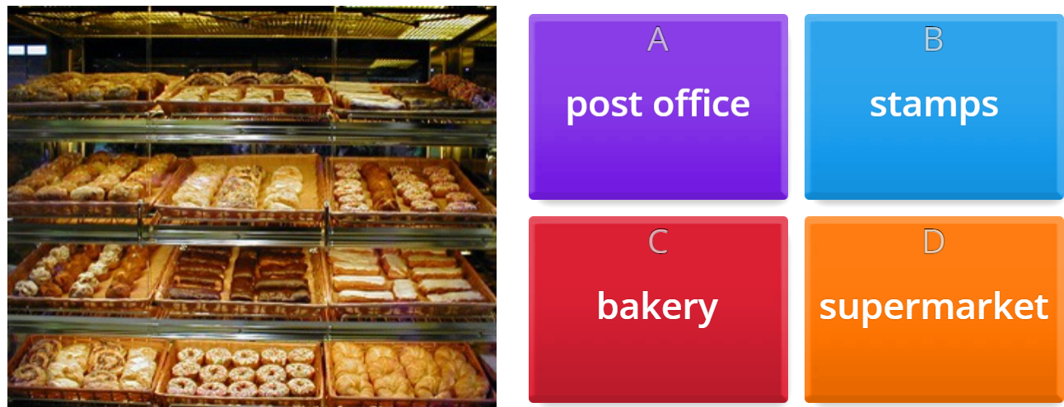
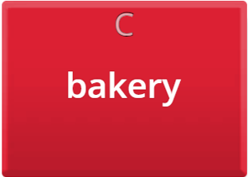
Warm-up: things you buy

Slide 6
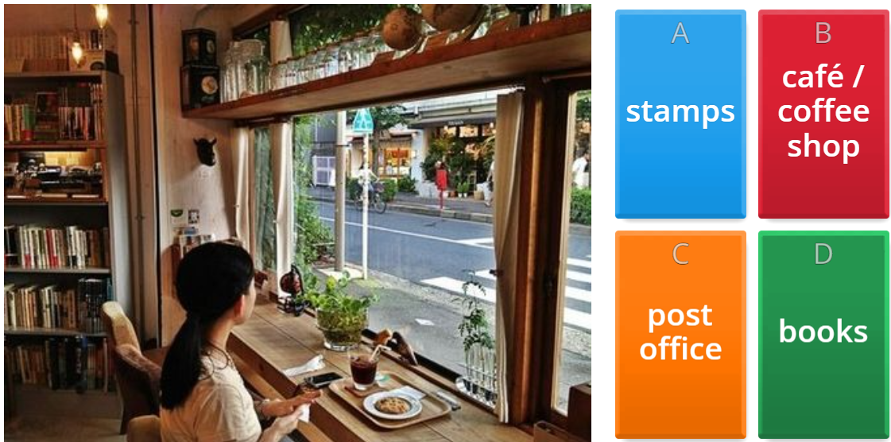

Warm-up: things you buy

Slide 7
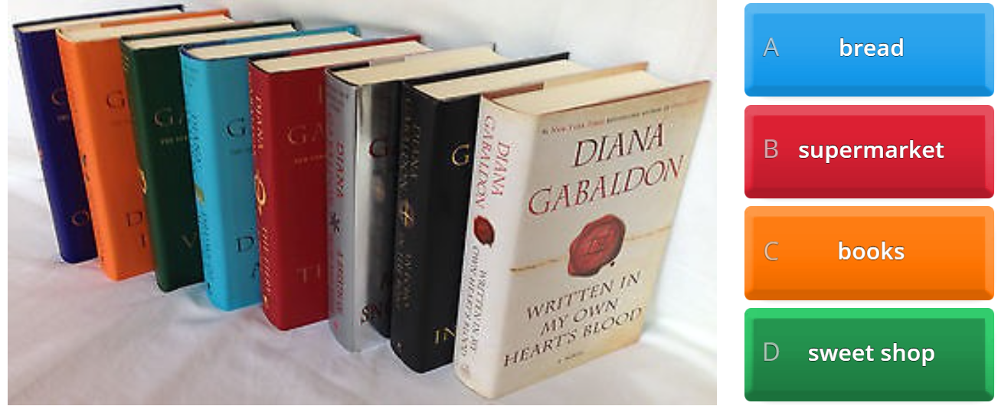

Warm-up: things you buy

Slide 8

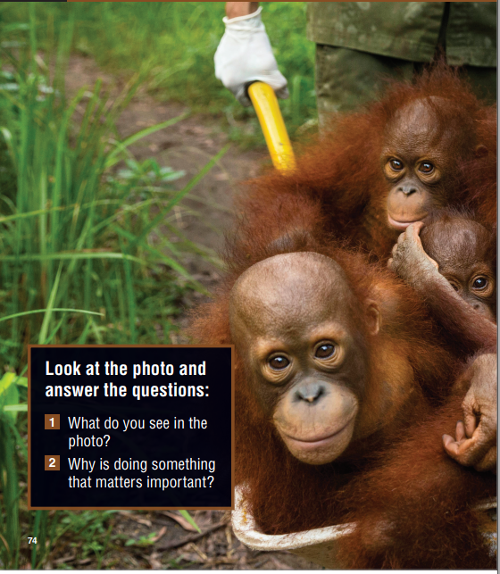


Slide 9
things I bought last week
WHAT ABOUT YOU?
I BOUGHT …..
Food? Shoes? ….
Grocery
Food
Books
Clothes
Kitchen utensils
Medicine

Slide 10
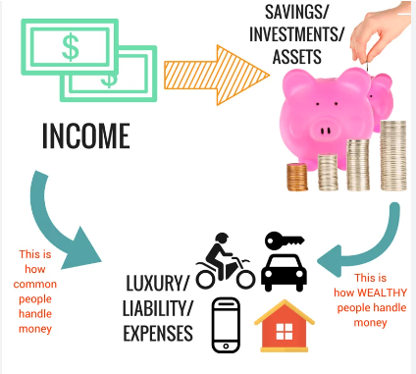
Spending habits
clothing and accessories;
coffee / tea;
electronic devices and accessories;
entertainment;
home improvement;
memberships (gym, sports club, etc.);
online shopping; subscriptions (music, video, etc.);
takeout food / eating out;
travel / transportation, etc.)

Slide 11
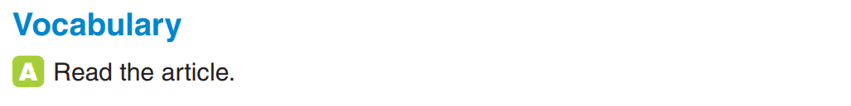
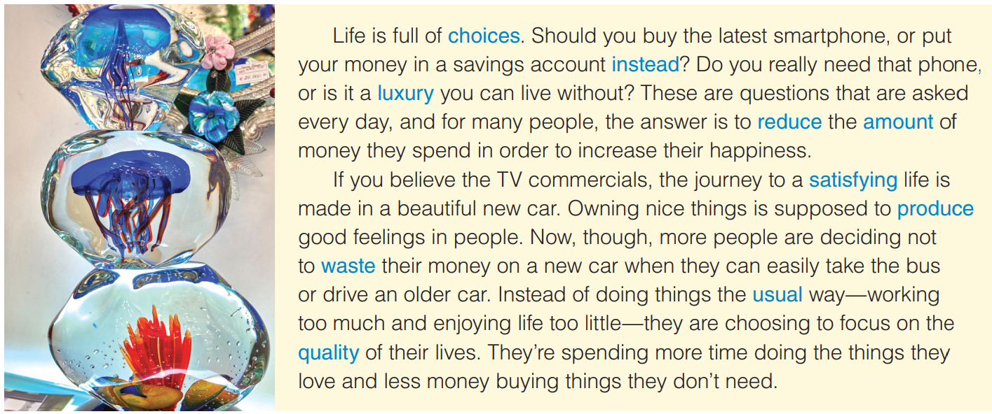
Why do people want to spend less?
To be happier
What are people spending more time doing?
the things they love
Do you think this piece of art is expensive?

Slide 12
listen and repeat
choice (n) /tʃɔɪs/: sự lựa chọn
instead (adverb) /ɪnˈsted/: thay vì
luxury (U) /ˈlʌkʃəri/: sang trọng
reduce (v) /rɪˈdjuːs/: làm giảm/ giảm đi
satisfy (v) /ˈsætɪsfaɪ/: làm hài lòng
satisfying (adj) : hài lòng
amount (n) /əˈmaʊnt/: nhiều
produce (v) /prəˈdjuːs/ ~ sth: sản xuất
waste (v) /weɪst/: lãng phí
usual (Adj) /ˈjuːʒuəl/, /ˈjuːʒəl/: thông thường/ bình thường
quality (n) /ˈkwɒləti/ : chất lượng

Slide 13
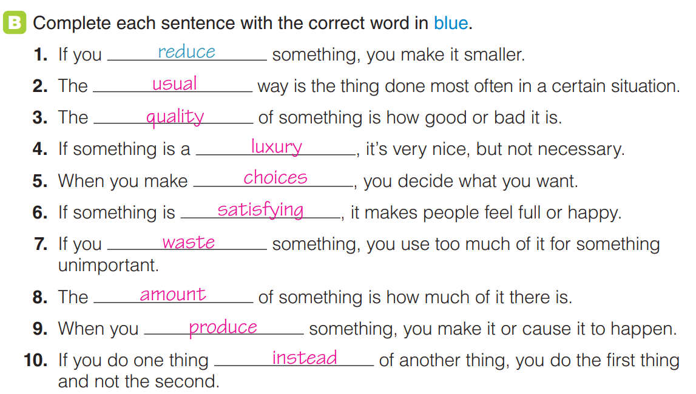

Slide 14
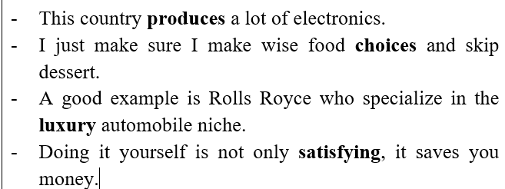
Choose 4 favorite words from vocabulary list to make full sentences.
  Suggested answers:

Slide 15


