Slide 1
Grammar passive voice in the present
UNIT 7 – THINGS THAT MATTER

Slide 2


Money is wasted on luxury items
Who wastes money on luxury items?
Who knows! We’ve just talked about money

Slide 3
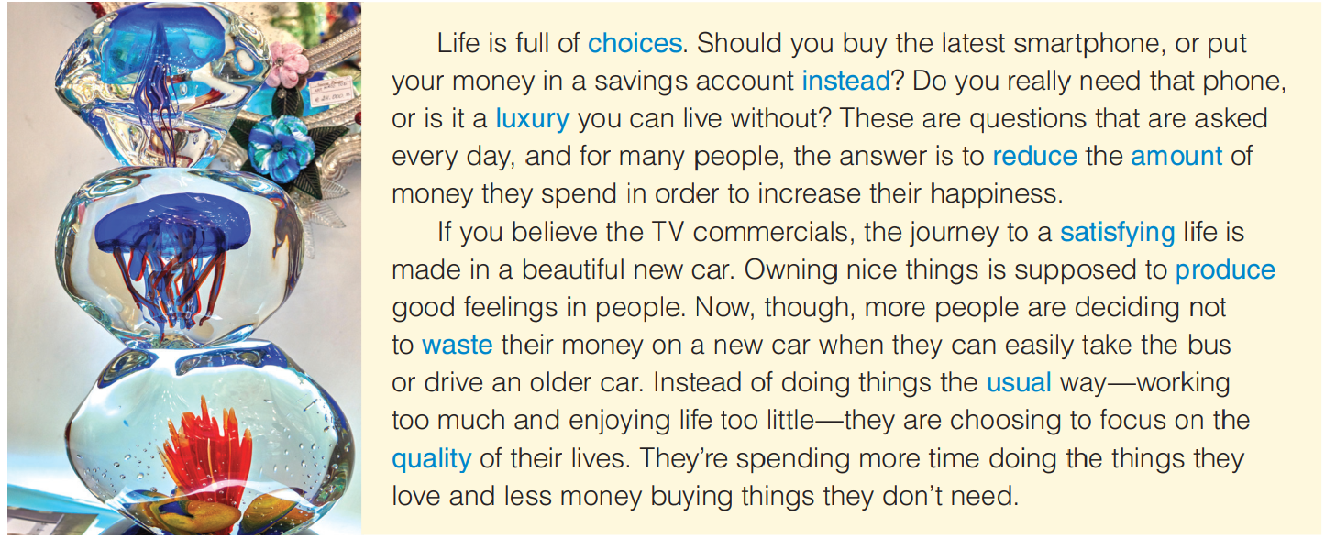
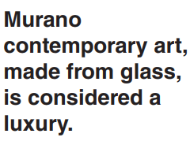
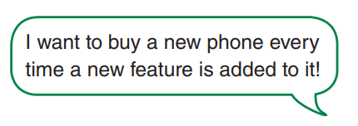
Do you know where Murano glass is made?

Slide 4
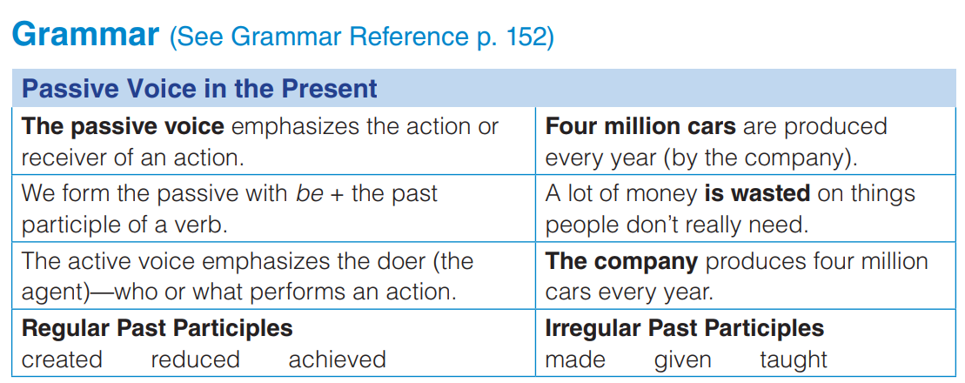
Write your own sentences:
Tomatoes are grown locally
….

Slide 5
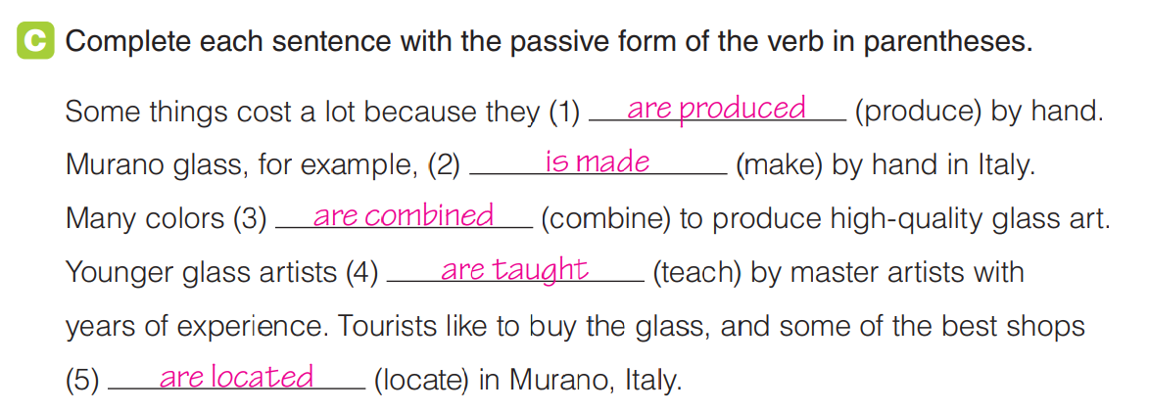

Slide 6
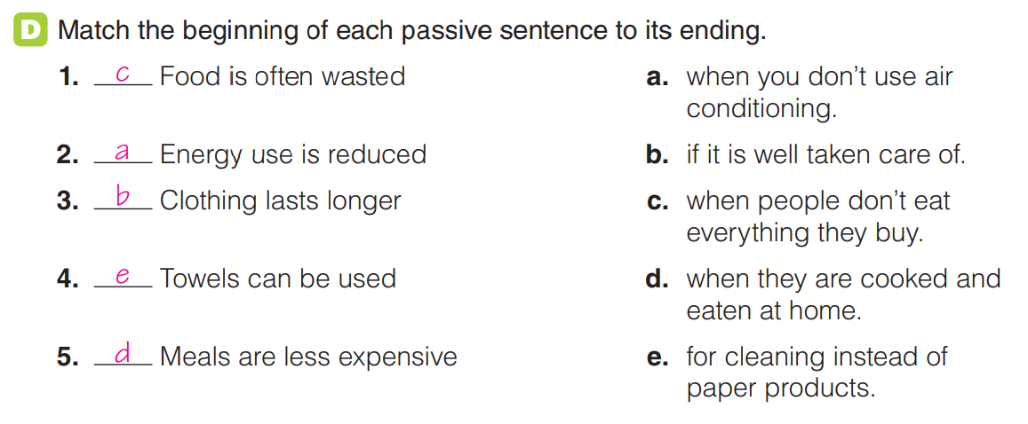

Slide 7
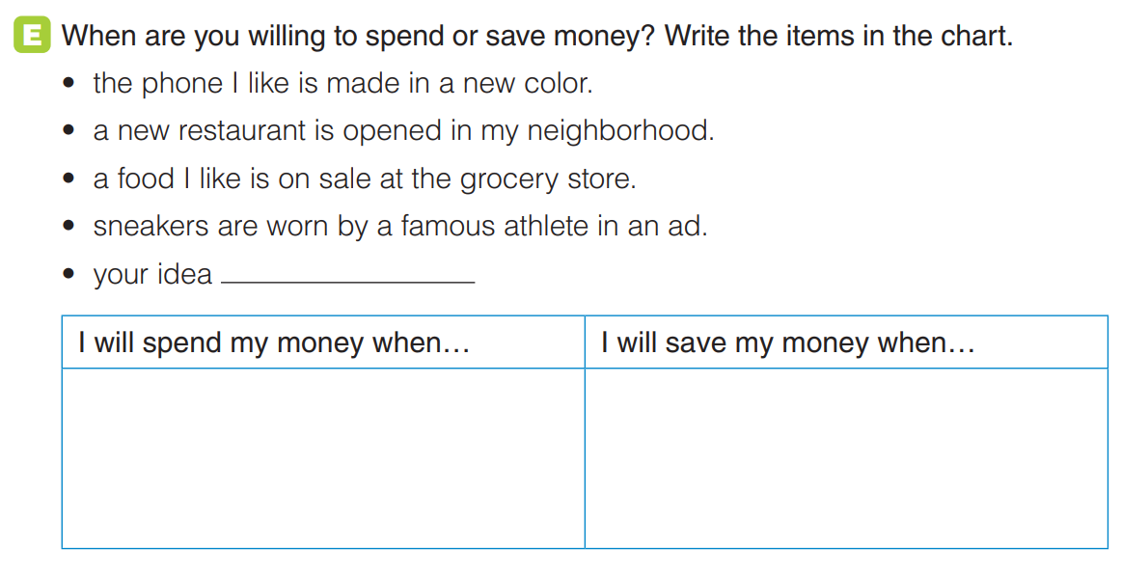

Slide 8
