Slide 1
Pronunciation
& communication
UNIT 7 – THINGS THAT MATTER

Slide 2


Warm-up: group sort

Slide 3
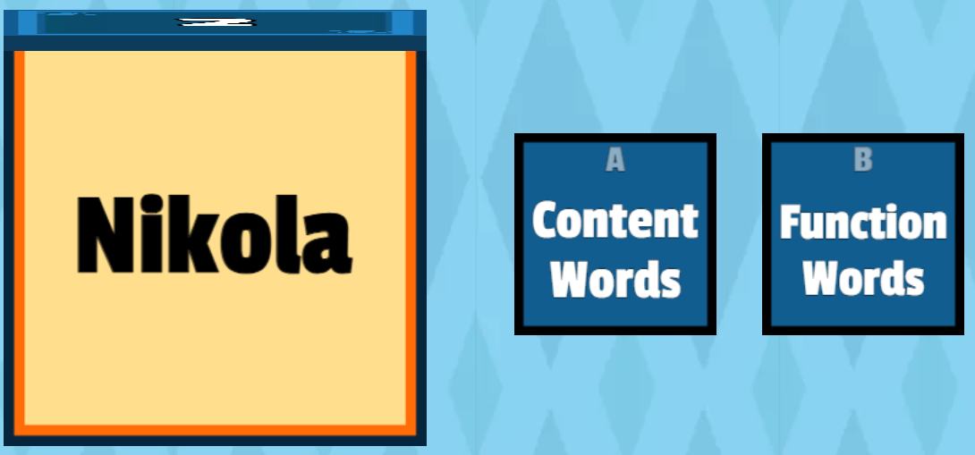
Warm-up: group sort

Slide 4
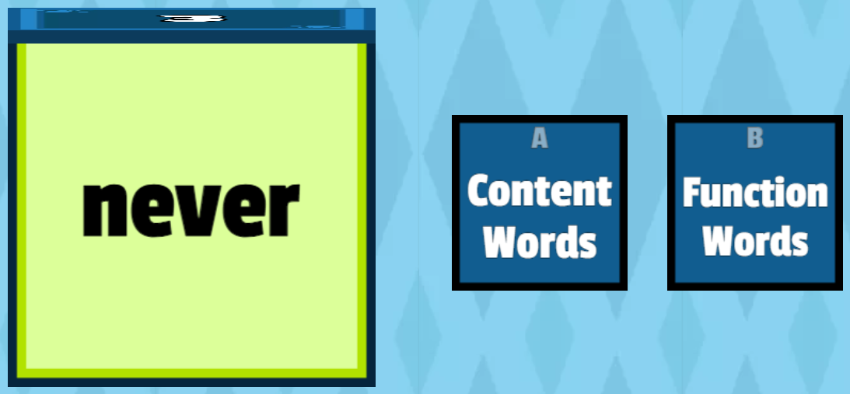
Warm-up: group sort

Slide 5

Warm-up: group sort

Slide 6

Warm-up: group sort

Slide 7

Warm-up: group sort

Slide 8

Warm-up: group sort

Slide 9

Warm-up: group sort

Slide 10

Warm-up: group sort

Slide 11

Warm-up: group sort

Slide 12
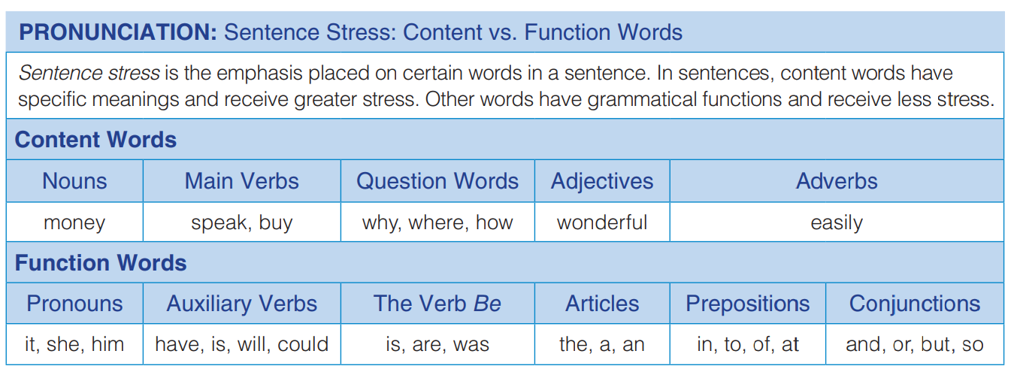

Slide 13
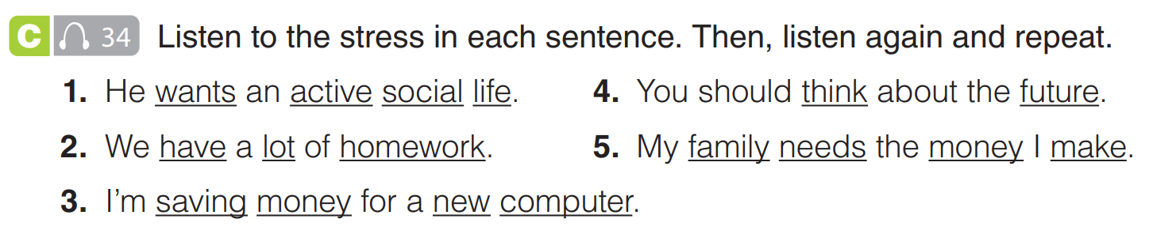


Slide 14
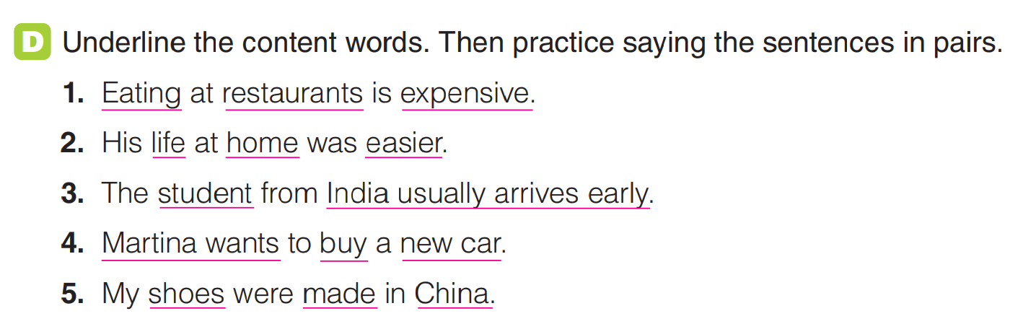

Slide 15
Word focus
NECESSITIES | LUXURIES
FOOD SHELTER | CAR JEWELLERY SMART PHONE

Slide 16
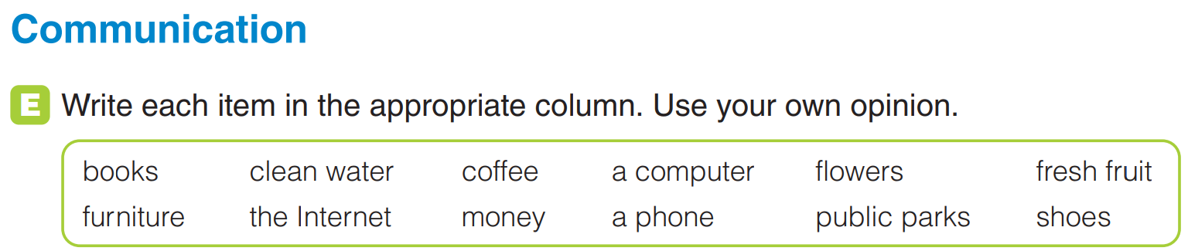
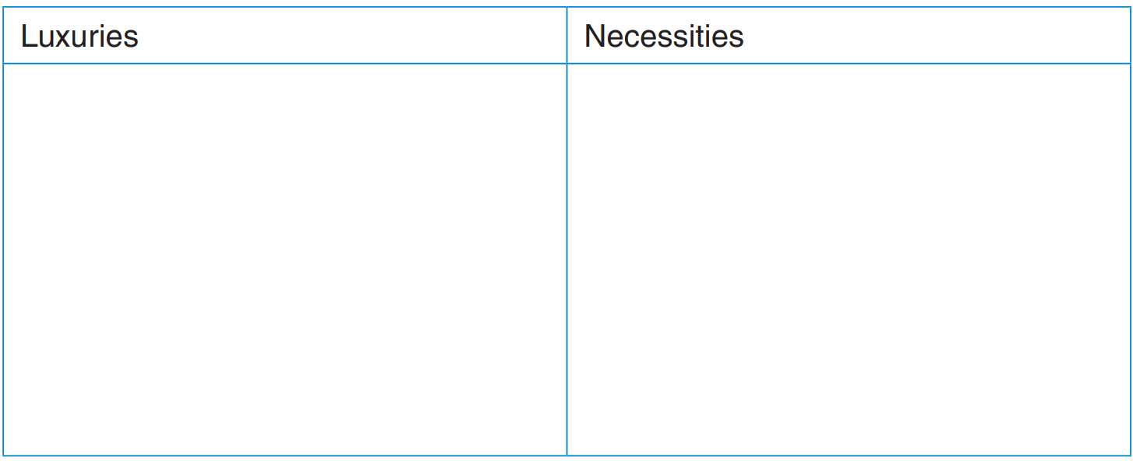

a car

Slide 17


