Slide 1
Language expansion grammar
UNIT 7 – THINGS THAT MATTER

Slide 2
Instructions
Please make sure you view this PowerPoint in Presentation mode.
When you start the game, choosing the correct question word on each slide will enable you to move on to the next. If the wrong word is clicked on, you'll be unable to progress until you click the correct answer.

Slide 4
A Quick Chance to Revise
Click on the word to see the past participle.
have
go
get
do
eat
had
gone/been
got/gotten
done
eaten
run
win
swim
sing
tell
run
won
swum
sung
told
sell
fall
feel
meet
know
sold
fallen
felt
met
known
hear
think
pay
come
break
heard
thought
paid
come
broken
wear
lose
make
write
buy
worn
lost
made
written
bought
drink
say
see
find
bring
drunk
said
seen
found
brought

Slide 5
Extra points
What’s the difference between been and gone?
Click to reveal the answer:
‘Been’ is used for when you went and returned. ‘Gone’ is used when you’re still at that place. E.g. ‘I’ve been to the shops’ (I went and returned). ‘She’s gone to the shops’ (she’s there now).
What’s the difference between got and gotten?
Click to reveal the answer:
‘Got’ is more common in British English, ‘gotten’ is more common
in American English.

Slide 6
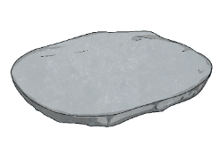
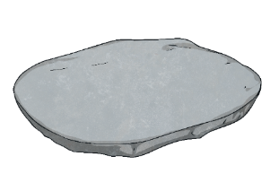

Rules of the Game
This game will help you revise irregular verbs.
You must help an alien, Bumper, choose the right verb in the past participle and step on the right stone to avoid the lava. If you choose the wrong stone, you must go back to the beginning of the game.
Everyone can join in by shouting ‘The floor is lava!’ If that happens, everyone must make sure that they aren’t touching the floor by jumping on a chair or other furniture.

Slide 7

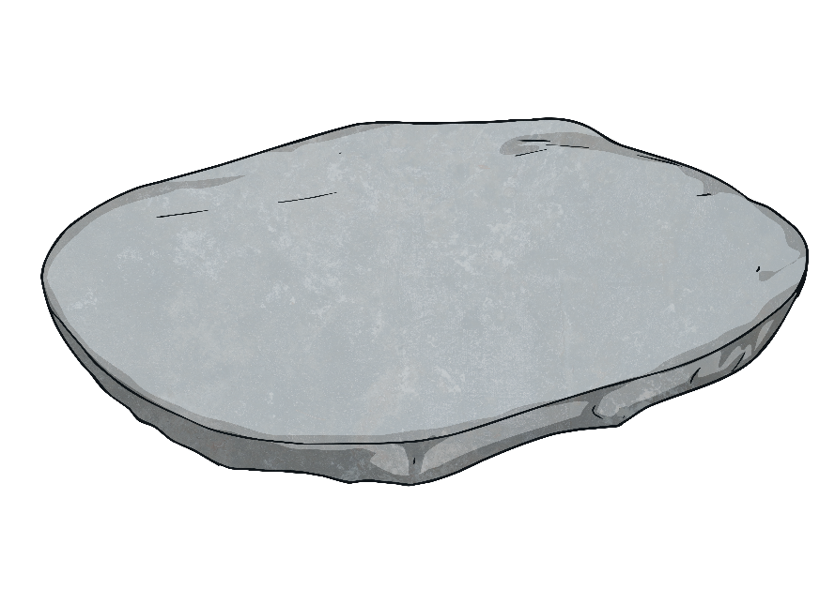
The Floor Is Lava
Oh no! Bumper the alien is stuck in lava. Click on the right answer to help them get across safely. If you get it wrong, watch out because…
The floor is
A
V
A
!
L
Start the Game

Slide 8
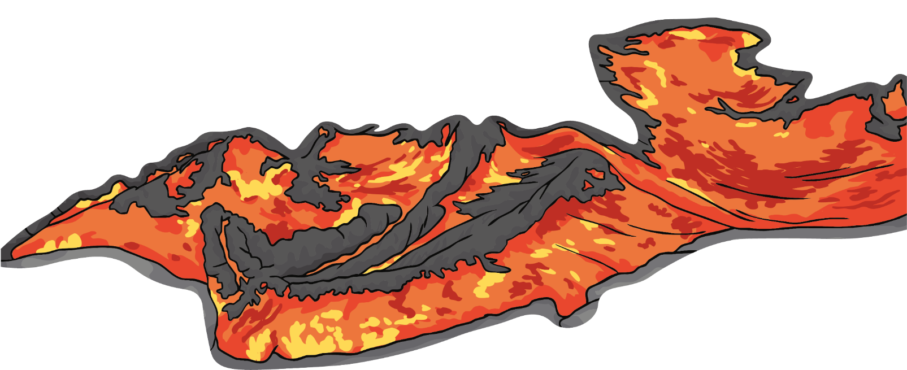


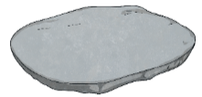


Step 1
What’s the past participle form of ‘wear’?
wore
worn
wearn
Next step

Slide 9



Step 2
What’s the past participle form of ‘do’?
done
donned
dun
Next step

Slide 10
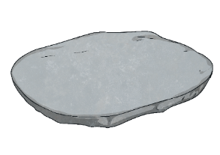
Step 3
What’s the past participle form of ‘win’?
win
wun
won
Next step

Slide 11
Step 4
What’s the past participle form of ‘swim’?
swam
swimmed
Next step
swum

Slide 12

Step 5
What’s the past participle form of ‘fall’?
full
fallen
Next step
felt

Slide 13


Step 6
What’s the past participle form of ‘say’?
sayed
sud
said
Next step

Slide 14
Step 7
What’s the past participle form of ‘think’?
thought
thunk
thinked
Next step

Slide 15

Step 8
What’s the past participle form of ‘see’?
sun
soon
seen
Next step

Slide 16
Step 9
What’s the past participle form of ‘have’?
hod
hud
had
Next step

Slide 17
Step 10
What’s the past participle form of ‘run’?
run
rod
ran
Next step

Slide 18
Step 11
What’s the past participle form of ‘sell’?
suld
sold
sell
Next step

Slide 19

Step 12
What’s the past participle form of ‘drink’?
drunk
drank
dronk
Next step

Slide 20
Step 13
What’s the past participle form of ‘go’?
went
gone/been
bean
Next step

Slide 21
Step 14
What’s the past participle form of ‘lose’?
lost
last
loose
Next step

Slide 22
Step 15
What’s the past participle form of ‘make’?
mode
mide
made
Next step

Slide 23
Step 16
What’s the past participle form of ‘get’?
got/getten
gotted/goat
Next step
got/gotten

Slide 24
Step 17
What’s the past participle form of ‘feel’?
fallen
felt
Next step
full

Slide 25
Step 18
What’s the past participle form of ‘pay’?
pied
pide
paid
Next step

Slide 26
Step 19
What’s the past participle form of ‘make’?
made
mide
mode
Next step

Slide 27
Step 20
What’s the past participle form of ‘sing’?
song
singe
sung
Next step

Slide 28
Step 21
What’s the past participle form of ‘meet’?
mot
moot
met
Next step

Slide 29
Step 22
What’s the past participle form of ‘come’?
come
came
cam
Next step

Slide 30
Step 23
What’s the past participle form of ‘write’?
wrotten
written
right
Next step

Slide 31
Step 24
What’s the past participle form of ‘find’?
finded
food
found
Next step

Slide 32

Step 25
What’s the past participle form of ‘eat’?
oat
eaten
eatted
Next step

Slide 33
Step 26
What’s the past participle form of ‘tell’?
told
tellen
tale
Next step

Slide 34
Step 27
What’s the past participle form of ‘know’?
now
knew
known
Next step

Slide 35
Step 28
What’s the past participle form of ‘break’?
brunk
brook
Next step
broken

Slide 36
Step 29
What’s the past participle form of ‘buy’?
brink
bought
Next step
brought

Slide 37
Step 30
What’s the past participle form of ‘bring’?
brunk
brought
bought

Slide 38


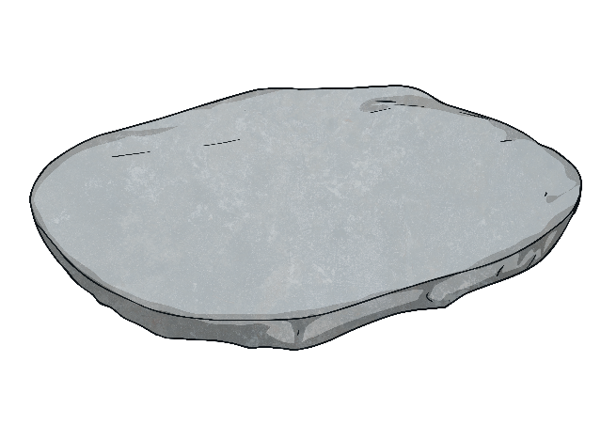
Congratulations!
You made it safely to the other side!

Slide 39

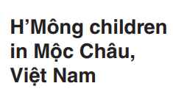
What makes people’s lives better?
Children’s lives are improved …………..
by education
by safe neighborhood
to improve
= to make life better
by better healthcare

Slide 40
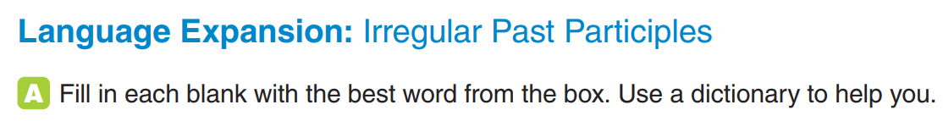
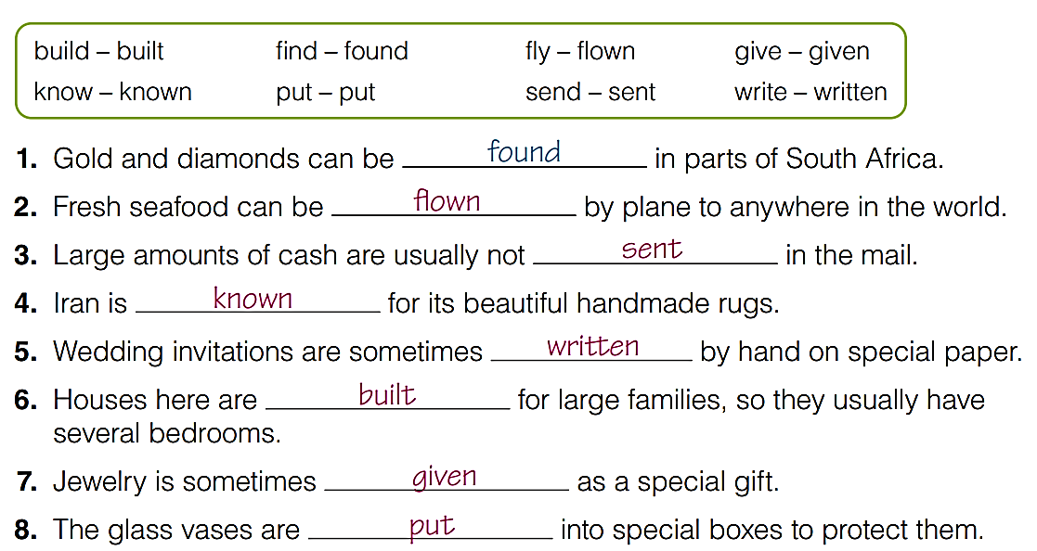

Slide 41
Past participles of verbs
Verbs | Base form | Past participle form
Regular | play produce want | played produced wanted
Irregular | be cut buy think see | been cut bought thought seen
Verb + ed

Slide 42
Notes:
Click chuột để xem đáp án

Slide 43
Grammar – passive voice with by
In Murano glass shops, master artists teach younger glass artists.
Active :
Passive:
S
V
O
In Murano glass shops, younger glass artists are taught by master artists.
S
V
O
by + O => who/what does the action => important/surprising
E.g.: Hamlet was written by William Shakespeare.
That painting was made by a monkey.
Omit “by + O” => unimportant, not surprising, assumed
E.g.: Many cars are made in Japan by workers.

Slide 44
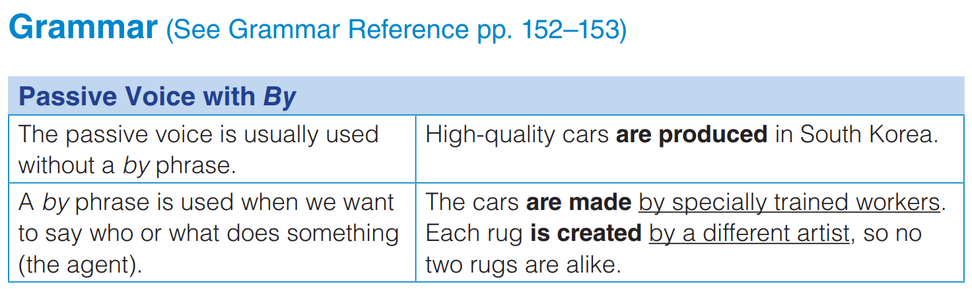

Slide 45
Read the sentences and cross out the unimportant by phrases
1. The Mercedes-Benz is made in Germany by people.
2. This necklace was given to me by my grandmother.
3. King Tut’s tomb was discovered by Howard Carter.
4. My car was stolen on April 19th by someone.
5. The company was started by the new owner’s grandfather.
6. Several kinds of fruit are grown in Ontario, Canada by fruit growers.

Slide 46
Rewrite each sentence in the passive voice.
We need to teach children good manners.
Should we keep money in a bank?
Companies usually offer good jobs to people with good education.
Some employers don’t value education as much as hard work.
Children need to be taught good manners.
Should money be kept in a bank?
People with a good education are often offered good jobs. /
Good jobs are often given to people with a good education
Education isn’t valued as much as hard work by some employers.

Slide 47
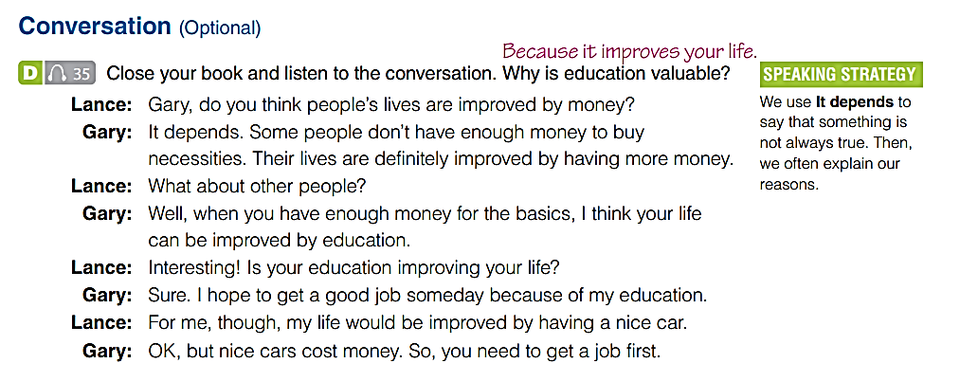


Slide 48
GOAL CHECK
Discuss What Makes People’s Lives Better
In pairs, discuss how these things improve your life.
a big house

