Slide 1
Reading:
A ZERO WASTE LIFESTYLES
UNIT 7 – THINGS THAT MATTER

Slide 2
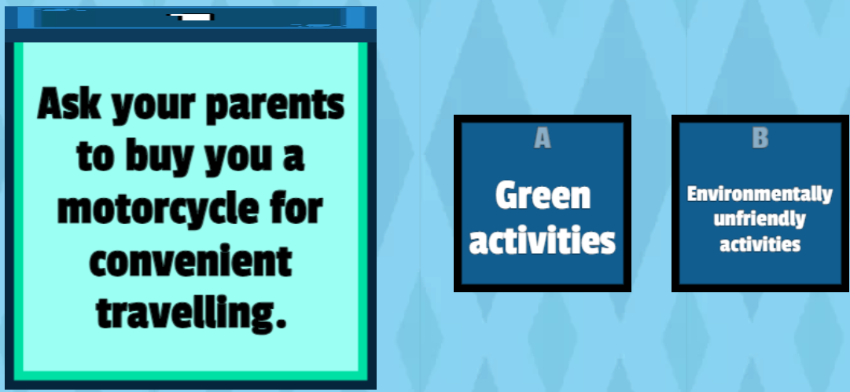
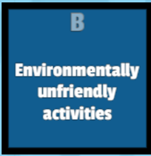
Warm-up game: What’s your lifestyle?

Slide 3
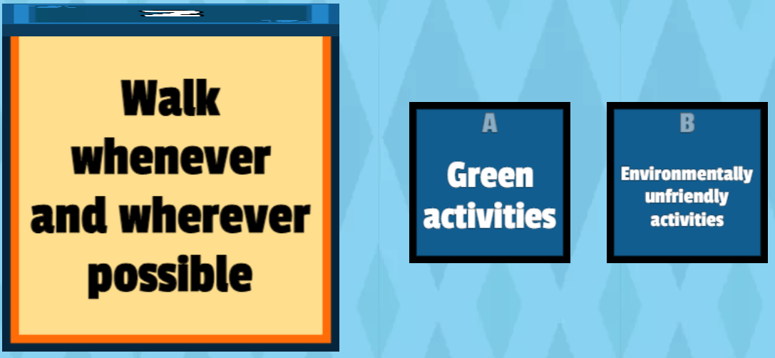

Warm-up game: What’s your lifestyle?

Slide 4
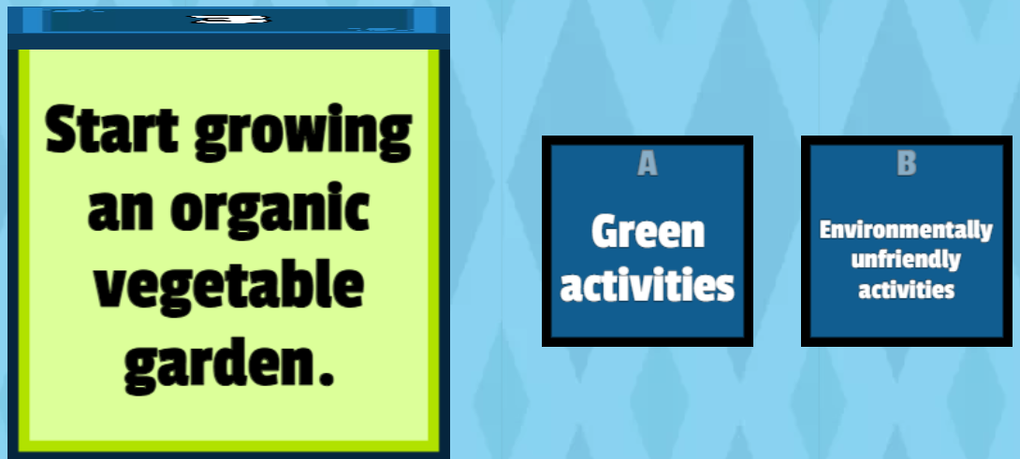

Warm-up game: What’s your lifestyle?

Slide 5
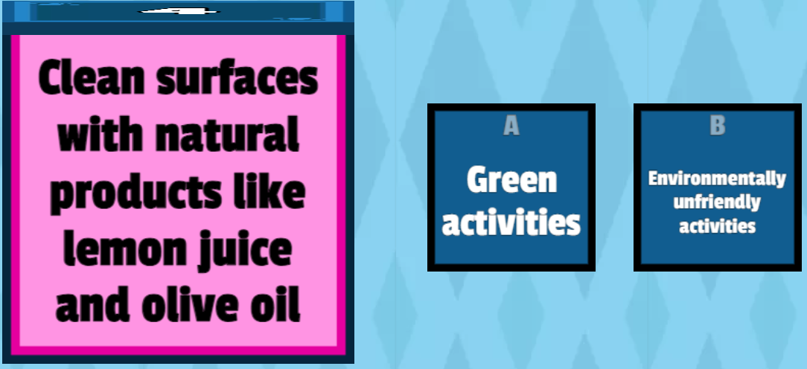

Warm-up game: What’s your lifestyle?

Slide 6
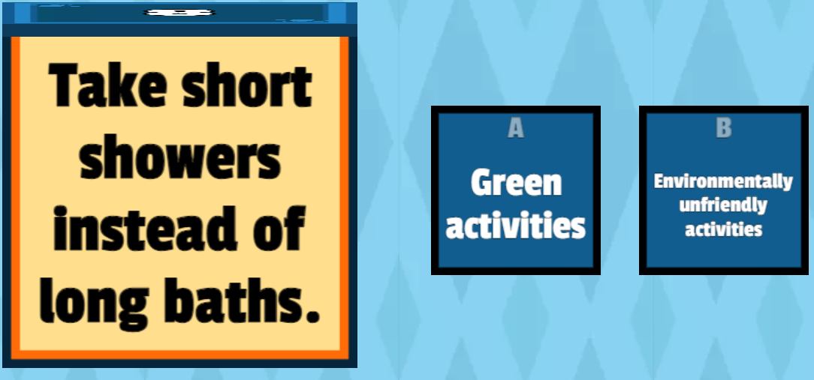

Warm-up game: What’s your lifestyle?

Slide 7
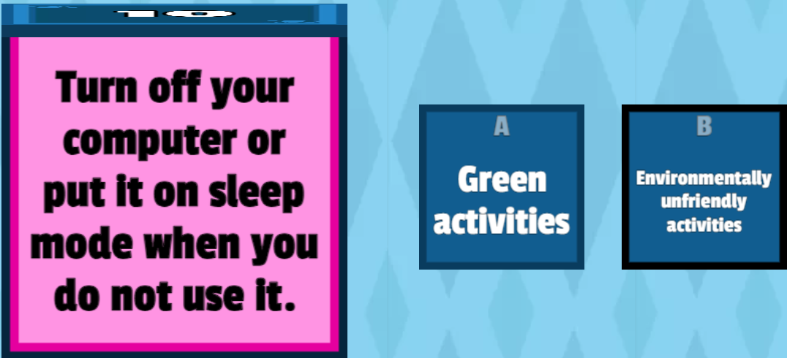

Warm-up game: What’s your lifestyle?

Slide 8
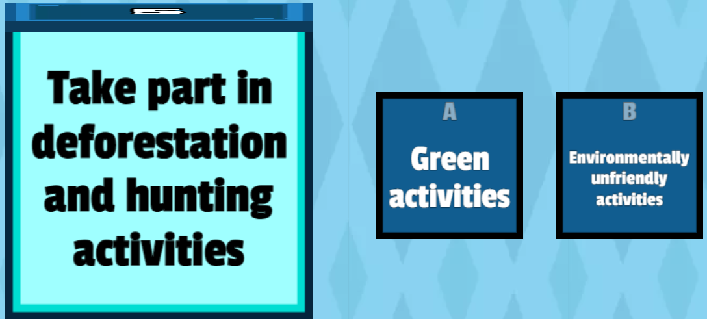
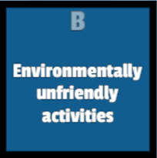
Warm-up game: What’s your lifestyle?

Slide 9
Brainstorming: what is a lifestyle?
Definition: typical living conditions, behaviors, and habits of certain people/group of people.
Examples:
Active Lifestyle.
Healthy Lifestyle
Solo Lifestyle
Rural Lifestyle
Urban Lifestyle
Etc.

Slide 10
MY WORLD
Which would you choose, and why?
More money or more free time?
A larger home or traveling more?
A new car or a cleaner environment?
Nice things for yourself or for your children?

Slide 11
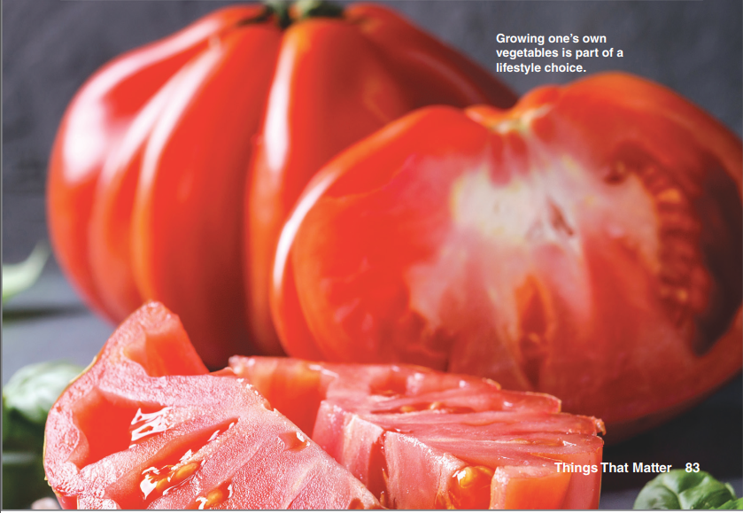

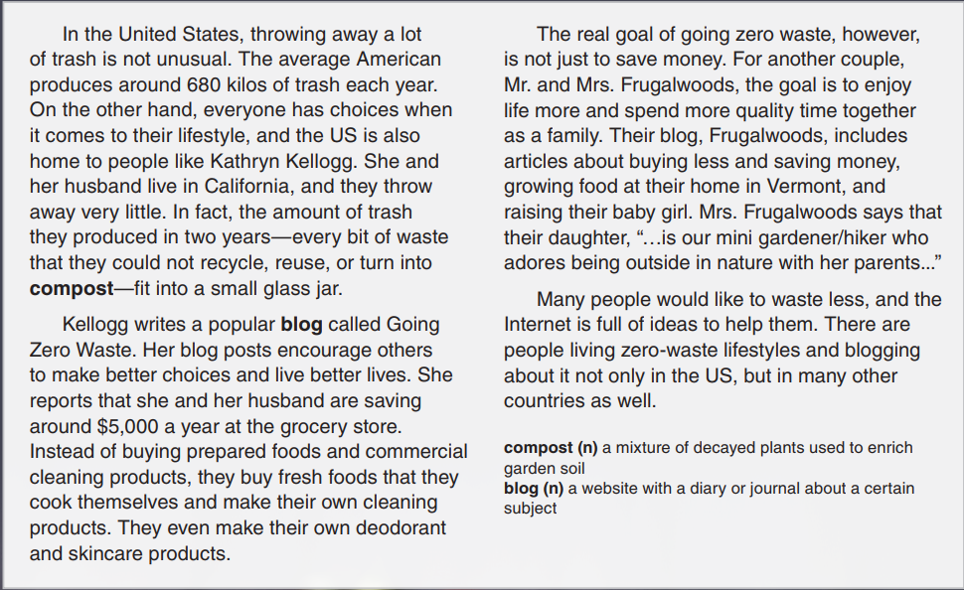
A Zero-Waste Lifestyle

Slide 12
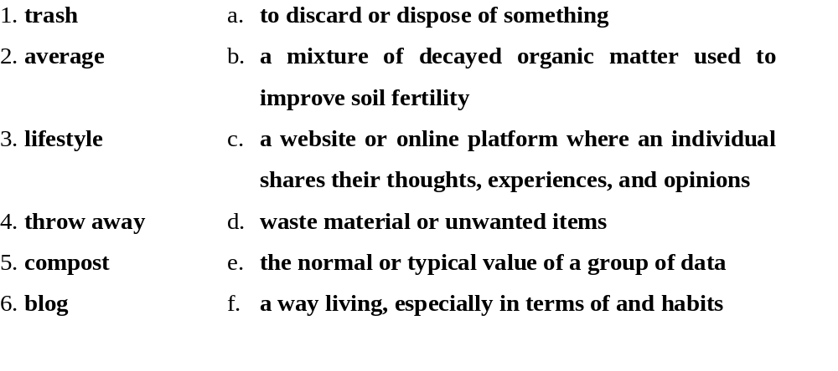
Vocabulary: match words and definitions

Slide 13
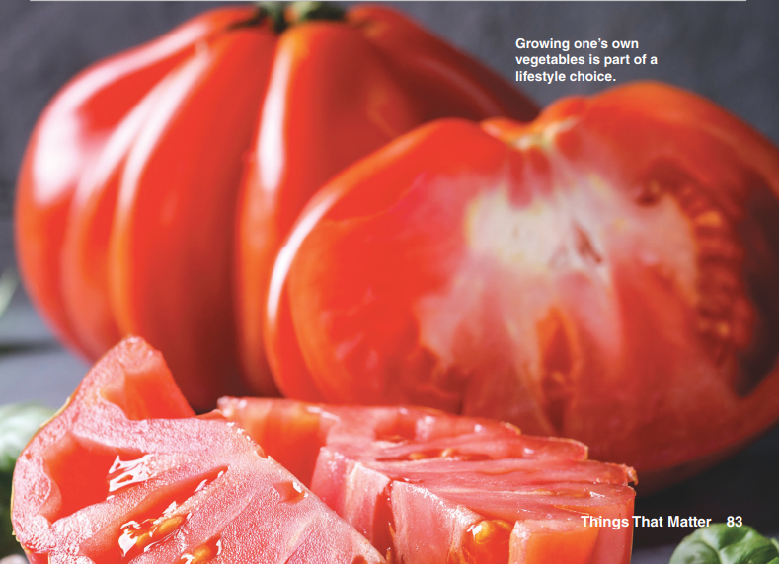
Discussion
What do you think A Zero-Waste Lifestyle means?
Do you think some people live a “zero-waste” lifestyle?

Slide 14
Read the article
Circle T for true or F for false.
Kathryn Kellogg and her husband produce 680 kilos of trash each year.
Posts on Kellogg's blog encourage people to make better choices.
The Frugalwoods' main goal is to save money.
The Frugalwoods' daughter enjoys being outdoors with her parents.
So far, the zero-waste lifestyle is popular only in the US.
T F
T F
T F
T F
T F

Slide 15
Find words that mean
waste materials or things that you no longer need (noun, paragraph 1)
a container with a wide opening at the top (noun, paragraph 1)
a purpose or target (noun, paragraph 3)
loves very much (verb, paragraph 3)
trash
glass jar
goal
adores

Slide 16
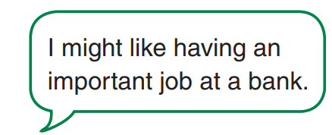
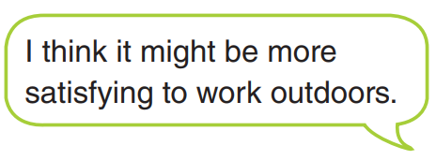
GOAL CHECK
What might you like and dislike about a person's lifestyle?
What might make a lifestyle satisfying for the person?

Slide 17


